Slide 1
Jobs and Unemployment
Outline
The labor force
The labor force participation rate
The unemployment rate
Sources of unemployment
Notes:
1

Slide 2

The 16 and older non-institutionalized population that holds a paying job or is actively seeking work.
Notes:
2

Slide 3
The Current Population Survey counts all persons as unemployed who, during the week before the monthly survey
Had no employment,
Were available for work,
and either
1. Had made specific efforts to find employment some time during the previous 4 weeks or
2. Were waiting to be recalled to a job from which they had been laid off.
Notes:
3

Slide 4
Labor force does not include
Discouraged Workers
People who are available and willing to work but have not made specific efforts to find a job within the previous four weeks.
Notes:
4

Slide 5
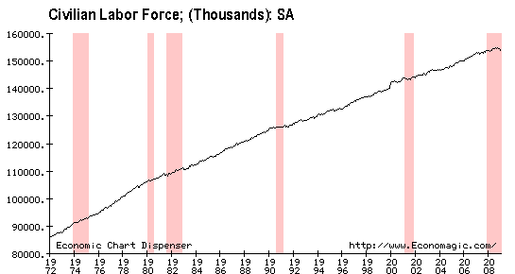
Notes:
5

Slide 6
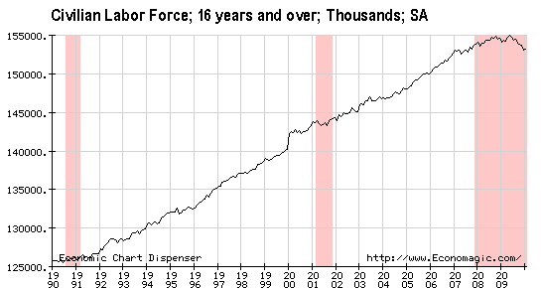

Slide 7
The adult population sums: employed, unemployed, and those not in labor force, June 2007 (in millions)
Unemployed
(6.9)
LABOR FORCE
(153.1)
NOT WORKING
(85.5)
Employed
(146.2)
Not in labor force
(78.6)
Labor force= employed + unemployed
Not working = not in the labor force + unemployed
Adult population = employed + unemployed + not in the labor force
7
Notes:
7

Slide 8
Employment statistics for the U.S., January 2009 (in thousands)
Thus, the unemployment rate (UR) is given by:
Source: www.bls.gov
Notes:
8

Slide 9
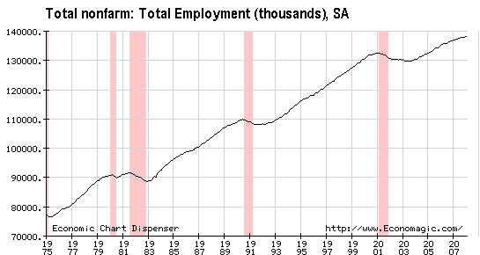
Notes:
9

Slide 10
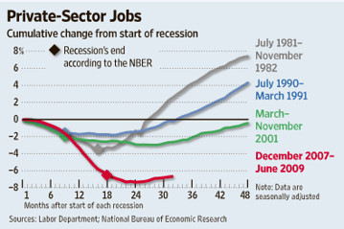
No Ordinary Recession

Slide 11
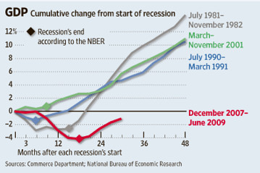

Slide 12
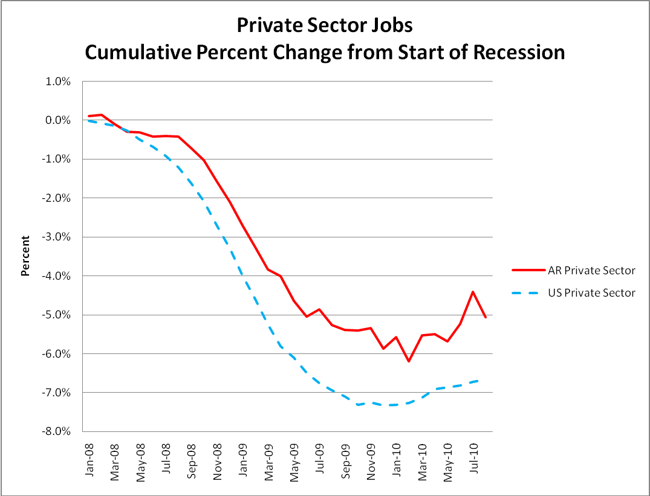
Job Market has been Slow to Recover

Slide 13
23.5 million new jobs
have were added in the U.S. 1991 and 2000. However, the U.S. lost 2.8 million jobs between March 2001 and August 2003.
Notes:
13

Slide 14
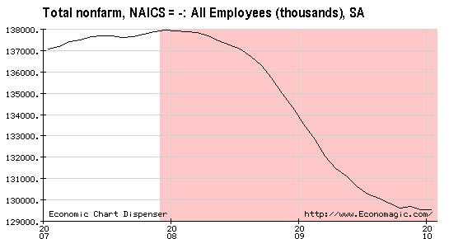
Nonfarm payrolls fell by 8, 424,000 between December 2007 and January 2010—an average of 337,000 jobs lost per month.
Notes:
14

Slide 15


The labor force as a percent of the adult population.
Notes:
15

Slide 16
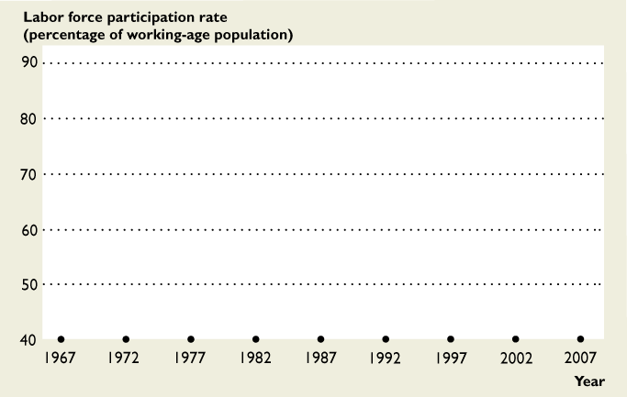
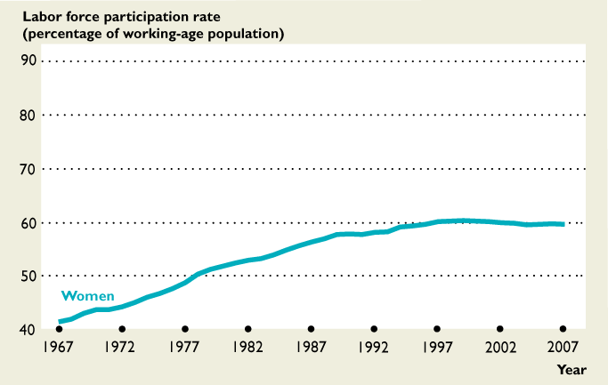
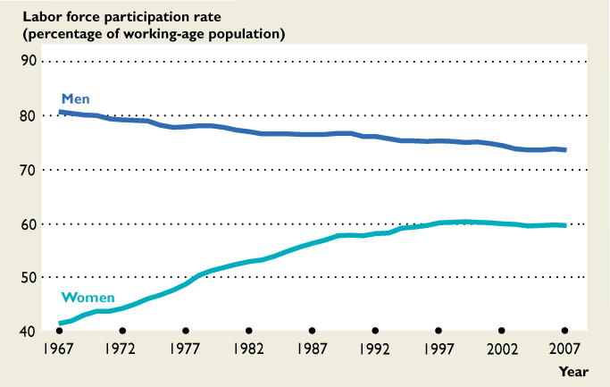
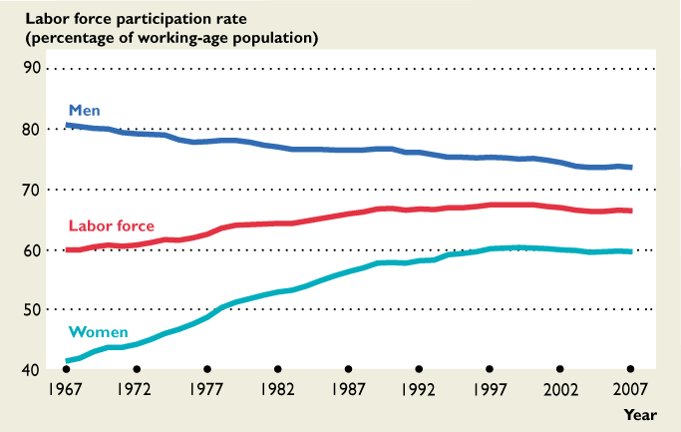

Slide 17
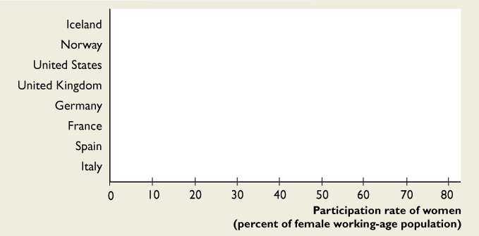
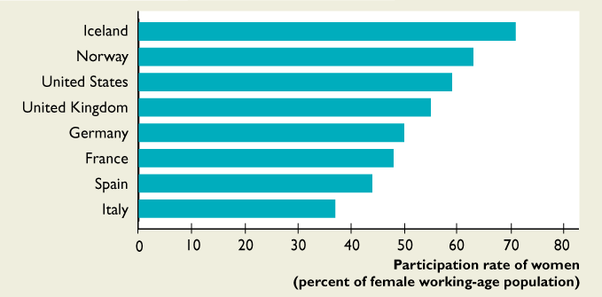
Women’s Labor Force Participation Rates are High in Scandinavian Countries

Slide 18
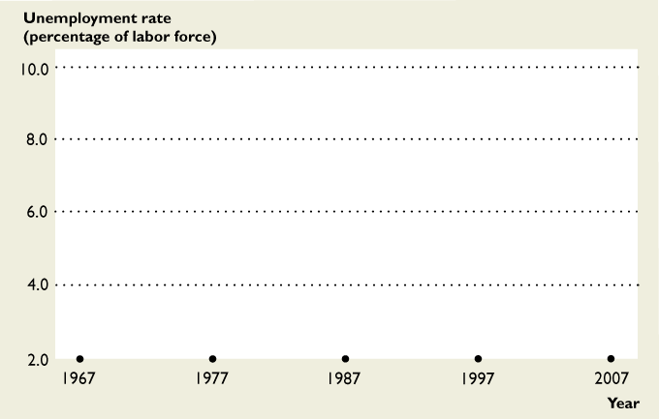
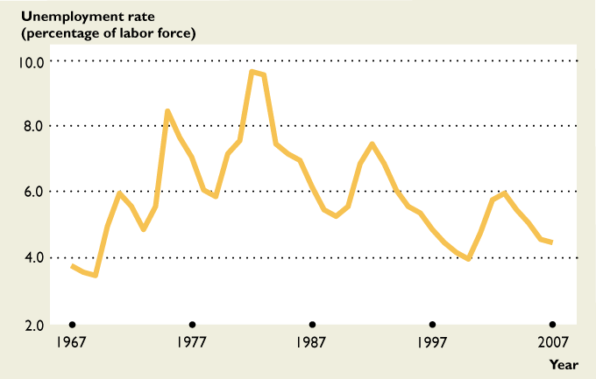
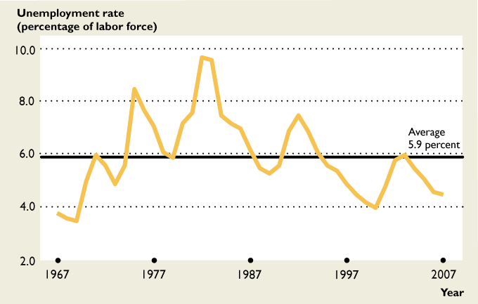
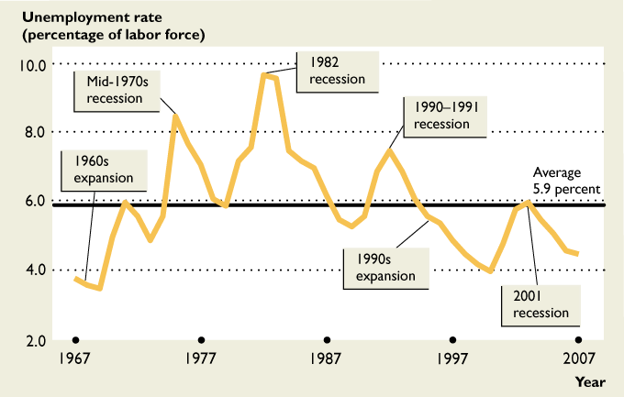

Slide 19
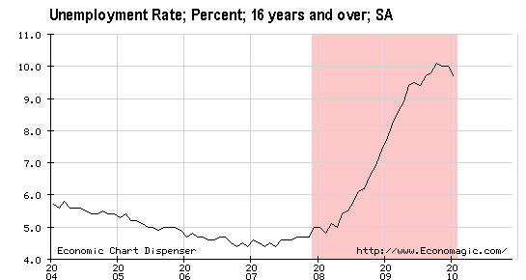
US Unemployment is at a 28-year high
Notes:
19

Slide 20
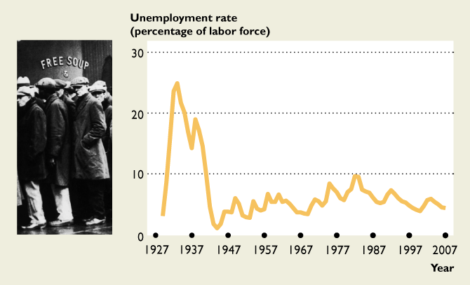
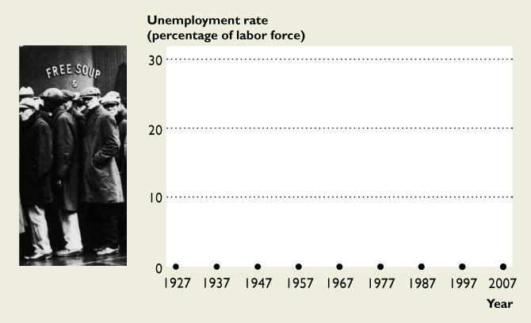

Slide 21
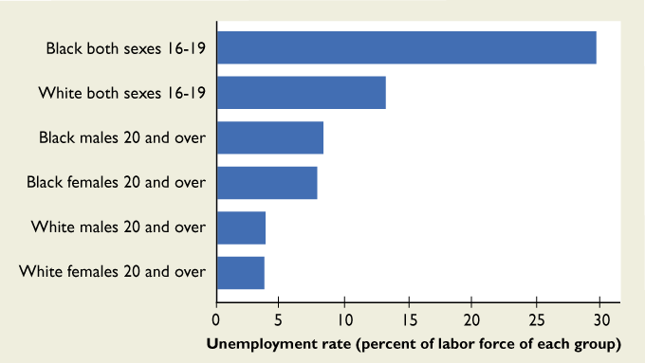
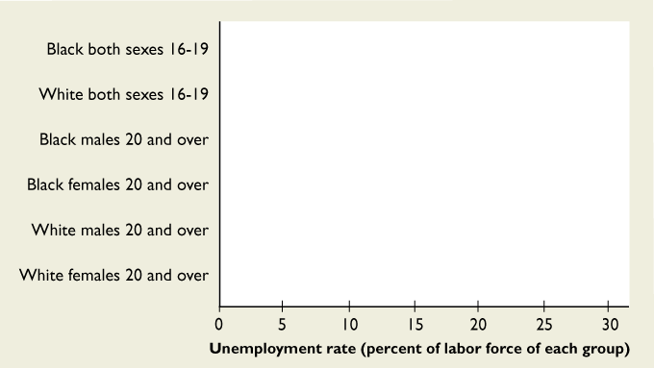
The record shows persistent disparities in unemployment rates for different groups.

Slide 22
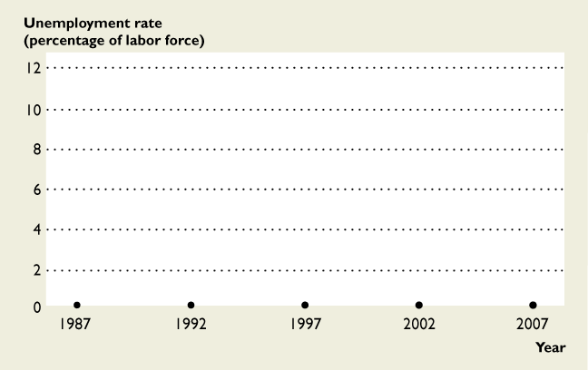
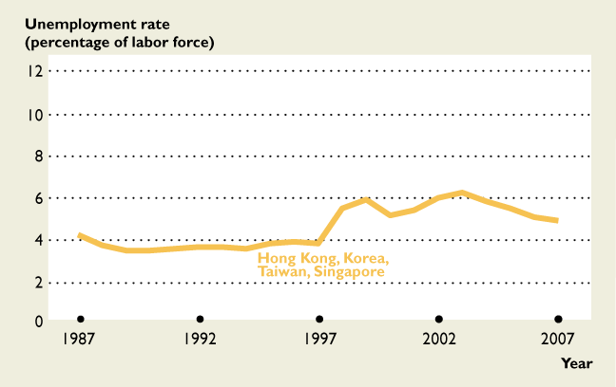
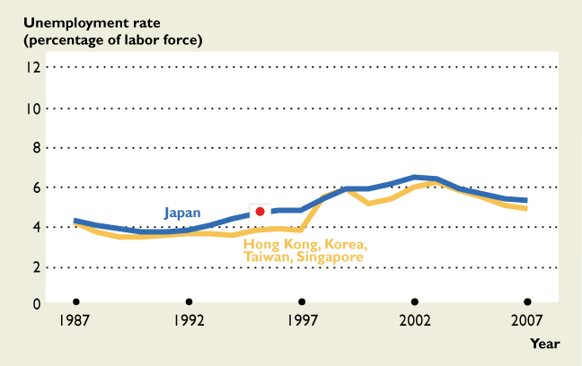
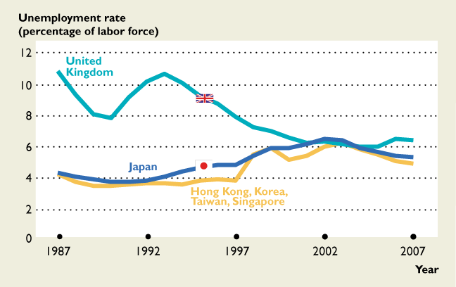
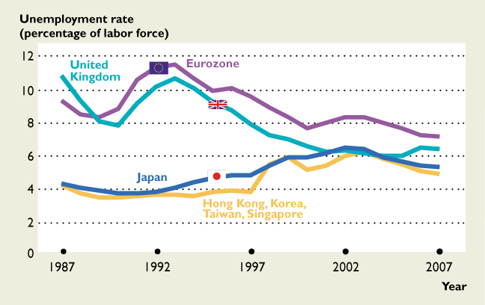
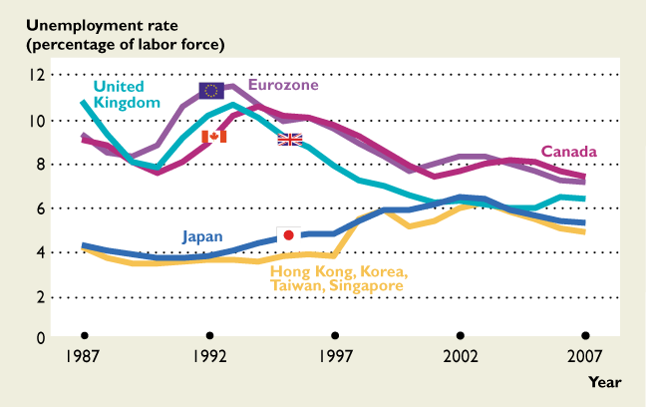
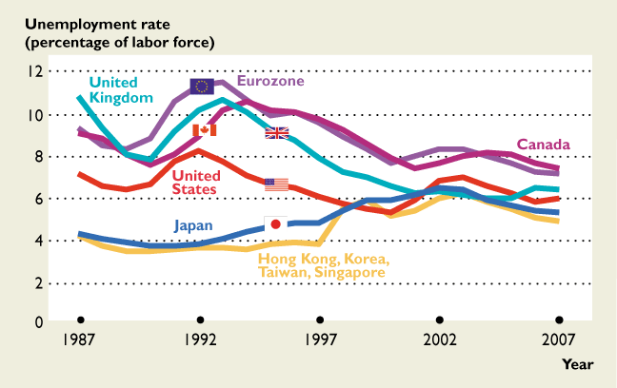

Slide 23
Full-time versus Part-time
Full-time workers: People who normally work 35 hours or more per week.
Part-time workers: people who normally work less than 35 hours per week.
Involuntary part-time workers: people who work 1 to 34 hours per week but who are looking for full-time work.

Slide 24
When labor markets weaken, an increasing number of people have to settle for part-time work.

Slide 25
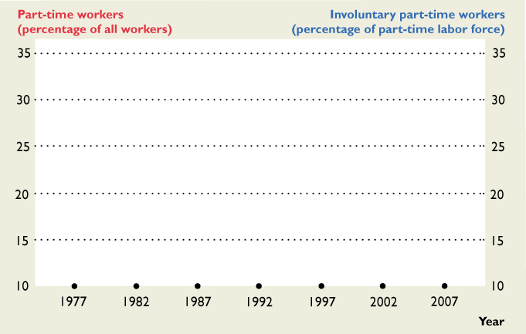
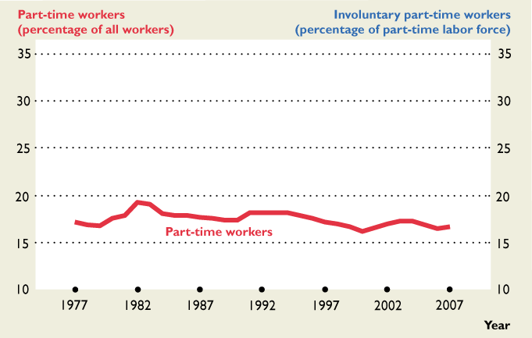
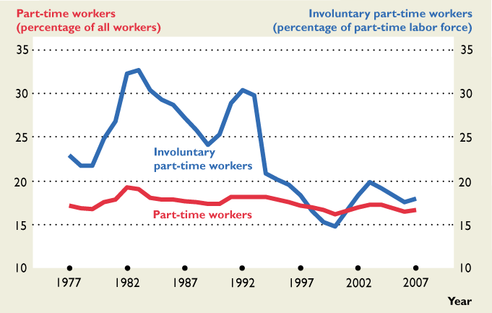
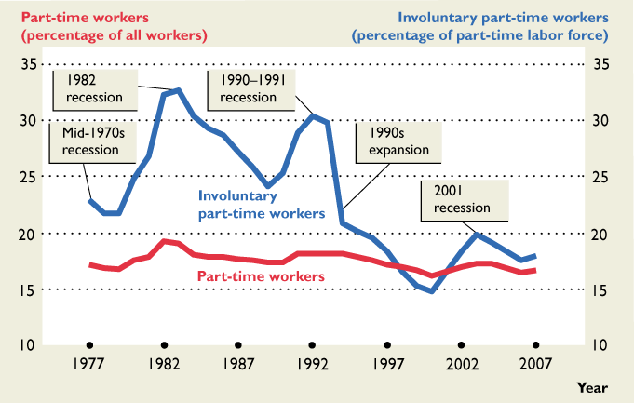

Slide 26
Unemployment Duration
Percentage Unemployed for
 | 2010 | 2000 | 1983
14 weeks or less | 47 | 77 | 60
27 weeks or more | 39 | 11 | 25
Source: www.bls.gov

Slide 27
Sources of
Unemployment
Job Losers: People who are fired or laid off from their jobs, either permanently or temporarily.
Job Leavers: People who voluntarily quit their jobs.
Entrants: People who have just left school and entered the job market are entrants.
Reentrants: People who previously held jobs but, then quit and left the labor force and have now decided to look for jobs.

Slide 28
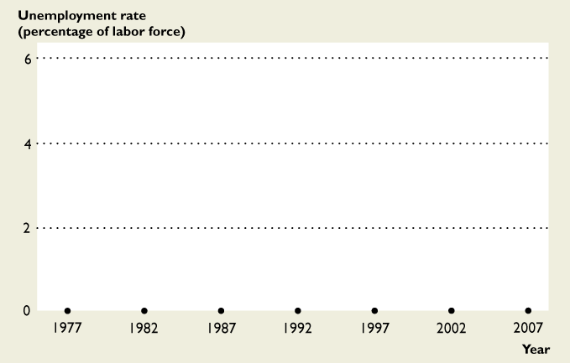
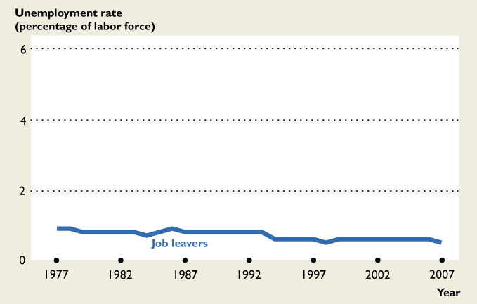
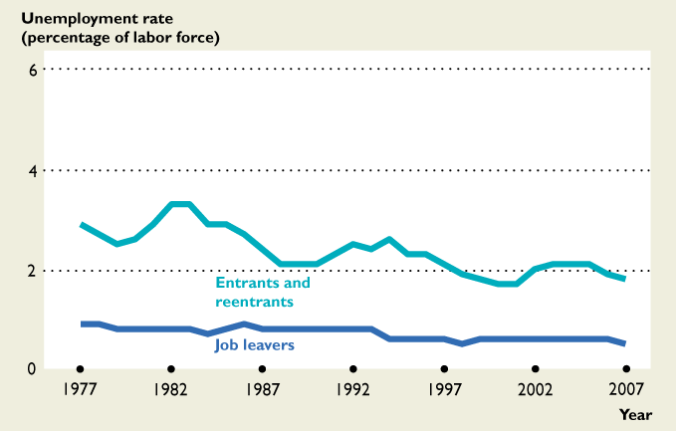
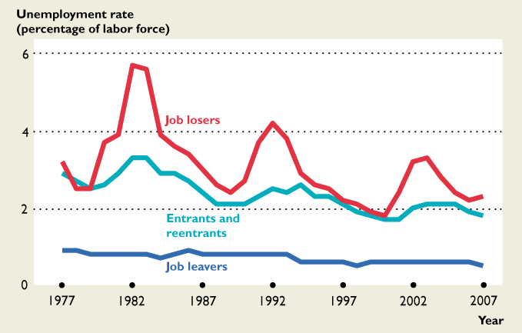
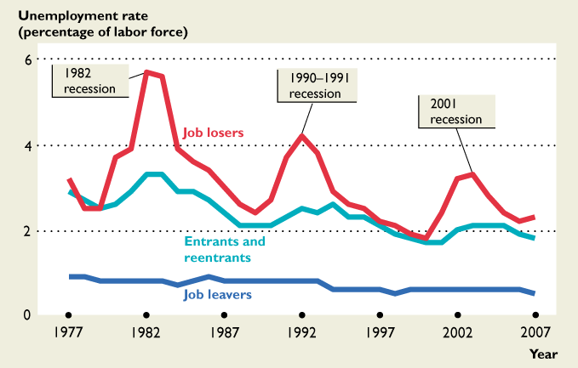

Slide 29
Types of unemployment
Economists distinguish between four types of unemployment:
Frictional
Seasonal
Structural
Cyclical
Notes:
29

Slide 30


Frictional Unemployment
Joblessness experienced by people who are between jobs or are just entering (or re-entering) the labor market.
I am looking for a job in my field—speech pathology
Notes:
30

Slide 31

Seasonal Unemployment
Joblessness related to changes in the weather, tourist patterns, or other seasonal factors.
It’s hard to find work as a ski instructor during the summer months
Notes:
31

Slide 32

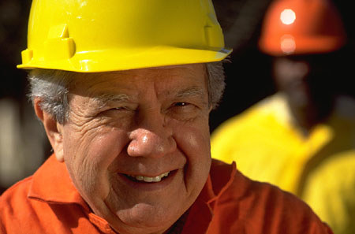
Structural Unemployment
Joblessness arising from mismatches between workers’ skills and employers’ requirements or between workers’ locations and employers’ locations.
An industrial robot took my job.
Notes:
32

Slide 33


Cyclical Unemployment
Joblessness arising from changes in production over the business cycle
I couldn’t find work
in 1991 due to slump
in home building
Notes:
33

Slide 34


Job losers may be eligible to collect unemployment benefits for up to 26 weeks. Maximum weekly benefits vary by state. Maximum weekly benefits in Arkansas are currently $409. In Washington state they are $515.
The basic requirements for collecting unemployment are:
You must have been employed.
You must be determined to be unemployed through no fault of your own as defined under state law.
You must file ongoing claims and respond to questions concerning your continued eligibility. You must report any earnings from work and any job offers or refusal of work during any claim period.
Benefits are determined based on the individual’s earning during a “base period.”
Notes:
34

Slide 35
Unemployment is a drag!
Unemployment causes stress on individuals and families.
Unemployment is correlated with rising incidence of spousal and child abuse, divorce, drug and alcohol use, and crime.
The purely economic cost of unemployment is lost physical output, as measured by the GDP Gap

Slide 36
GDP Gap
GDP Gap = Potential GDP - Actual GDP,
where potential GDP is the the level of output the economy would achieve if the unemployment rate were equal to the Natural Rate of the NAIRU
NAIRU is an acronym for “non-accelerating
inflation rate of unemployment.” It is
the unemployment rate corresponding to zero
cyclical unemployment
NAIRU is the “full-employment”
unemployment rate.

Slide 37

The GDP Gap in2009
Actual unemployment for the year
was 9.3%. If you assume
that the NAIRU was
5%, then we can use
Okun’s law to estimate
a GDP gap of $1.1 Trillion
billion for 2009 (chained 2005 dollars)
Okun’s law: Each percentage point difference between the actual unemployment rate and the NAIRU converts to a 2.0 percent GDP gap.

Slide 38
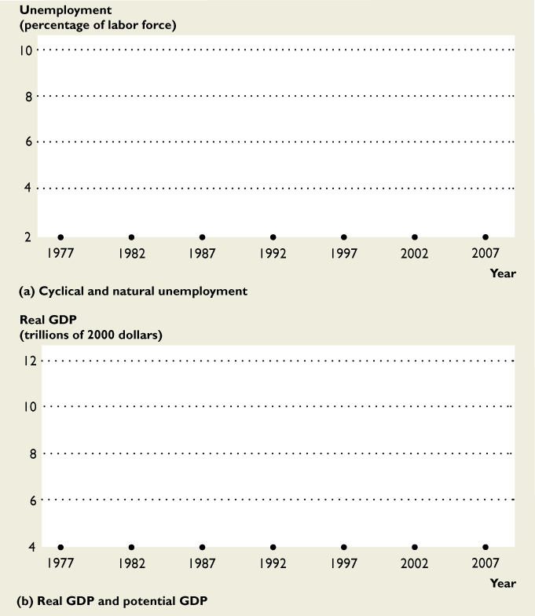
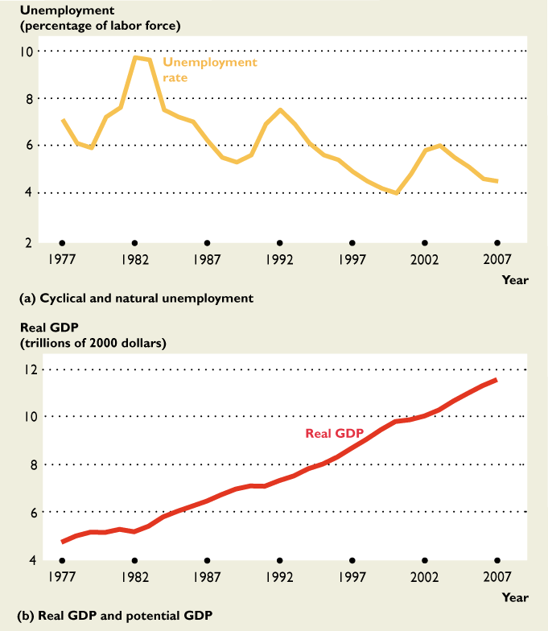
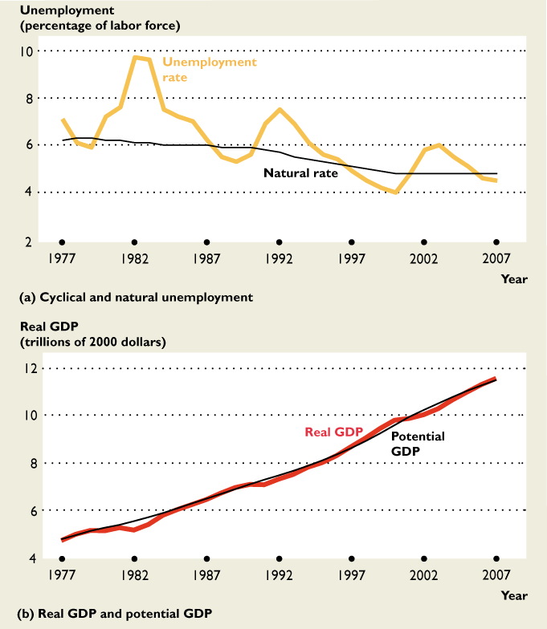
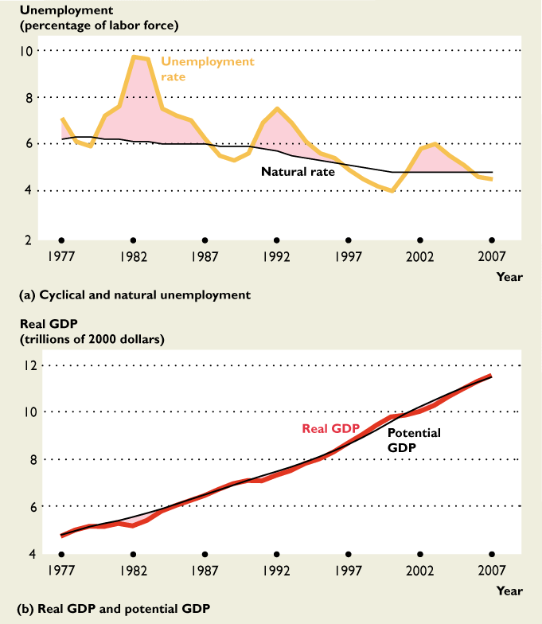
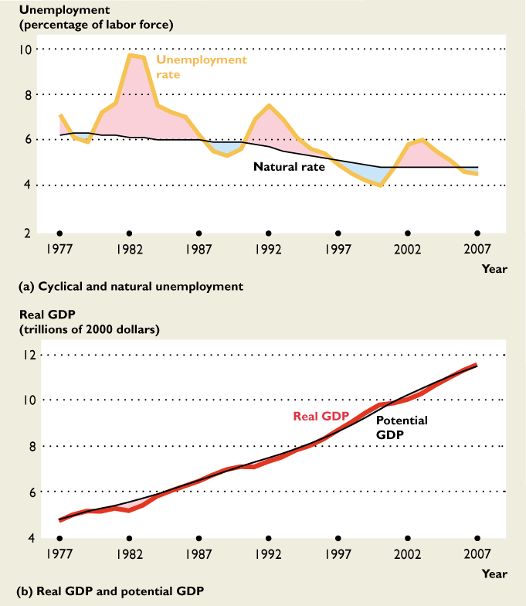

Slide 39
Recession is shaded
Source: Brown’s calculation from BLS and BEA data

