Slide 1
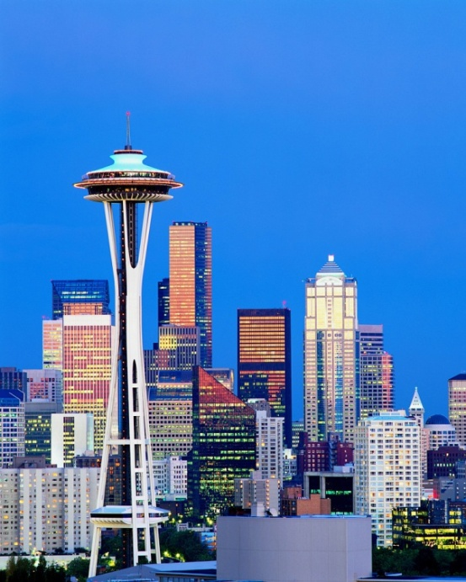
The U.S. and Global Economies
What, how, for whom? The USA
The circular flow model
What, how, for whom? The world

Slide 2
What do we produce?
Consumption goods and services
Capital goods
Government goods and services
Exports

Slide 3
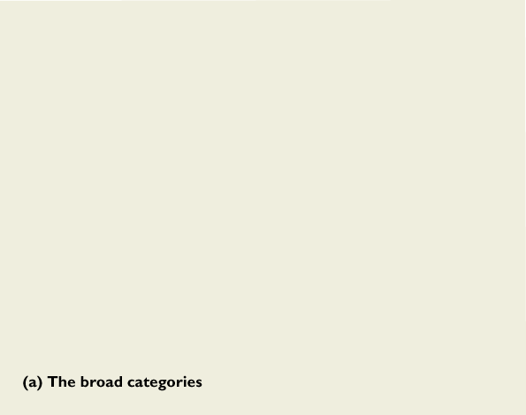
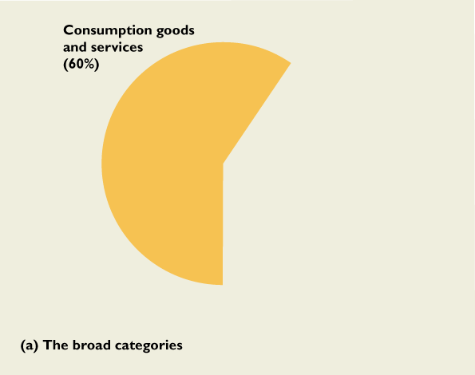
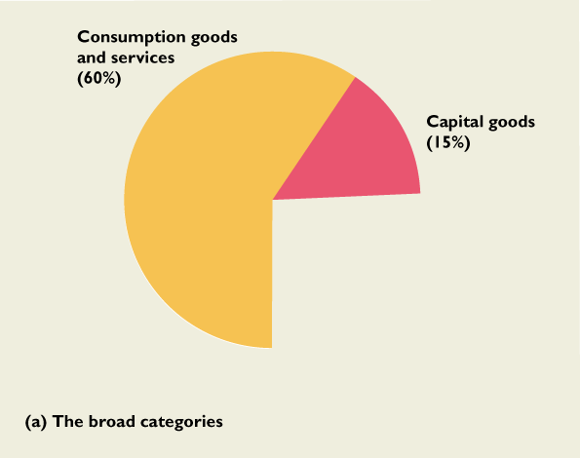
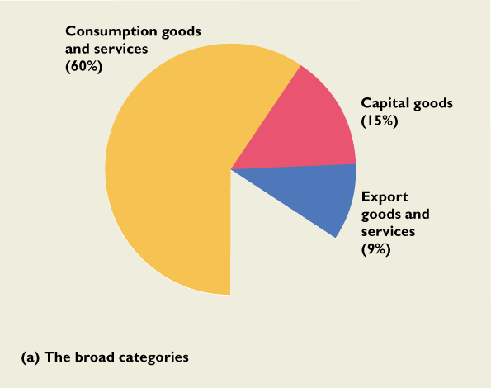
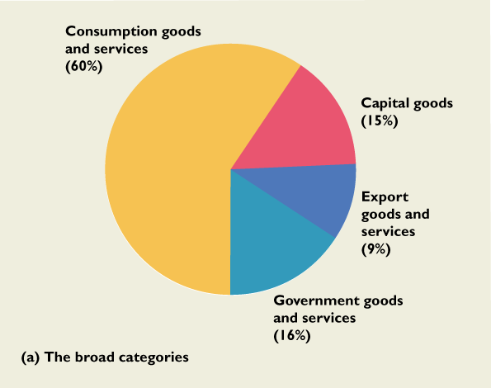
What we produce

Slide 4
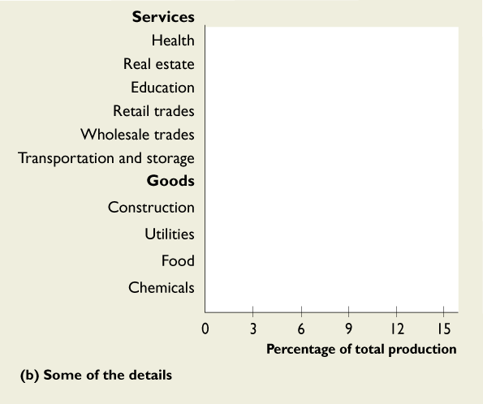
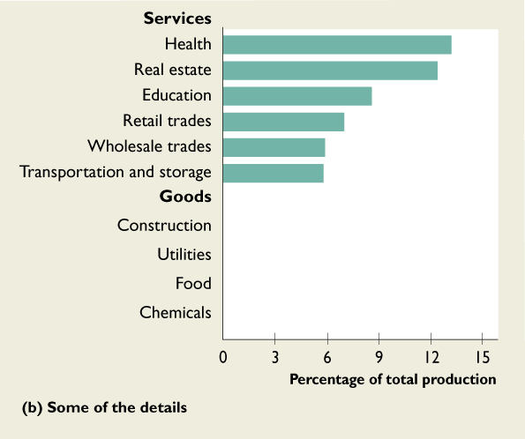
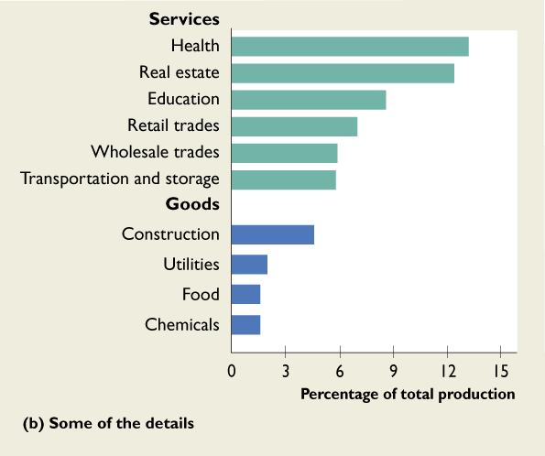

Slide 5
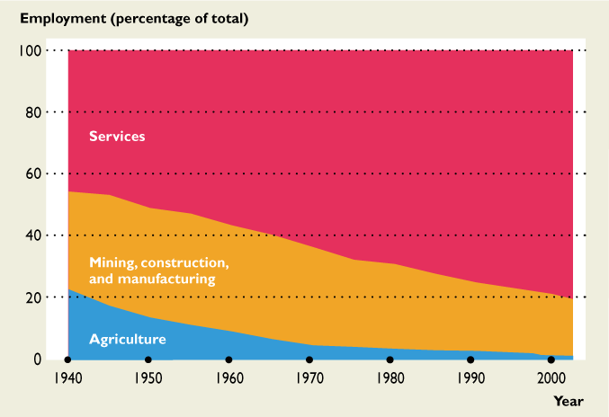
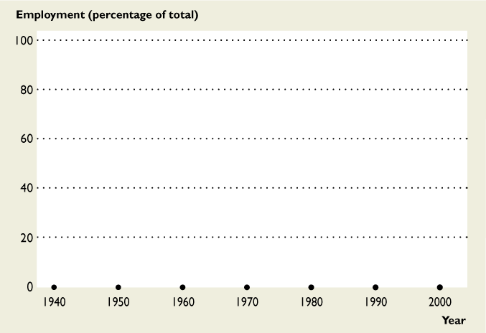
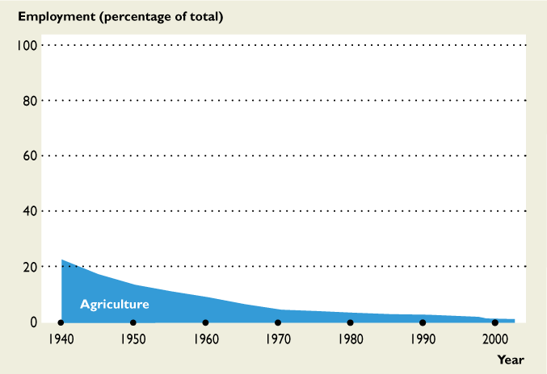
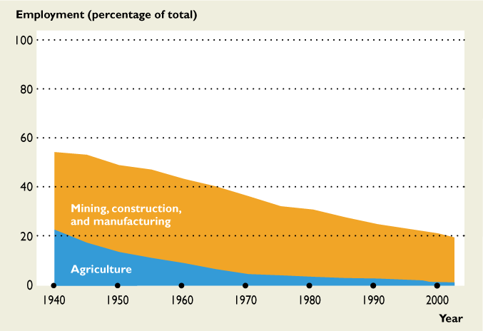
The Service Economy

Slide 6

How do we produce?
We produce by using productive resources or factors of production
Land
Labor
Capital
Entrepreneurship

Slide 7
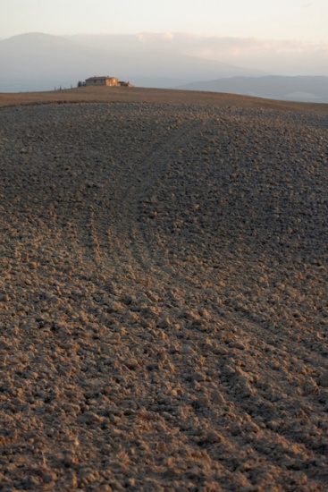

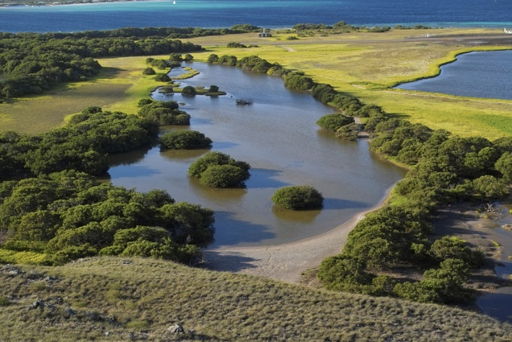

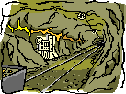
Land or natural resources

Slide 8



Labor or “human resources”

Slide 9
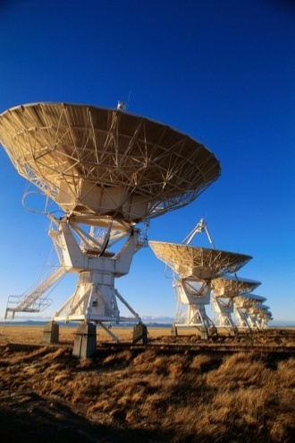

Capital or “manmade instruments of production”

Slide 10

Human Capital
Human capital is the knowledge and skill people obtain from education, on-the-job training, and work experience.

Slide 11
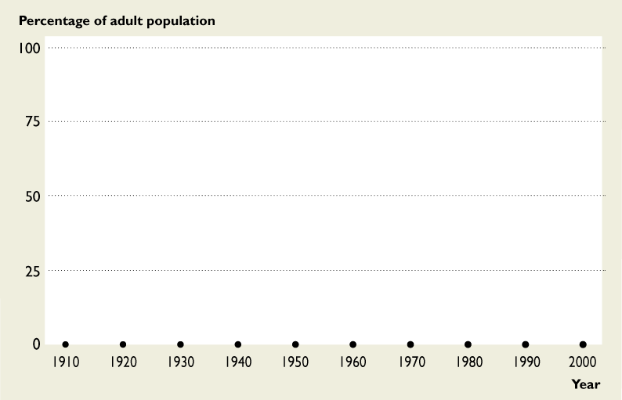
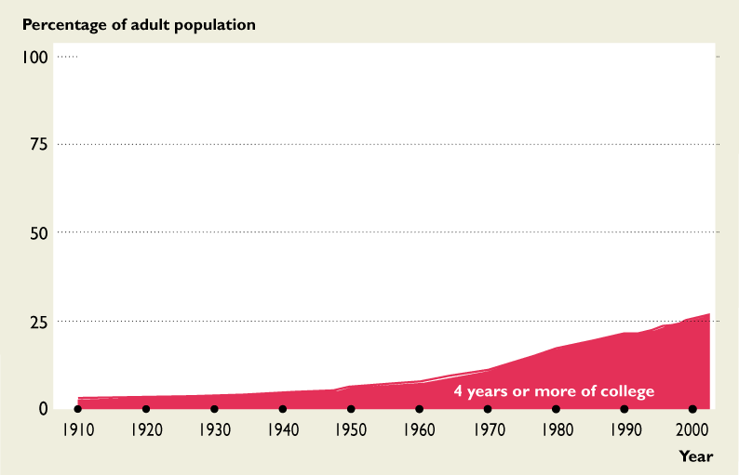
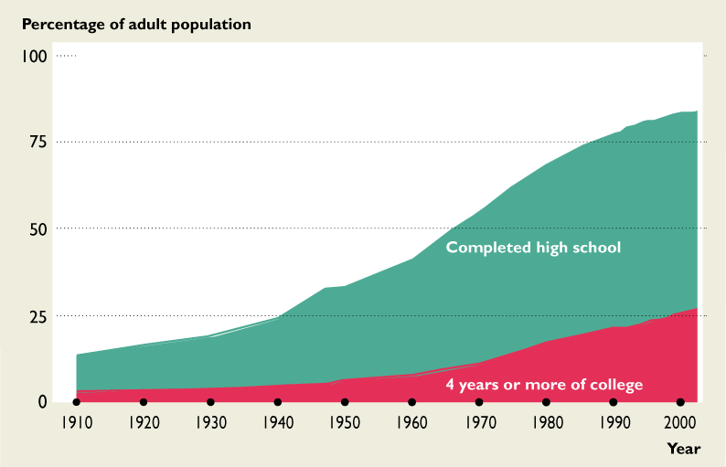
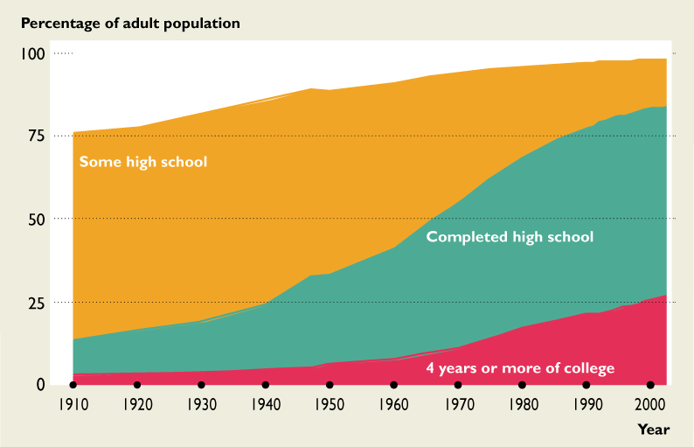
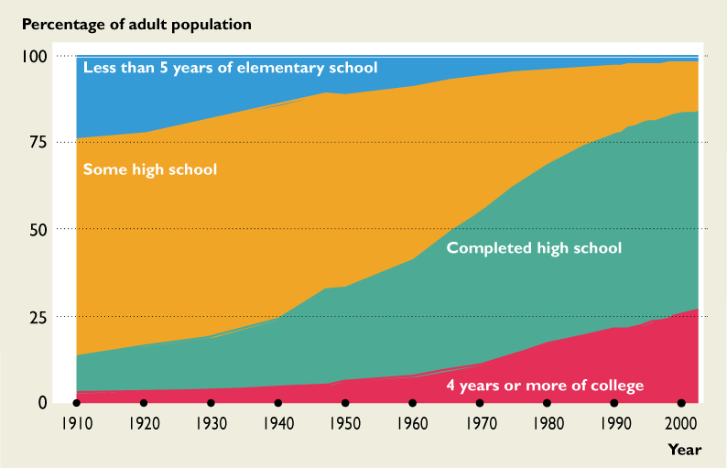
Measuring human capital

Slide 12
Entrepreneurship
Entrepreneurship is the willingness and ability to combine land, labor and capital into productive enterprises.
Entrepreneurs identify profitable business opportunities and mobilize and coordinate resources to take advantage.
Entrepreneurs have a key role in the commercialization of new knowledge
Sam Walton, Michael Dell, Martha Stewart, and Bill Gates are examples of highly successful entrepreneurs.

Slide 13
Income received by owners of economic resources
Rent: Income paid for the use of land.
Wages (and salaries): income paid for the services of labor.
Interest: income paid for the use of capital.
Profit (or loss): Income earned by an entrepreneur for running a business.

Slide 14
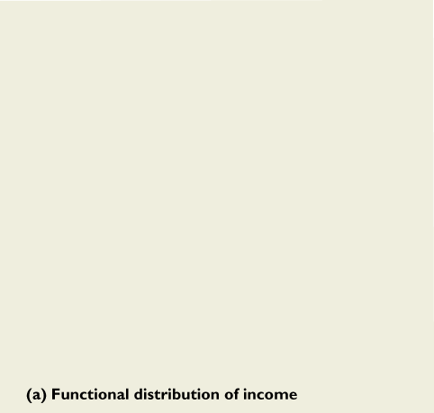
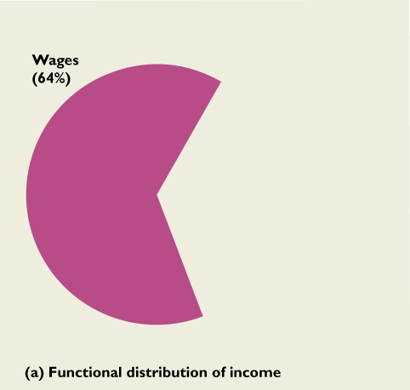
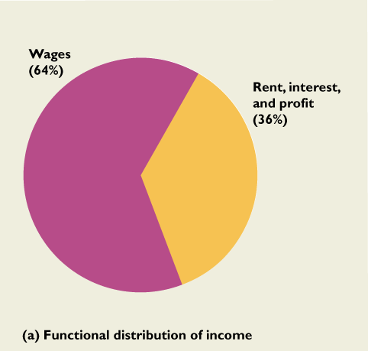

Slide 15
Out of school for less than 10 years

Slide 16

The circular flow model
The subject of macroeconomics has to do with problems experienced by industrialized, market economies.
Production for market
Well defined and protected property rights.

Slide 17

What is a market?
A market is an institution that facilitates the exchange of goods and services for money

Slide 18
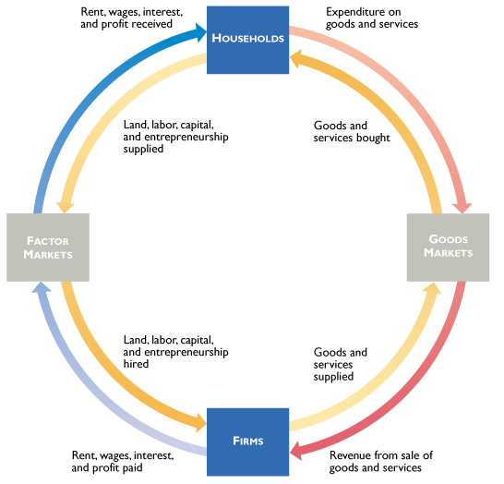
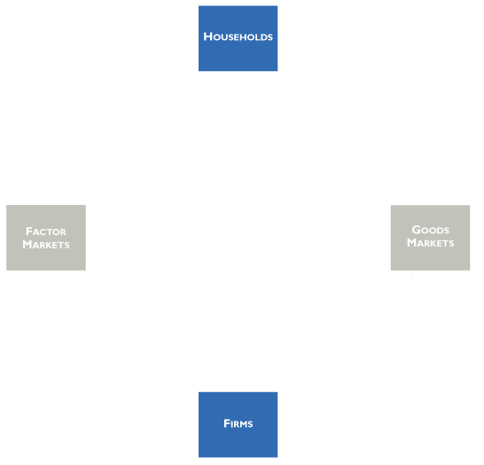
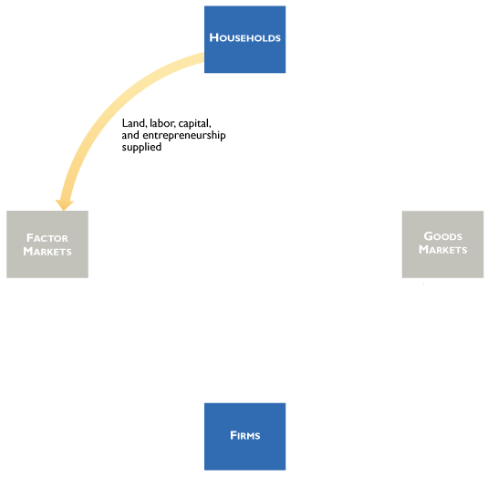
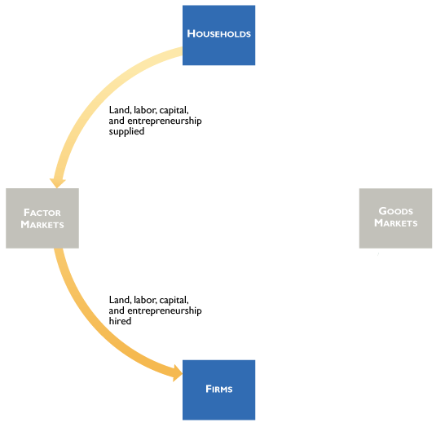
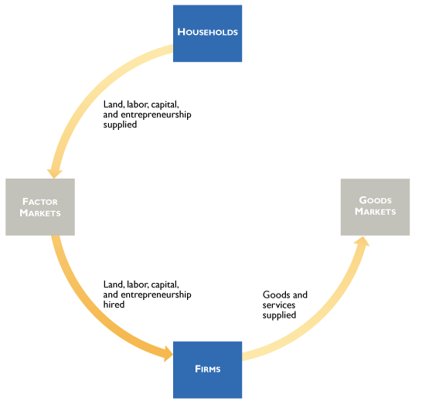
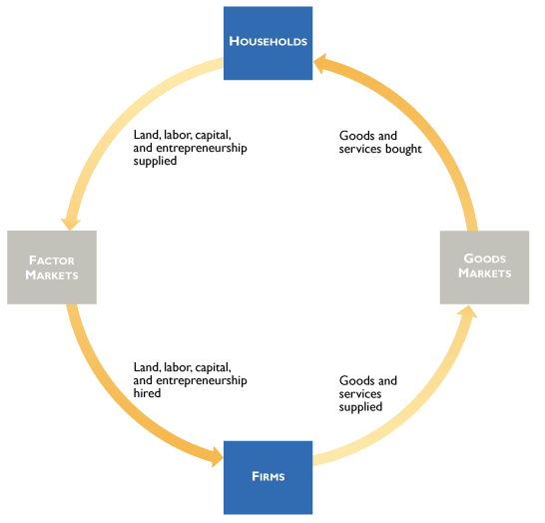
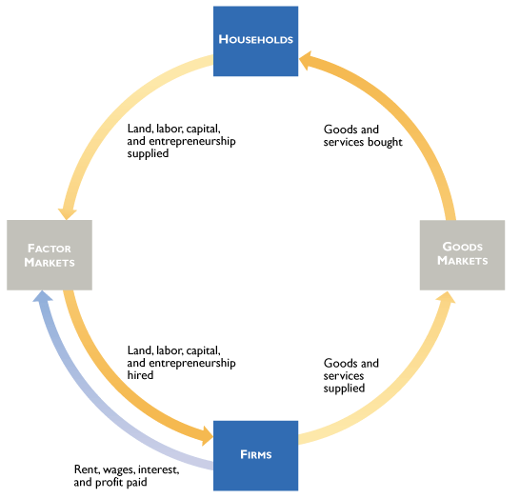
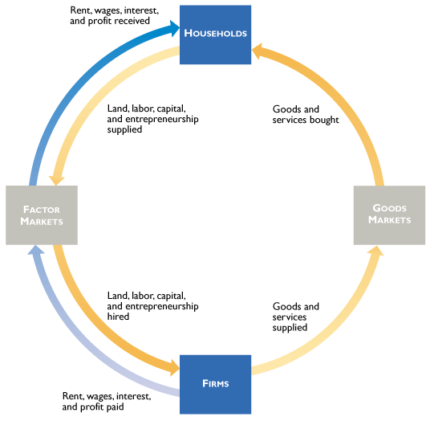
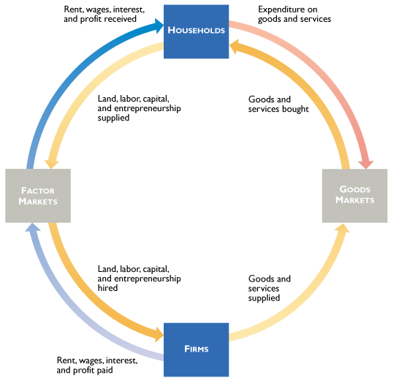

Slide 19
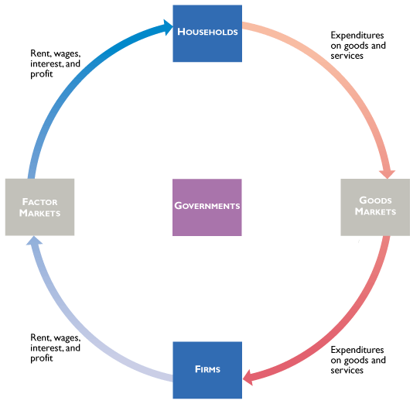
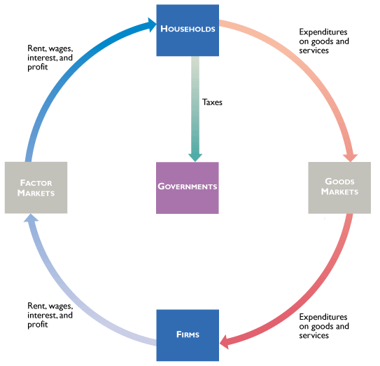
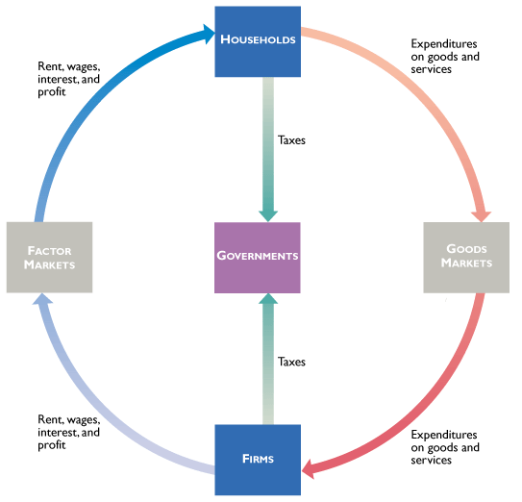
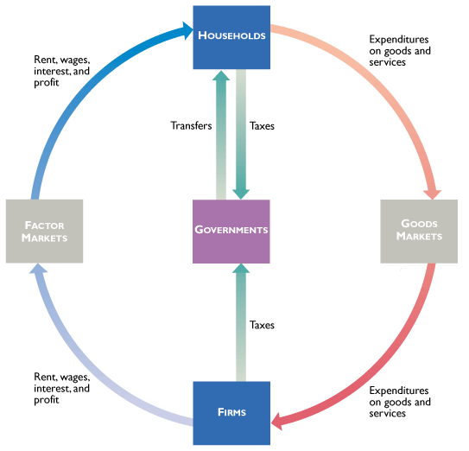
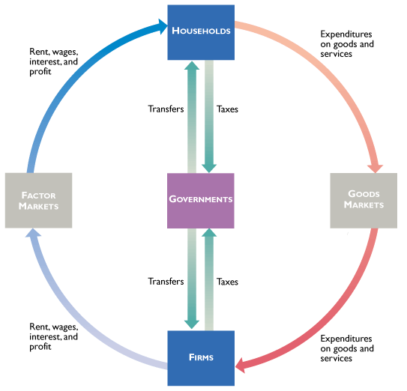
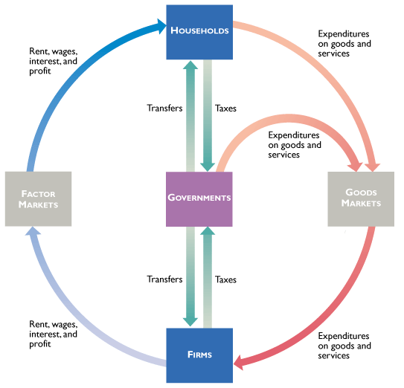
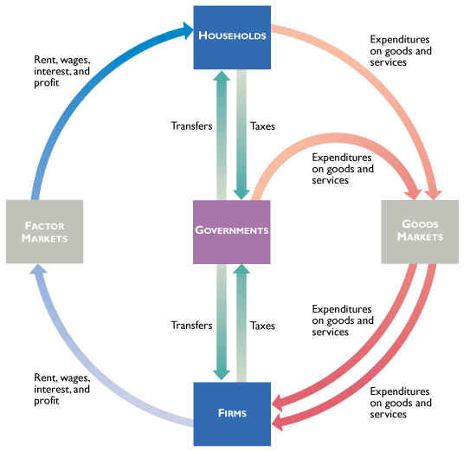

Slide 20

Economic Functions of Government
Administration of justice
Provision of “public goods”
Correcting for “externalities”
such as air pollution.
Redistribution of income
Economic stabilization

Slide 21
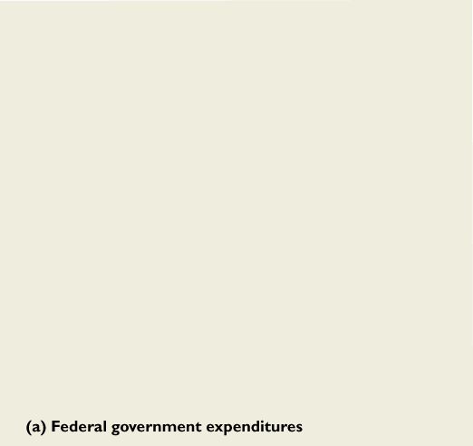
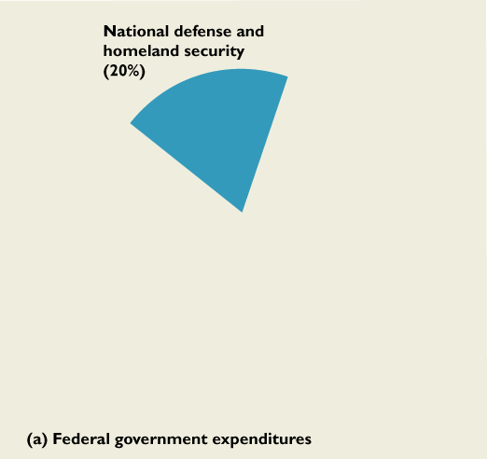
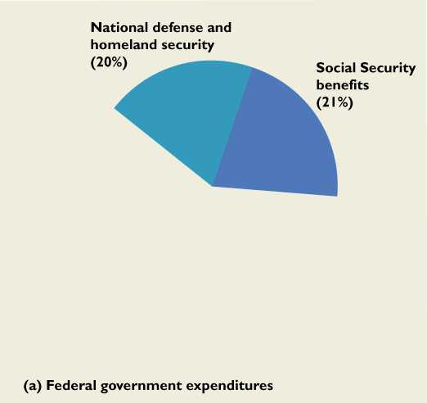
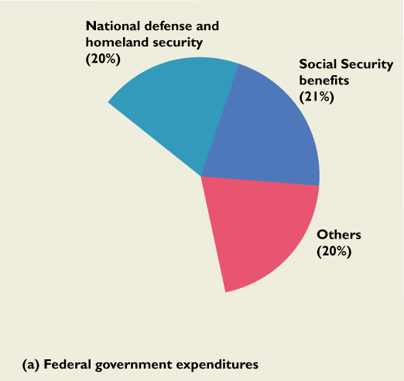
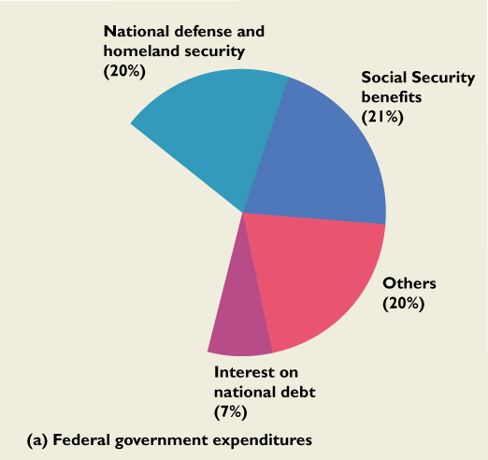
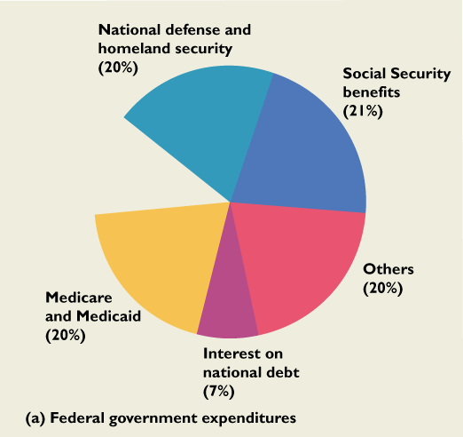
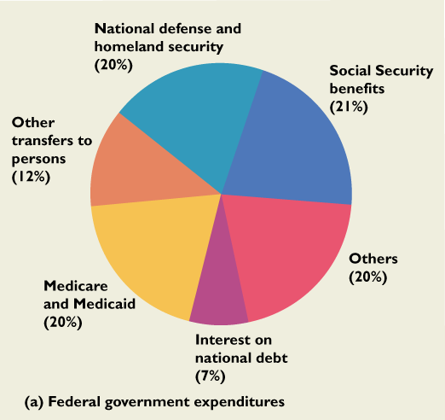

Slide 22
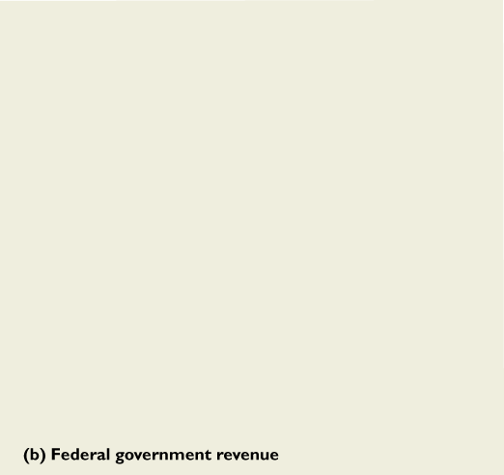
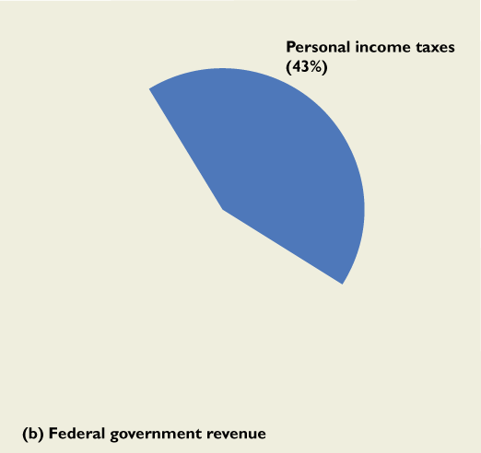




Slide 23




Slide 24






Slide 25








Slide 26

Arkansas State Revenues by Source, 2009
$16,199.7 (Millions)
Source: www.state.ar.us/dfa

Slide 27

Arkansas State Expenditures, by Category, 2009
Source: www.state.ar.us/dfa

Slide 28

The Global Economy
The world is more “integrated” than ever before, as measured by the movement of resources, goods and services between countries

Slide 29








Distribution of global production

Slide 30




Energy Sources in the World Economy

Slide 31




Energy Sources in the World Economy

Slide 32




Energy Sources in the World Economy

Slide 33



