Slide 1
Interest Rates and Monetary Policy
McGraw-Hill/Irwin
Copyright © 2012 by The McGraw-Hill Companies, Inc. All rights reserved.
Notes:
This chapter starts by introducing the transactions and asset demand for money and explaining how the interaction of the demand and supply of money determine the interest rates in the market. Banks’ balance sheets are used to explain how open market operations is effective in changing the money supply. We will learn about tools other than open market operations that the Fed might use to manipulate the money supply and the reasons that these tools are chosen, or not chosen. We will then evaluate expansionary and restrictive monetary policy, conditions under which these policies should be used, and how they impact interest rates, investment, and aggregate demand. We close with a discussion of issues related to monetary policy and current monetary policy.

Slide 2
Interest Rates
The price paid for the use of money
Many different interest rates
Speak as if only one interest rate
Determined by the money supply and money demand
LO1
16-2
Notes:
Understanding interest rates is a key economic concept. For example, imagine a gentleman who was beginning a new career working for an investment firm. He did not have a business background, but he was a salesman. One evening as he was discussing his new career with an economist friend, he told his friend that the reason his firm could offer investors a much higher return than the banks was because his firm had been around for over 100 years and, therefore, was considered “safer” than a bank and did not have to purchase insurance to safeguard depositors’ funds like banks did. The economist stopped him and had to explain to him that actually it was the opposite: His firm had to pay a higher interest rate to investors to compensate the investors for their increased risk with his firm because their investments were not insured.

Slide 3

The money market
Earlier we said that the interest rate (r) influences aggregate spending—specifically investment and consumption. However, we have yet to develop a theory of the interest rate
The interest rate is governed by the demand and supply of money.

Slide 4
Why do agents hold money?
To make planned expenditures/payments
To be prepared for unexpected expenditures/payments.
To store wealth.

Slide 5
Demand for Money
Why hold money?
Transactions demand, D_{t}
  Determined by nominal GDP
  Independent of the interest rate
Asset demand, D_{a}
  Money as a store of value
  Varies inversely with the interest rate
Total money demand, D_{m}
LO1
16-5
Notes:
People hold money for many different reasons. One reason is that it is convenient to have money available to purchase necessary goods and services. This is referred to as the transactions demand, or D_{t}. The larger the value of all goods and services exchanged in the economy, the larger the amount of money that will be needed to handle all of the transactions.
The second reason for holding money is the asset demand or D_{a}. People like to hold some of their financial assets as money because money is the most liquid of all financial assets. If an emergency arises where you need funds in a hurry, you will have access to those funds quickly.
The disadvantage to holding money as an asset is that it is a non-productive asset. If you bury a pile of money in the backyard, when you dig it up ten years later, it will be the same amount that you buried, and ten years later the purchasing power of the money has probably declined.
The amount of money demanded as an asset is inversely related to the interest rates, meaning as interest rates go up, the demand for money as an asset goes down and vice versa.

Slide 6
The interest rate (r) measures
the opportunity cost of
holding money
The higher the interest rate, the more interest I give up by holding my wealth in money-- as opposed to an interest-bearing asset.

Slide 7



Demand for Money
(c)
Total
demand for
money, D_{m}
and supply
(a)
Transactions
demand for
money, D_{t}
(b)
Asset
demand for
money, D_{a}
10
7.5
5
2.5
0
S_{m}
Rate of interest, i percent
+
=
5
D_{t}
D_{a}
D_{m}
50
100
150
200
50
100
150
200
50
100
150
200
250
300
Amount of money
demanded
(billions of dollars)
Amount of money
demanded
(billions of dollars)
Amount of money
demanded and supplied
(billions of dollars)
LO1
16-7
Notes:
The total demand for money is the sum of the transactions demand for money plus the asset demand for money. The transactions demand for money is assumed to be vertical as it depends on GDP rather than the interest rate. The asset demand for money is inversely related to the interest rate, meaning as interest rates go up, the amount of money demanded goes down. When we introduce the supply of money into the graphs, we find an equilibrium point for money.

Slide 8
Classical Theory of Interest
DI = C + S
“Interest is the reward for waiting.”
Keynes: Interest is the reward for parting with liquidity.

Slide 9
Demand for Money
Nominal Interest Rate (%)
As we move along D_{M}, nominal GDP is held constant.
The movement from point E to F is a change in the demand for money as a store of value in reaction to a decrease in the yield of bonds.
E
6%
F
3%
D_{M}
0
1.0
1.2
Money
($Trillions)

Slide 10
Effect of a Change in nominal GDP (Y)
D_{m1} →D_{m2}
Increase in Y, ceteris paribus
Nominal Interest Rate (%)
E
G
6%
F
H
3%
Dm₂
Dm₁
0
1.0
1.12
1.2
1.5
Money
($Trillions)

Slide 11
Interest Rates
Equilibrium interest rate
  Changes with shifts in money supply and money demand
Interest rates and bond prices
  Inversely related
  Bond pays fixed annual interest payment
  Lower bond price will raise the interest rate
LO1
16-11
Notes:
Just like in other resource markets, there is an equilibrium interest rate that will cause the supply of money available to equal the demand for money. This rate can be thought of as the market-determined price that borrowers must pay for using someone else’s money over some period of time.

Slide 12
Bond Prices and the Rate Of Interest
Bond prices and interest rates (or yields), move inversely

Slide 13

Example
Suppose you paid $800 for a bond that promises to pay $1,000 to its holder one year from today. What is the interest rate or percentage yield of the bond? Notice first that your interest income would be equal to $200. Hence to compute the yield, use the following equation:
Yield (%) = (interest income/price of the bond) × 100
Thus, we have:
Yield (%) = (200/800) × 100 = 25 percent
Now suppose, instead of paying $800 for the bond, you paid $900. What is the yield now?
Yield (%) = (100/900) × 100 = 11 percent

Slide 14
Federal Reserve Balance Sheet
Assets
  Securities
  Loans to commercial banks
Liabilities
  Reserves of commercial banks
  Treasury deposits
  Federal Reserve Notes outstanding
LO2
16-14
Notes:
Just like any other organization, the Federal Reserve Bank’s balance sheet reports the assets and liabilities of the organization as of that point in time. The Fed’s balance sheet helps us to consider how the Fed conducts monetary policy.

Slide 15
Federal Reserve Balance Sheet
March 24, 2010 (in Millions)
Assets Liabilities and Net Worth
Securities
Loans to Commercial
Banks
All Other Assets
Total
$2,017,955
85,659
212,911
$2,316,525
Reserves of Commercial
Banks
Treasury Deposits
Federal Reserve Notes
(Outstanding)
All Other Liabilities and
Net Worth
Total
$ 1,147,747
150,087
893,035
125,656
$2,316,525
Source: Federal Reserve Statistical Release, H.4.1, March 24, 2010, http://www.federalreserve.gov
LO2
16-15
Notes:
The two main assets of the Federal Reserve Banks are securities and loans to commercial banks. The securities are government bonds that have been purchased by the Federal Reserve Bank to increase the supply of money in the economy. Loans to commercial banks also help the banks to increase their reserves. The liabilities of the Federal Reserve Banks have three noteworthy items. The reserves of commercial banks represent the required reserves that banks must hold to ensure their stability. These reserves are also listed as assets on the banks’ books. The Treasury Deposits represent the amount of money the U.S. government has on deposit with the Fed. The government uses this money to pay its obligations. The Federal Reserve Notes Outstanding represents the supply of paper money currently circulating outside of the Federal Reserve Banks. Over the past couple of years, the balance sheet of the Fed has increased dramatically as the Fed has taken various actions to help the economy recover from the recession.

Slide 16
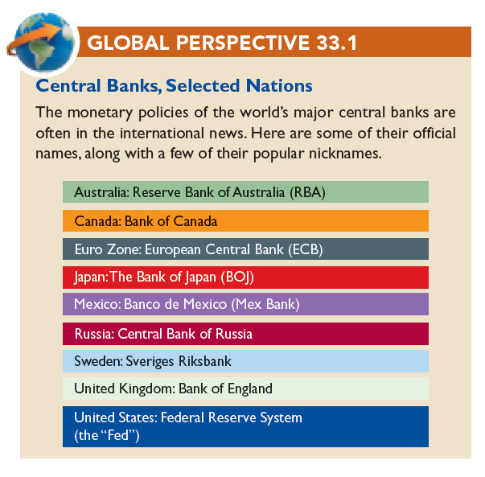
Central Banks
LO2
16-16
Notes:
This chart contains some examples of the central banks of other nations. Like the Federal Reserve System, these banks coordinate the monetary policies of their countries.

Slide 17
Tools of Monetary Policy
Open market operations
  Buying and selling of government securities (or bonds)
  Commercial banks and the general public
  Used to influence the money supply
When the Fed sells securities, commercial bank reserves are reduced
LO2
16-17
Notes:
Open market operations are used by the Fed to increase or decrease the commercial bank reserves available which, in turn, will affect the amount of money available in the economy.

Slide 18
Tools of Monetary Policy
Fed buys bonds from commercial banks
Federal Reserve Banks
Assets
Liabilities and Net Worth
+ Securities
+ Reserves of Commercial Banks
(a) Securities
(b) Reserves
Commercial Banks
Assets
Liabilities and Net Worth
Securities (a)
+Reserves (b)
LO2
16-18
Notes:
As part of their open-market operations, the Fed will buy or sell government bonds. If they purchase the bonds from commercial banks, the commercial banks are in effect transferring part of their holding of securities to the Fed, which creates new reserves for the banks in their accounts at the Fed. By increasing the commercial banks’ reserves, the Fed has increased their lending capacity.

Slide 19
Tools of Monetary Policy
Fed sells bonds to commercial banks
Federal Reserve Banks
Assets
Liabilities and Net Worth
- Securities
- Reserves of Commercial Banks
(a) Securities
(b) Reserves
Commercial Banks
Assets
Liabilities and Net Worth
+ Securities (a)
- Reserves (b)
LO2
16-19
Notes:
If the Fed sells government bonds to commercial banks, the opposite effect occurs. The banks lose reserves, which will reduce their lending capacity.

Slide 20
Open Market Operations
Fed buys $1,000 bond from a commercial bank
New Reserves
$1000
Excess
Reserves
$5000
Bank System Lending
Total Increase in the Money Supply, ($5,000)
LO2
16-20
Notes:
When the Fed buys government bonds from commercial banks, it increases the assets of the Fed and increases the reserves of the commercial banks. This will increase the lending ability of the commercial banks.

Slide 21
Open Market Operations
Fed buys $1,000 bond from the public
Check is Deposited
New Reserves
$1000
$800
Excess
Reserves
$200
Required
Reserves
$4000
Bank System Lending
$1000
Initial
Checkable
Deposit
Total Increase in the Money Supply, ($5000)
LO2
16-21
Notes:
When the Fed buys government bonds from the public, the effect is much the same. The assets of the Fed increase, and as the public deposits the funds into a commercial bank, its reserves and lending ability will increase.

Slide 22
Tools of Monetary Policy
The reserve ratio
  Changes the money multiplier
The discount rate
  The Fed as lender of last resort
  Short term loans
Term auction facility
  Introduced December 2007
  Banks bid for the right to borrow reserves
LO2
16-22
Notes:
In addition to open market operations, the Fed has three other tools available. The Fed can change the reserve ratio, which will affect the ability of commercial banks to lend. If the reserve ratio is increased, the money multiplier will decrease and vice versa.
As the “lender of last resort,” the Fed makes short-term loans to banks to cover unexpected and immediate needs for additional funds. The rate that the Fed charges the banks is called the discount rate. In providing the loan, the Fed increases the reserves of the borrowing bank. Since there are no required reserves against loans from the Fed, all new reserves are considered excess reserves, and as such, they enhance the ability of the bank to lend. If the Fed raises the discount rate, it discourages banks from borrowing, and if it lowers the rate, it encourages banks to borrow.
The term auction facility is another way that the Fed can alter bank reserves. Twice a month, the Fed auctions off the right for banks to borrow reserves for 28- and 84-day periods. This tool allows the Fed to guarantee that the amount of reverses it wishes to lend will be borrowed and, therefore, will be available as excess reserves in the banking system to increase lending.

Slide 23
The Reserve Ratio
Effects of Changes in the Reserve Ratio
(1) Reserve Ratio, % | (2) Checkable Deposits | (3) Actual Reserves | (4) Required Reserves | (5) Excess Reserves, (3) –(4) | (6) Money-Creating Potential of Single Bank, = (5) | (7) Money-Creating Potential of Banking System
(1) 10 | $20,000 | $5000 | $2000 | $3000 | $3000 | $30,000
(2) 20 | 20,000 | 5000 | 4000 | 1000 | 1000 | 5000
(3) 25 | 20,000 | 5000 | 5000 | 0 | 0 | 0
(4) 30 | 20,000 | 5000 | 6000 | -1000 | -1000 | -3333
LO2
16-23
Notes:
This table shows that a change in the reserve ratio affects the money-creating ability of the banking system as a whole in two ways, (1) by changing the amount of excess reserves, and (2) changing the size of the monetary multiplier.

Slide 24
Tools of Monetary Policy
Open market operations are the most important
Reserve ratio last changed in 1992
Discount rate was a passive tool
Term auction facility is new
  Guaranteed amount lent by the Fed
  Anonymous
LO2
16-24
Notes:
The open market operations are the most important tool in the Fed’s arsenal. It gives the Fed great flexibility in controlling the money supply, and the impact on the money supply is swift. The other tools are typically only used in special circumstances. For example, the last change in the reserve ratio came in 1992 and was done more to shore up banks and thrifts in the aftermath of the 1990-1991 recession than to impact the money supply.

Slide 25
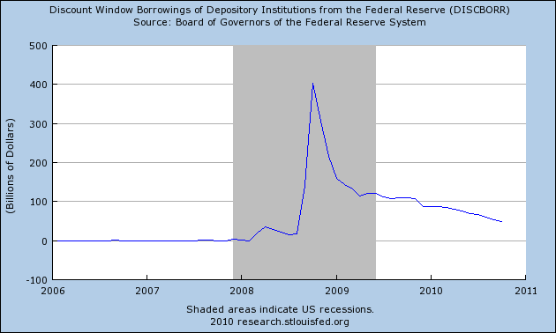
FED exercised lender-of-last-resort function
during 2008-2009 financial crisis

Slide 26
140 Bank Failures (FDIC-Insured) in 2009
See WSJ interactive graphic
http://graphicsweb.wsj.com/documents/Failed-US-Banks.html

Slide 27
The Federal Funds Rate
Rate charged by banks on overnight loans
Targeted by the Federal Reserve
FOMC conducts open market operations to achieve the target
Demand curve for Federal funds
Supply curve for Federal funds
LO3
16-27
Notes:
Instead of leaving excess reserves at the Federal Reserve Banks, which typically pay less interest than commercial banks, when banks have excess reserves, they will prefer to loan them to other banks that temporarily need the money to meet their own reserve requirements. The rate charged by the commercial bank on these overnight loans is referred to as the federal funds rate. It serves as the equilibrium rate for this market of bank reserves. The Federal Reserve targets this rate by manipulating the supply of reserves that are offered in the market. Typically this is done by buying or selling government bonds. The FOMC meets regularly to choose a desired federal funds rate and then directs the Federal Reserve Bank of New York to undertake the open market operations needed to achieve that rate.

Slide 28
The Federal Funds Rate
Using Open Market Operations
4.5
S_{f 3}
4.0
S_{f 1}
Federal Funds Rate, Percent
3.5
S_{f 2}
D_{f}
Q_{f3}
Q_{f1}
Q_{f2}
Quantity of Reserves
LO3
16-28
Notes:
In this example, we are assuming that the Fed desires a 4% interest rate. The demand curve is downward sloping because lower interest rates give banks greater incentives to borrow. The supply curve for Federal funds is horizontal at the desired rate because the Fed uses open market operations to manipulate the supply to keep it there.

Slide 29
Monetary Policy
Expansionary monetary policy
  Economy faces a recession
  Lower target for Federal funds rate
  Fed buys securities
  Expanded money supply
  Downward pressure on other interest rates
LO3
16-29
Notes:
During times of recession and unemployment, as in the past couple of years, the Fed will initiate expansionary monetary policy. The idea is to increase the supply of money in the economy in order to increase borrowing and spending. One of the problems with the recovery today is that while spending has increased some, borrowing is actually down. It seems ironic that when people save instead of borrow, it can actually be detrimental to the economy. If the Fed feels the economy is overheating or heading into a period of inflation, it will switch to restrictive monetary policy. This policy involves increasing the interest rate to reduce borrowing and spending, which should curtail the expansion of aggregate demand and keep prices down.

Slide 30
Monetary Policy
Restrictive monetary policy
  Periods of rising inflation
  Increases Federal funds rate
  Increases money supply
  Increases other interest rates
LO3
16-30
Notes:
During times of rising inflation, the Fed will switch to a more restrictive monetary policy. In order to keep prices down, the Fed will increase the interest rate in order to reduce borrowing and spending, which will hopefully slow the expansion of aggregate demand that is driving up the price levels.

Slide 31
Monetary Policy
10
8
Prime interest rate
6
Percent
4
Federal funds rate
2
0
1998 1999 2000 2001 2002 2003 2004 2005 2006 2007 2008 2009 2010
Year
16-31

Slide 32
Effect of an increase in the money supply
Because the money supply is determined by the Federal Reserve, it can be represented by a vertical line.
Interest
rate
S_{m}
S’_{m}
At point a, the intersection of the money supply, S_{m}, and the money demand, D_{m}, determines the market interest rate, i.
i
a
i’
b
Following an increase in the money supply to S’_{m}, the quantity of money supplied exceeds the quantity demanded at the original interest rate, i.
D_{m}
0
Quantity of
money
M
M’
People attempt to exchange money for bonds or other financial assets. In doing so, they push down the interest rate to i’, where quantity demanded equals quantity supplied. This new equilibrium occurs at point b.

Slide 33
Effects of an increase in the money supply on interest rates, investment, and aggregate demand
(a) Supply and demand
for money
(b) Demand for
investment
(c) Aggregate demand
Interest rate
S_{m}
Interest rate
S’_{m}
Price level
i
a
i
a
b
b
b
P
i’
i’
a
AD’
D_{m}
D_{I}
AD
0
M
M’
Money
0
I
I’
0
Y
Y’
Real GDP
An increase in the money supply drives the interest rate down to i'.
Investment
This sets off the spending multiplier process, so the aggregate output demanded at price level P increases from Y to Y ‘
With the cost of borrowing lower, the amount invested increases from I to I‘.

Slide 34
Monetary Policy, Real GDP, Price Level
Affect on real GDP and price level
Cause-effect chain
  Market for money
  Investment and the interest rate
  Investment and aggregate demand
  Real GDP and prices
Expansionary monetary policy
Restrictive monetary policy
LO4
16-34
Notes:
This next section will discuss how monetary policy affects the economy’s levels of investment, aggregate demand, real GDP, and prices.

Slide 35
Monetary Policy and Equilibrium GDP
(c)
Equilibrium real
GDP and the
Price level
(a)
The market
for money
(b)
Investment
demand
S_{m1}
S_{m2}
S_{m3}
AS
10
8
6
0
P₃
AD₃
I=$25
Rate of Interest, i (Percent)
P₂
Price Level
D_{m}
AD₂
I=$20
ID
AD₁
I=$15
$125
$150
$175
$15
$20
$25
Q₁
Q_{f}
Q₃
Amount of money
demanded and
supplied
(billions of dollars)
Amount of investment
(billions of dollars)
Real GDP
(billions of dollars)
LO4
16-35
Notes:
An expansionary monetary policy that shifts the money supply curve rightward in (a) lowers the interest rate from 10% to 8% which results in the investment spending in (b) to increase from $15 to $20 billion and causes aggregate demand to increase. This shifts the aggregate demand curve rightward from AD1 to AD2 in (c) so that real output rises to the full employment level Qf along the horizontal dashed line. Conversely, a restrictive monetary policy will cause the money supply curve to shift leftward, thereby increasing the interest rate, decreasing investment and aggregate demand.

Slide 36
Monetary Policy and Equilibrium GDP
(c)
Equilibrium real
GDP and the
Price level
(d)
Equilibrium real
GDP and the
Price level
AS
AS
P₃
P₃
c
b
a
AD₃
I=$25
AD₃
I=$25
P₂
AD₄
I=$22.5
P₂
Price Level
Price Level
AD₂
I=$20
AD₂
I=$20
AD₁
I=$15
AD₁
I=$15
Q₁
Q_{f}
Q₃
Q₁
Q_{f}
Q₃
Real GDP
(billions of dollars)
Real GDP
(billions of dollars)
LO4
16-36
Notes:
In (d), the economy at point a has an inflationary output gap because it is producing above potential output.

Slide 37
Expansionary Monetary Policy
Problem: Unemployment and Recession
CAUSE-EFFECT CHAIN
Fed buys bonds, lowers reserve ratio, lowers the discount rate, or increases reserve auctions
Excess reserves increase
Federal funds rate falls
Money supply rises
Interest rate falls
Investment spending increases
Aggregate demand increases
Real GDP rises
LO4
16-37
Notes:
This chain illustrates the causes and effects of expansionary monetary policy. When faced with the problems of unemployment and recession, the Fed takes actions to increase the money supply, which should eventually lead to real GDP rising. Unfortunately, it is not an immediate reaction so the Fed may overshoot the mark, which can lead to inflation.

Slide 38
Restrictive Monetary Policy
Problem: Inflation
CAUSE-EFFECT CHAIN
Fed sells bonds, increases reserve ratio, increases the discount rate, or decreases reserve auctions
Excess reserves decrease
Federal funds rate rises
Money supply falls
Interest rate rises
Investment spending decreases
Aggregate demand decreases
Inflation declines
LO4
16-38
Notes:
In times of inflation, the Fed practices restrictive monetary policy and decreases the supply of money, which should lead to a decrease in the inflation rate. However, because prices tend to be inflexible, if the Fed is not careful, their actions can lead to a recession.

Slide 39
Recent U.S. Monetary Policy
Highly active in recent decades
Responded with quick and innovative actions during the recent financial crisis and the severe recession
Critics contend the Fed contributed to the crisis by keeping the Federal funds rate too low for too long
LO5
16-39
Notes:
Given the fact that the recession was declared to have officially ended in June of 2009, many economists will continue to debate whether the Fed’s actions helped or hindered the recovery. Over the past decade, the Fed has acted quickly to attempt to stimulate the economy, even lowering the Federal funds rate to almost zero.

Slide 40
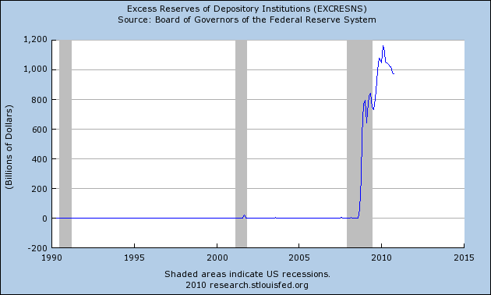
Banks have excess reserves, but are
not making loans

Slide 41
Problems and Complications
Lags
  Recognition and operational
  Cyclical asymmetry
  Liquidity trap
LO5
16-41
Notes:
The lags complicate monetary policy because although its impact is faster than fiscal policy, there is still a three to six month delay that can cause problems and end up with the Fed overshooting its targets. Economists also feel that monetary policy is more effective dealing with slowing expansions and controlling inflations than it is with helping the economy recover from a severe recession. Even though the Fed may create excess reserves during periods of recession, that does not mean the banks will loan the money out. This is why in the recent recessionary period, the U.S. turned more towards the use of fiscal policy to attempt to spend its way out of the recession. Which policies actually succeeded we will probably never figure out.

