Slide 1
Chapter 15: Decisions Under Risk and Uncertainty
McGraw-Hill/Irwin
Copyright © 2011 by the McGraw-Hill Companies, Inc. All rights reserved.

Slide 2

In business we are forced to make decisions involving risk—that is, where the consequences of any action we take is uncertain due to unforeseeable events. Where do we begin?

Slide 3
Risk vs. Uncertainty
Risk
  Must make a decision for which the outcome is not known with certainty
  Can list all possible outcomes & assign probabilities to the outcomes
Uncertainty
  Cannot list all possible outcomes
  Cannot assign probabilities to the outcomes

Slide 4

The game of roulette is subject to risk. The return on investment in R & D is subject to uncertainty.

Slide 5
Analyzing the Problem—Preliminary Steps
Listing the available alternatives, not only for direct action but also for gathering information on which to base later action;
Listing the outcomes that can possibly occur (these depend on chance events as well as on the decision maker’s own actions);
Evaluating the chances that any uncertain outcome will occur; and
Deciding how well the decision maker likes each outcome.

Slide 6
Experiments
These are processes that generate well-defined outcomes
Experiment | Experimental Outcomes
Toss a coin | Head, tail
Select a part for inspection | Defective, nondefective
Conduct a sales call | Purchase, no purchase
Roll a die | 1, 2, 3, 4, 5, 6
Play a football game | Win, lose, tie

Slide 7
Probability is a numerical measure of the likelihood of an event occurring
0
1.0
0.5
Probability:
The occurrence of the event is just
as likely as it is unlikely

Slide 8

Unfortunately, business experiments are rarely repeatable. We cannot introduce a new product 1,000 times and measure the frequency with which it succeeds—can we?

Slide 9
Objective versus Subjective Probabilities
Repeatable experiments (tossing a die, flipping a coin) generate objective probabilities.
Non-repeatable experiments necessarily involve assigning hypothetical or subjective probabilities to particular outcomes.

Slide 10

According to the subjective view, the probability of an outcome represents the decision maker’s degree of belief that the outcome will occur.
I estimate my odds of becoming a country music star at
two to one.

Slide 11
Measuring Risk with Probability Distributions
Table or graph showing all possible outcomes/payoffs for a decision & the probability each outcome will occur
To measure risk associated with a decision
  Examine statistical characteristics of the probability distribution of outcomes for the decision

Slide 12
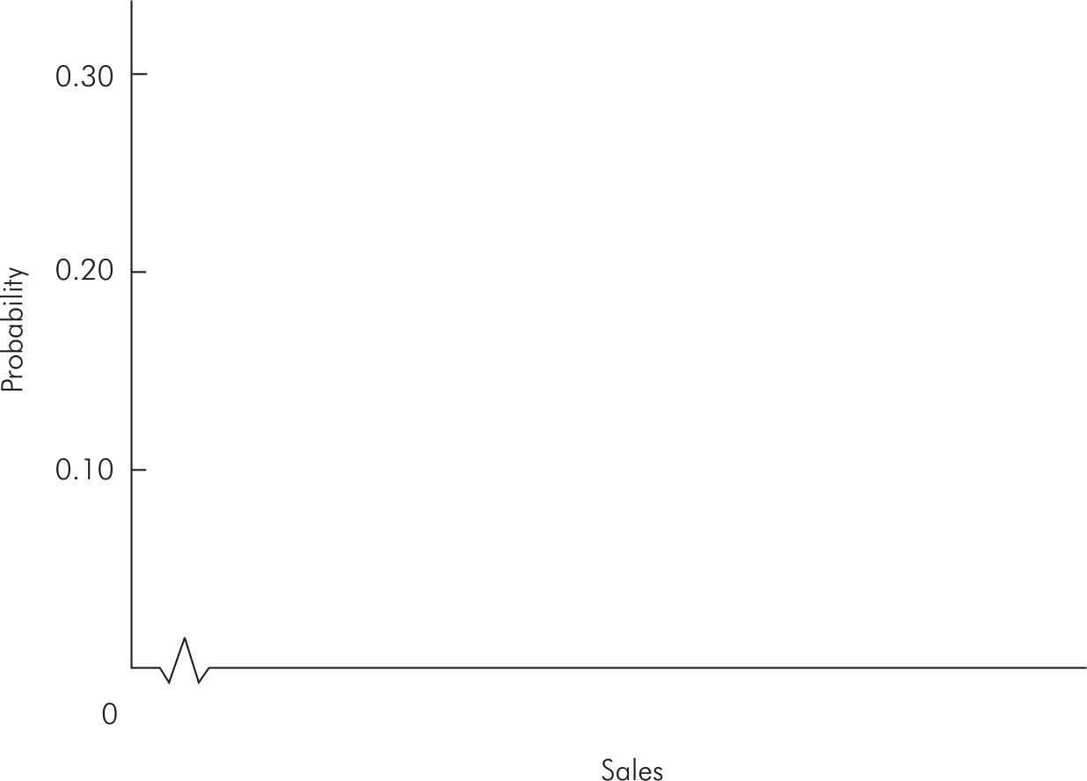
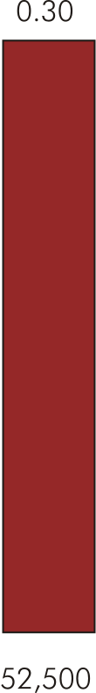
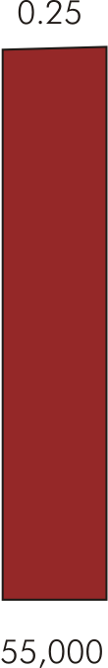
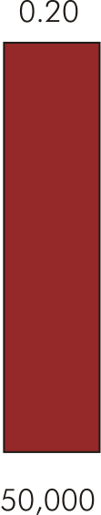
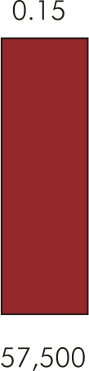
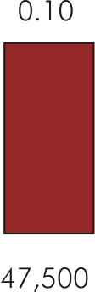
Probability Distribution for Sales (Figure 15.1)

Slide 13
Expected Value
Expected value (or mean) of a probability distribution is:
Where X_{i} is the i^{th} outcome of a decision, p_{i} is the probability of the i^{th} outcome, and n is the total number of possible outcomes

Slide 14
Expected Value
Does not give actual value of the random outcome
  Indicates “average” value of the outcomes if the risky decision were to be repeated a large number of times

Slide 15

(Subjective) Probability Distribution for a New Product Launch
The following gives the subjective view of a manager concerning the probability distribution for the first year’s outcome of a new product launch.
Outcome | Sales Revenue | Probability
Complete success | $10,000,000 | 0.1
Promising | 7,000,000 | 0.3
Mixed response | 3,000,000 | 0.2
Failure | 1,000,000 | 0.4

Slide 16
Computing Expected Value or E(v)
Suppose the decision maker faces a risky prospect than has n possible monetary outcomes, v₁, v₂, . . . , v_{n}, predicted to occur with probabilities p₁, p₂, . . . , p_{n}. Then the (monetary) expected value is found by:
E(v) for the new product launch is given by:

Slide 17

The Wildcatters Drilling Problem
Payoffs measured in 1,000s
Wet
$600
0.4
Drill
120
Dry
120
-$200
0.6
Do not drill
$0

Slide 18

The Expected Value Criterion
I will select the course of action with the highest expected value. Note that the expected value of “not drilling” is equal to zero.
Expected value of the drilling option:

Slide 19
Good Decision, Bad Outcome
OK, the well turned out to be dry. But that does not mean the decision to drill was a bad one. When confronted with risk, we must distinguish between bad decisions and bad outcomes.

Slide 20

My expected value of homes sold this month is 1.246
Expected values for discrete random variables can assume any value.

Slide 21
Variance
Variance is a measure of absolute risk
  Measures dispersion of the outcomes about the mean or expected outcome
The higher the variance, the greater the risk associated with a probability distribution

Slide 22
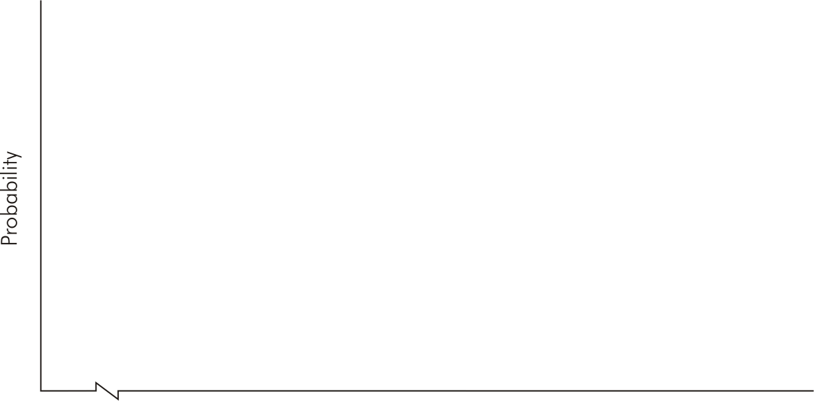
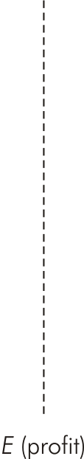
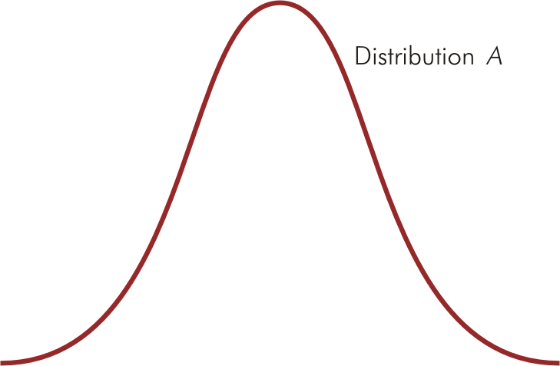
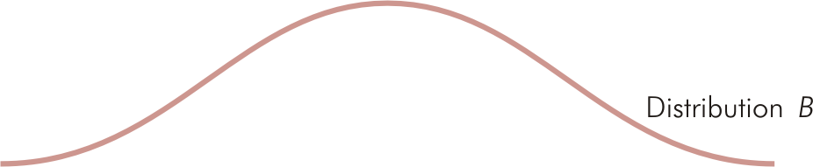
Identical Means but Different Variances (Figure 15.2)

Slide 23
Standard Deviation
Standard deviation is the square root of the variance
The higher the standard deviation, the greater the risk

Slide 24
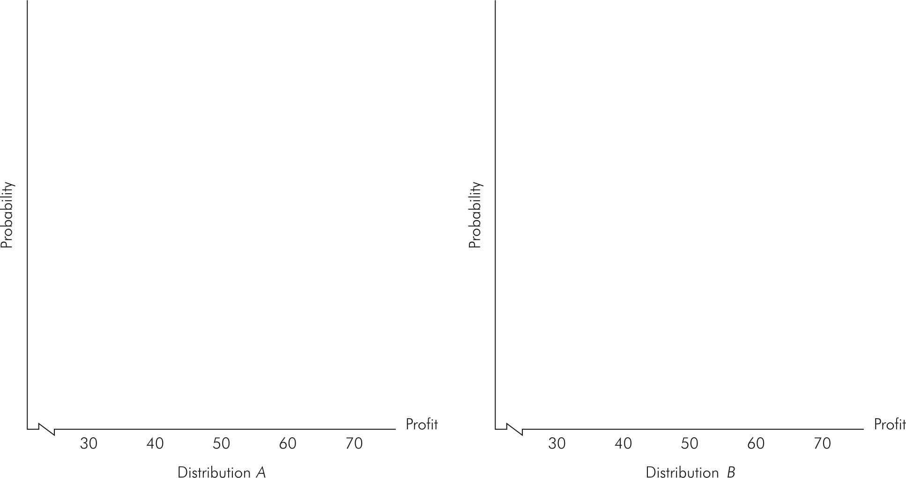
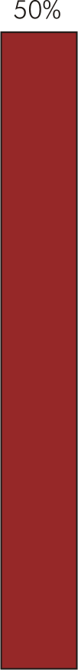
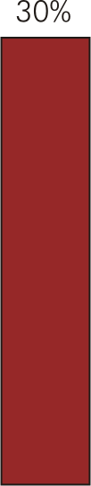
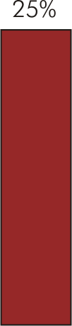
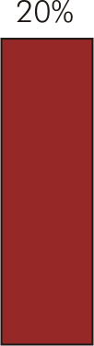
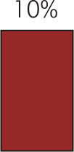
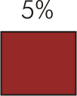
Probability Distributions with Different Variances (Figure 15.3)

Slide 25
Coefficient of Variation
When expected values of outcomes differ substantially, managers should measure riskiness of a decision relative to its expected value using the coefficient of variation
  A measure of relative risk

Slide 26
Decisions Under Risk
No single decision rule guarantees profits will actually be maximized
Decision rules do not eliminate risk
  Provide a method to systematically include risk in the decision making process

Slide 27
Summary of Decision Rules Under Conditions of Risk
Choose decision with highest expected value
Expected value rule
Mean-variance rules
Coefficient of variation rule
Given two risky decisions A & B:
If A has higher expected outcome & lower variance than B, choose decision A
If A & B have identical variances (or standard deviations), choose decision with higher expected value
If A & B have identical expected values, choose decision with lower variance (standard deviation)
Choose decision with smallest coefficient of variation

Slide 28
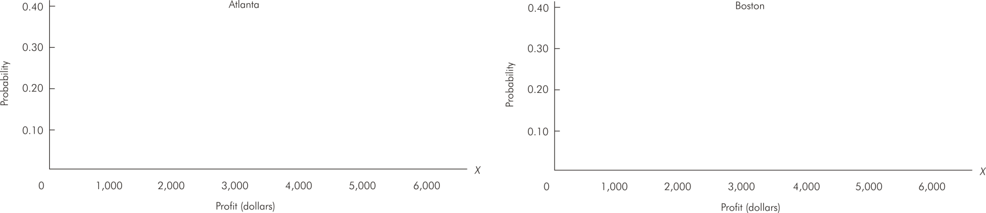






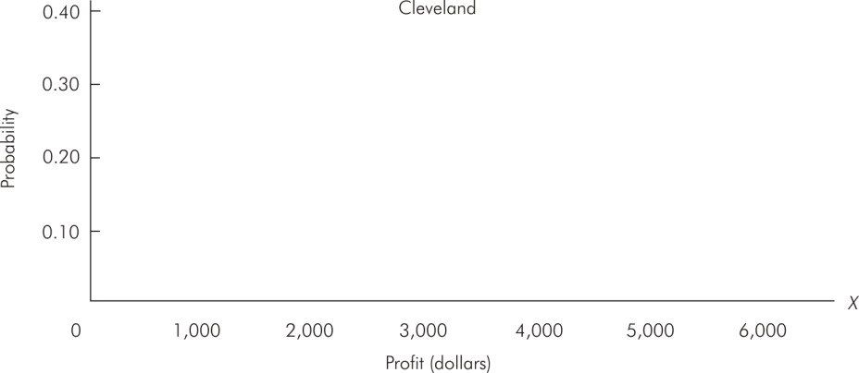
Probability Distributions for Weekly Profit at Three Restaurant Locations
E(X) = 3,500 σ_{A} = 1,025 υ = 0.29
E(X) = 3,750 σ_{B} = 1,545 υ = 0.41
E(X) = 3,500 σ_{C} = 2,062 υ = 0.59

Slide 29
Which Rule is Best?
For a repeated decision, with identical probabilities each time
  Expected value rule is most reliable to maximizing (expected) profit
  Average return of a given risky course of action repeated many times approaches the expected value of that action

Slide 30
Which Rule is Best?
For a one-time decision under risk
  No repetitions to “average out” a bad outcome
  No best rule to follow
Rules should be used to help analyze & guide decision making process
  As much art as science

Slide 31
Expected Utility Theory
Actual decisions made depend on the willingness to accept risk
Expected utility theory allows for different attitudes toward risk-taking in decision making
  Managers are assumed to derive utility from earning profits

Slide 32
Risk Aversion
When it comes to risks that are large relative to financial resources, firms and individuals tend to adopt a conservative attitude. That is, they are not “risk-neutral”—which is what the expected value criterion assumes.

Slide 33


A Coin Gamble
You have 2 choices: You can have $60, no questions asked. Or, you can accept the following gamble: A fair coin is tossed. Heads: you win $400. Tails: You lose $200 dollars. OK, what is your choice?
Question: Which choice has the highest expected value?
For the “gamble” choice:
If you refuse the bet, you are not risk neutral!

Slide 34

The Certainty Equivalent (CE)
The CE is the amount of money for certain that makes the individual exactly indifferent to the risky prospect.
Example: Suppose that a guaranteed $25 would make you indifferent to the bet with an expected value of $100. Thus your CE = $25. If CE < E(v), then the individual is risk averse.

Slide 35

The CE and the Degree of Risk Aversion
Principle: The higher the discount factor, the higher the degree of risk aversion.
The discount factor for risk is the difference between the expected value of the gamble and the CE. My CE is $75. Thus my discount factor is equal to: $100 - $75 = $25. If your CE is $25, then your discount factor is $75.

Slide 36

The Demand For Insurance
Insurance entails the transfer (for a price) of risk from risk averse individuals or firms to risk neutral insurance companies.
Risk pooling allows insurance companies to be risk neutral. An insurance company does not know which homes will catch fire. It can predict how many homes out of 10,000 will catch fire, however.

Slide 37
Expected Utility
This is a similar decision making process to expected value—with one big difference. In contrast to the risk neutral manager, who averages monetary values at each step, the risk averse manager averages expected utilities associated with monetary values.

Slide 38
Expected Utility Theory
Managers make risky decisions in a way that maximizes expected utility of the profit outcomes
Utility function measures utility associated with a particular level of profit
  Index to measure level of utility received for a given amount of earned profit

Slide 39
Manager’s Attitude Toward Risk
Risk averse
  If faced with two risky decisions with equal expected profits, the less risky decision is chosen
Risk loving
  Expected profits are equal & the more risky decision is chosen
Risk neutral
  Indifferent between risky decisions that have equal expected profit

Slide 40
Manager’s Attitude Toward Risk
Determined by the manager’s marginal utility of profit:
Marginal utility (slope of utility curve) determines attitude toward risk

Slide 41
Manager’s Attitude Toward Risk
Can relate to marginal utility of profit
Diminishing MU_{profit}
  Risk averse
Increasing MU_{profit}
  Risk loving
Constant MU_{profit}
  Risk neutral

Slide 42
Expected Utility of Profits
According to expected utility theory, decisions are made to maximize the manager’s expected utility of profits
Such decisions reflect risk-taking attitude
  Generally differ from those reached by decision rules that do not consider risk
  For a risk-neutral manager, decisions are identical under maximization of expected utility or maximization of expected profit

Slide 43
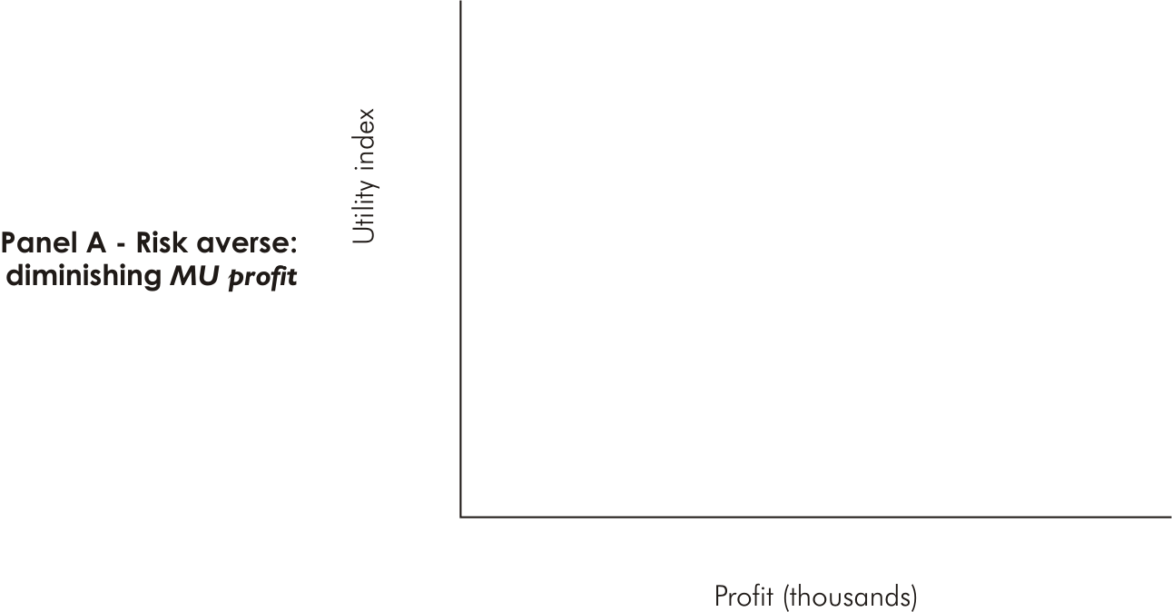
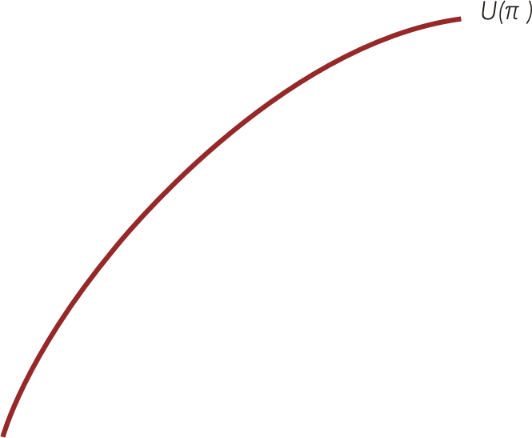
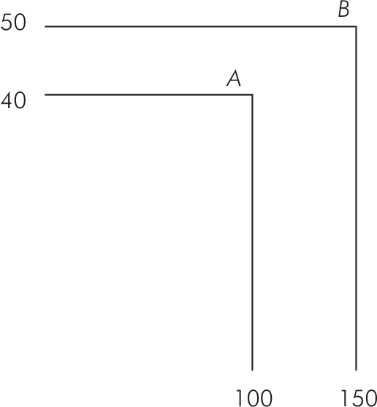
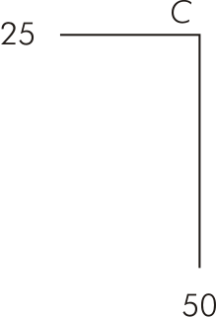
Manager’s Attitude Toward Risk (Figure 15.5)

Slide 44
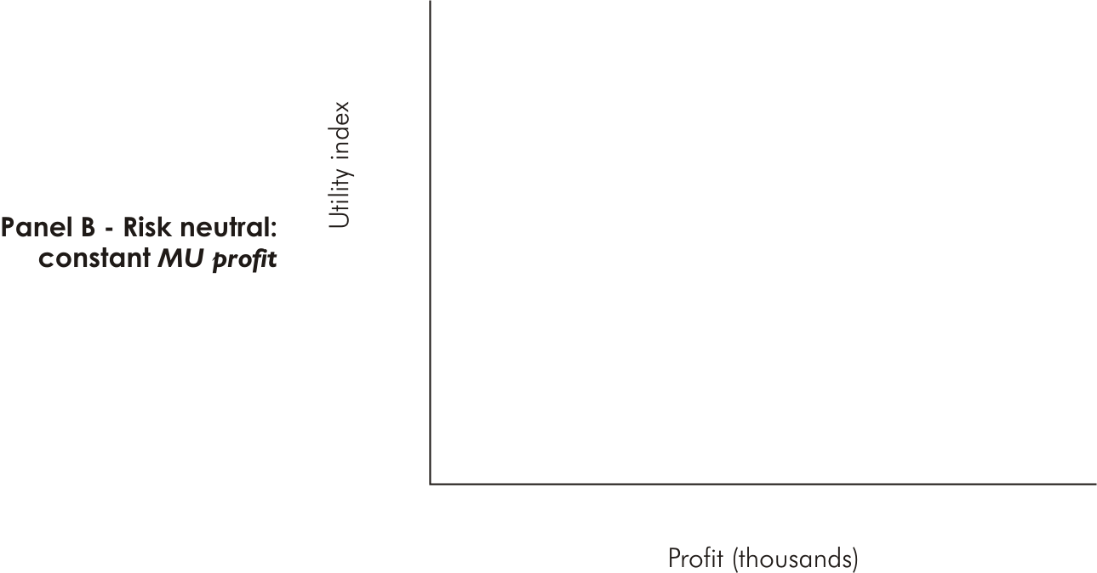
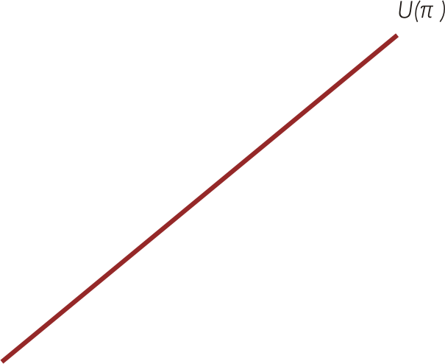
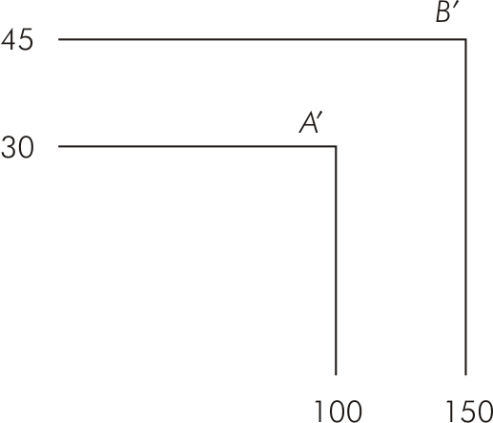
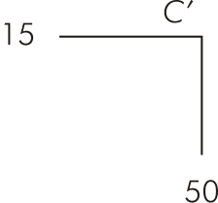
Manager’s Attitude Toward Risk (Figure 15.5)

Slide 45
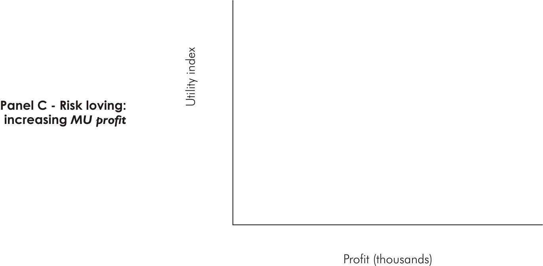
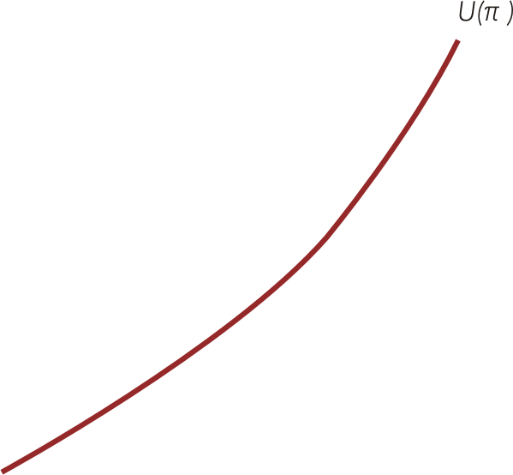
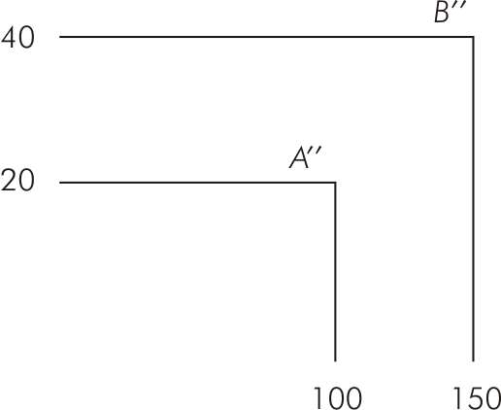
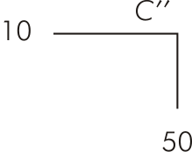
Manager’s Attitude Toward Risk (Figure 15.5)

Slide 46
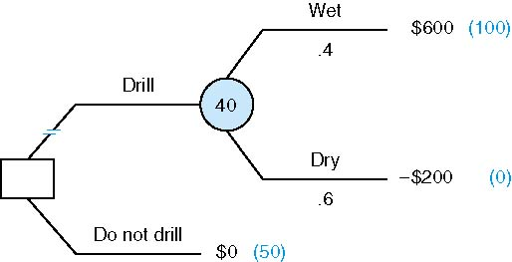
A Risk Averse Wildcatter
Notes:
U($600) = 100
U (-$200) = 0

Slide 47
Expected Utility: How It Works
The decision maker first attaches a utility value to each possible monetary outcome.
The worst monetary outcome is assigned a value of zero; the best monetary outcome must have a greater than zero—but that is the only requirement.
Our wildcatter assigns a value of 0 to the worst outcome
(-$200) and a value of 100 to the best outcome ($600). Thus the expected utility of drilling is given by:

Slide 48
Expected Utility: How It Works-Continued
Now I must compare the expected utility of drilling with the expected utility of not drilling—that is U(0). How do I find that?
Principle: To find U(0), compare $0 for certain with a gamble offering $600 thousand (with probability p) and -$200 thousand (with probability 1 – p).
The wildcatter finds his preference for $0 by finding the probability p that leaves him indifferent to the options of $0 and the gamble (drilling).

Slide 49
I find my preference for $0 by finding the probability p that leaves me indifferent to the options of $0 and the gamble (drilling). Say I have determined it is 0.5.
Then the expected utility of the 50-50 gamble is equal to:
Expected utility rule: The decision maker should choose the course of action that maximizes his or her expected utility.
Should the wildcatter drill?

Slide 50
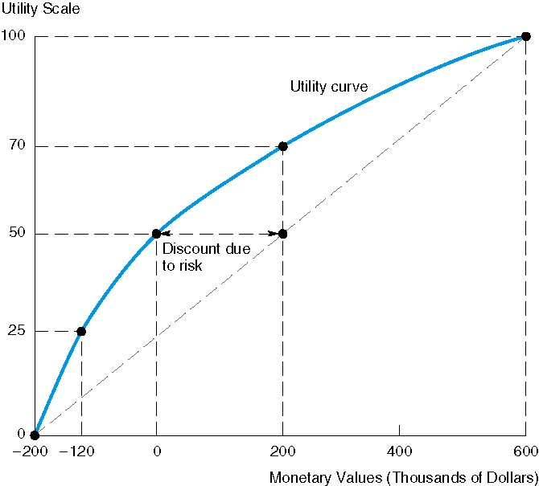

Slide 51

Notes on Preceding Figure
The utility curve gives us the “certainty equivalent” of a bet with a given expected value.
The CE of a bet with an expected value of $200 thousand is $0. That is, the certainty of obtaining $0 and a bet with an expected value of $200 thousand have the same expected utility (50).
A concave utility curve means the decision maker is risk averse—that is, there is a discount due to risk equal to E(v) – CE ($200 thousand in the example above).
A risk-neutral decision maker is guided by expected value—there is no discount for risk so that the utility curve is linear.
A risk lover has a convex utility curve.

