Slide 1
Chapter 4: Basic Estimation Techniques
McGraw-Hill/Irwin
Copyright © 2011 by the McGraw-Hill Companies, Inc. All rights reserved.

Slide 2
Basic Estimation
Parameters
  The coefficients in an equation that determine the exact mathematical relation among the variables
Parameter estimation
  The process of finding estimates of the numerical values of the parameters of an equation

Slide 3
Regression Analysis
Regression analysis
  A statistical technique for estimating the parameters of an equation and testing for statistical significance

Slide 4
Simple Linear Regression
  Intercept parameter (a) gives value of Y where regression line crosses Y-axis (value of Y when X is zero)
  Slope parameter (b) gives the change in Y associated with a one-unit change in X:
Simple linear regression model relates
dependent variable Y to one independent
(or explanatory) variable X

Slide 5
Simple Linear Regression
Parameter estimates are obtained by choosing values of a & b that minimize the sum of squared residuals
  The residual is the difference between the actual and fitted values of Y: Y_{i} – Ŷ_{i}
The sample regression line is an estimate of the true regression line

Slide 6
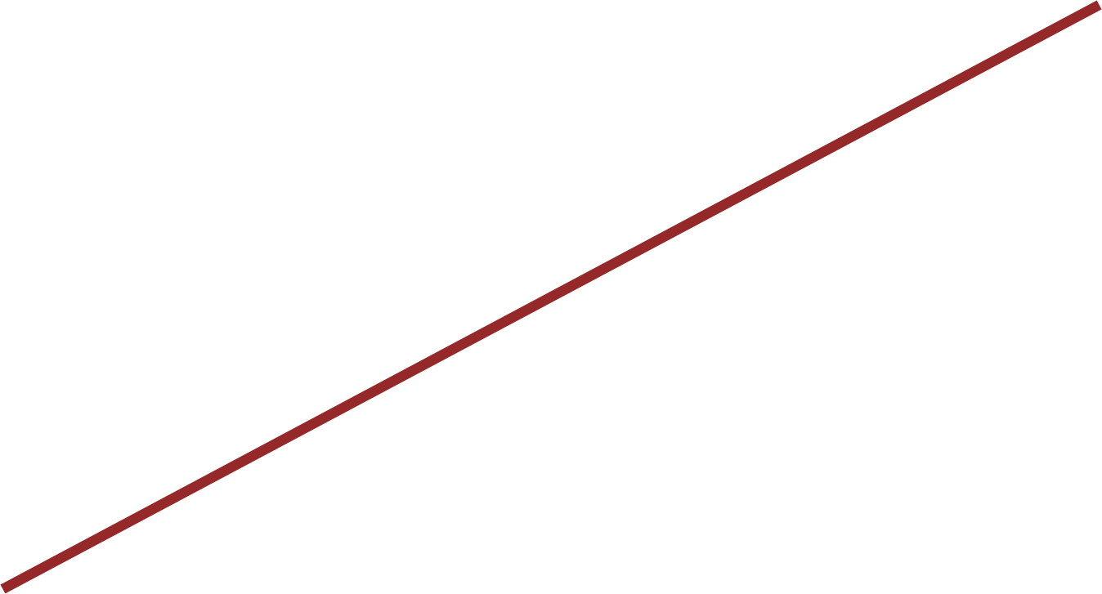
Sample Regression Line (Figure 4.2)
S
Sales (dollars)
70,000
S_{i} = 60,000
Sample regression line Ŝ_{i} = 11,573 + 4.9719A
60,000
•
•
e_{i}
50,000
•
40,000
Ŝ_{i} = 46,376
30,000
•
•
•
20,000
•
10,000
A
0
2,000
4,000
6,000
8,000
10,000
Advertising expenditures (dollars)

Slide 7
Unbiased Estimators
The distribution of values the estimates might take is centered around the true value of the parameter
The estimates â & do not generally equal
the true values of a & b
â & are random variables computed using
data from a random sample

Slide 8
Unbiased Estimators
An estimator is unbiased if its average value (or expected value) is equal to the true value of the parameter

Slide 9
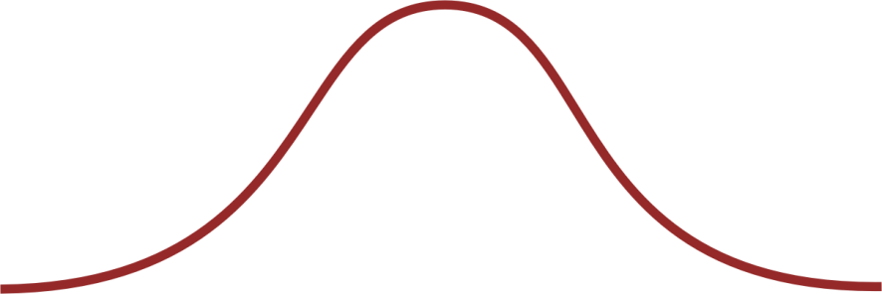
Relative Frequency Distribution* (Figure 4.3)
1
0
1
2
3
4
5
6
7
8
9
10
*Also called a probability density function (pdf)

Slide 10
Statistical Significance
Must determine if there is sufficient statistical evidence to indicate that Y is truly related to X (i.e., b ≠ 0)
Even if b = 0, it is possible that the sample will produce an estimate that is different from zero
Test for statistical significance using t-tests or p-values

Slide 11
Performing a t-Test
First determine the level of significance
  Probability of finding a parameter estimate to be statistically different from zero when, in fact, it is zero
  Probability of a Type I Error
1 – level of significance = level of confidence

Slide 12
Performing a t-Test
Use t-table to choose critical t-value with n – k degrees of freedom for the chosen level of significance
  n = number of observations
  k = number of parameters estimated
t-ratio is computed as

Slide 13
Performing a t-Test
If the absolute value of t-ratio is greater than the critical t, the parameter estimate is statistically significant at the given level of significance

Slide 14
Using p-Values
Treat as statistically significant only those parameter estimates with p-values smaller than the maximum acceptable significance level
p-value gives exact level of significance
  Also the probability of finding significance when none exists

Slide 15
Coefficient of Determination
R² measures the percentage of total variation in the dependent variable (Y) that is explained by the regression equation
  Ranges from 0 to 1
  High R² indicates Y and X are highly correlated

Slide 16
F-Test
Used to test for significance of overall regression equation
Compare F-statistic to critical F-value from F-table
  Two degrees of freedom, n – k & k – 1
  Level of significance

Slide 17
F-Test
If F-statistic exceeds the critical F, the regression equation overall is statistically significant at the specified level of significance

Slide 18
Multiple Regression
Uses more than one explanatory variable
Coefficient for each explanatory variable measures the change in the dependent variable associated with a one-unit change in that explanatory variable, all else constant

Slide 19
Quadratic Regression Models
Use when curve fitting scatter plot is U-shaped or ∩-shaped
Y = a + bX + cX²
  For linear transformation compute new variable Z = X²
  Estimate Y = a + bX + cZ

Slide 20
Log-Linear Regression Models
Use when relation takes the form: Y = aX^{b}Z^{c}
Percentage change in Y
Percentage change in X
b =
Percentage change in Y
Percentage change in Z
c =
Transform by taking natural logarithms:
b and c are elasticities

