Slide 1
Chapter 6: Elasticity and Demand
McGraw-Hill/Irwin
Copyright © 2011 by the McGraw-Hill Companies, Inc. All rights reserved.

Slide 2

Elasticity
Issue: How responsive is the demand for goods and services to changes in prices, ceteris paribus. The concept of price elasticity of demand is useful here.

Slide 3
Price elasticity of demand
Let price elasticity of demand (E_{P}) be given by:
% change in Q
E_{P} =
% change in P
[1]

Slide 4
Price
A
240
B
235
P = 290 – Q/2
0
100
110
Output
Question: What is E_{P} in the range of demand curve between prices of $240 to $235? To find out:
Meaning, a 1% increase in prices will result in a 4.8% decrease in quantity-demanded (and vice-versa).

Slide 5

Point elasticity
In our previous example we computed the elasticity for a certain segment of the demand curve (point A to B). For purposes of marginal analysis, we are interested in point elasticity—meaning, elasticity when the change in price in infinitesimally small.

Slide 6

Formula for point elasticity
[2]
Here we are calculating the responsiveness of sales to a change in price at a point on the demand curve—that is, a defined price-quantity point .

Slide 7
Arc elasticity
To compute arc elasticity, or “average” elasticity between two price-quantity points on the demand curve:
Note the advantage of arc elasticity—that is, it matters not what the initial price is (say, $240 or $235), our calculation of E_{P} does not change.

Slide 8
Price Elasticity of Demand (E)
Table 6.1
Elasticity | Responsiveness | ⏐E⏐
Elastic
Unitary Elastic
Inelastic
⏐%∆Q⏐> ⏐%∆P⏐
⏐E⏐> 1
⏐%∆Q⏐= ⏐%∆P⏐
⏐E⏐= 1
⏐%∆Q⏐< ⏐%∆P⏐
⏐E⏐< 1

Slide 9
Factors Affecting Price Elasticity of Demand
Availability of substitutes
  The better & more numerous the substitutes for a good, the more elastic is demand
Percentage of consumer’s budget
  The greater the percentage of the consumer’s budget spent on the good, the more elastic is demand
Time period of adjustment
  The longer the time period consumers have to adjust to price changes, the more elastic is demand

Slide 10
Perfectly inelastic demand
P
r
i
c
e
$
1
0
0
Buyers are absolutely non-responsive to a change in price
9
0
8
0
7
0
E
=
0
6
P
0
5
0
4
0
3
0
2
0
1
0
0
5
0
1
0
0
1
5
0
2
0
0
2
5
0
Q
u
a
n
t
i
t
y
Notes:
2
2

Slide 11
Perfectly elastic demand
In this case, if the price rises a penny above $5, quantity-demanded falls to zero.
P
r
i
c
e
$
1
0
9
8
7
6
E
=
- infinity
P
5
4
3
2
1
0
5
0
1
0
0
1
5
0
2
0
0
2
5
0
Q
u
a
n
t
i
t
y
(
b
)
P
e
r
f
e
c
t
l
y
E
l
a
s
t
i
c
D
e
m
a
n
d
Notes:
3

Slide 12
Price Elasticity Changes Along a Linear Demand Curve
P
Demand tends to be elastic at higher prices and inelastic at lower prices
r
i
c
e
$
4
0
0
D
e
m
a
n
d
i
s
p
r
i
c
e
e
l
a
s
t
i
c
A
3
0
0
E
l
a
s
t
i
c
i
t
y
=
-1
M
2
0
0
D
e
m
a
n
d
i
s
p
r
i
c
e
i
n
e
l
a
s
t
i
c
M
a
r
g
i
n
a
l
r
e
v
e
n
u
e
B
1
0
0
M
R
=
4
0
0
-
.
5
Q
P
=
4
0
0
-
.
2
5
Q
0
4
0
0
8
0
0
1
,
2
0
0
1
,
6
0
0
Q
u
a
n
t
i
t
y
D
e
m
a
n
d
e
d
(
a
)
Notes:
4
3

Slide 13
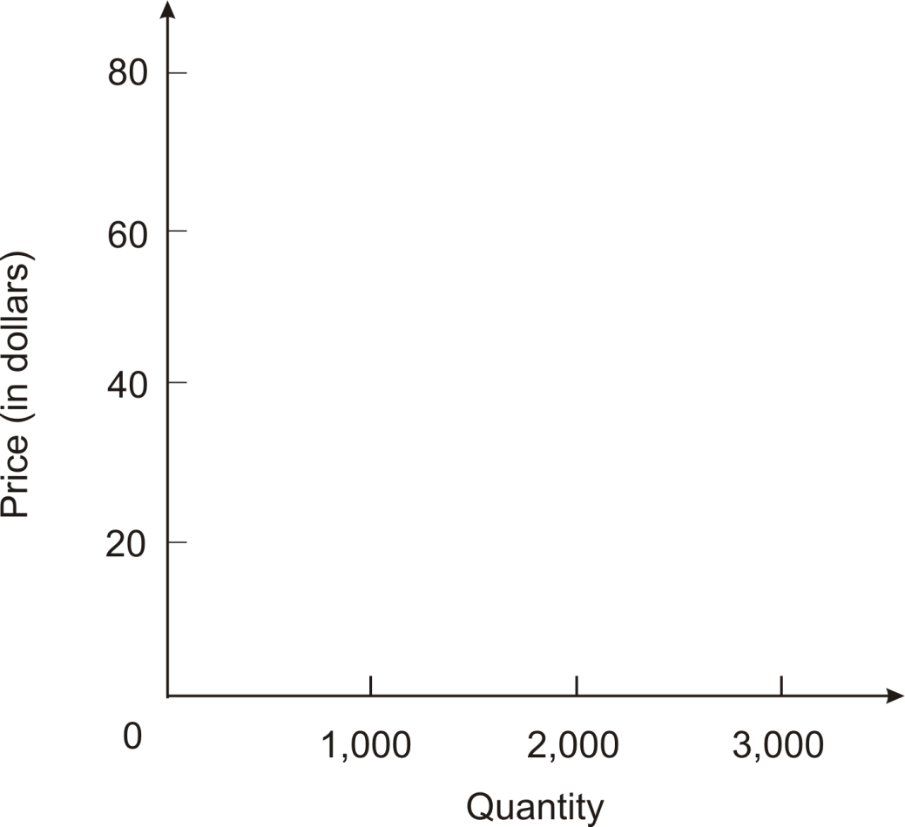
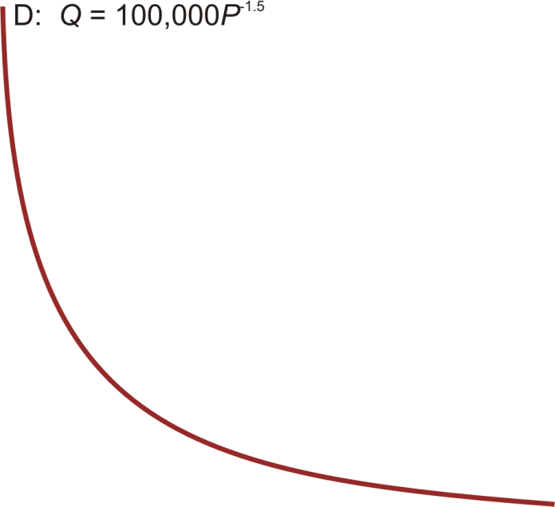
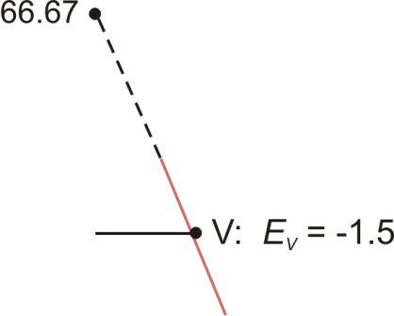
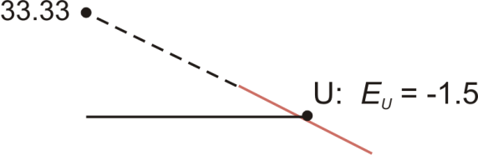
Constant Elasticity of Demand (Figure 6.3)

Slide 14
Check Station
Prove that price elasticity is unity at point M
Therefore :

Slide 15
Income Elasticity
Income elasticity (E_{M}) measures the responsiveness of quantity demanded to changes in income, holding the price of the good & all other demand determinants constant
  Positive for a normal good
  Negative for an inferior good

Slide 16

Cross price elasticity of demand
How sensitive is the demand for rental cars to airline fares?
How does the demand for apples respond to a change in the price of oranges?
Will a strong dollar hurt tourism in Florida?
Cross price elasticity gives us a measure of the responsiveness of demand to the price of complements or substitutes

Slide 17
Cross-Price Elasticity
Cross-price elasticity (E_{XR}) measures the responsiveness of quantity demanded of good X to changes in the price of related good R, holding the price of good X & all other demand determinants for good X constant
  Positive when the two goods are substitutes
  Negative when the two goods are complements

Slide 18

Revenue rule
Revenue rule: When demand is elastic, price and revenue move inversely. When demand is inelastic, price and revenue move together.
As price falls along the elastic portion of the demand curve (price above $200), revenue will increase; whereas as price falls along the inelastic portion (below $200), revenue will decrease

Slide 19
Marginal Revenue
Marginal revenue (MR) is the change in total revenue per unit change in output
Since MR measures the rate of change in total revenue as quantity changes, MR is the slope of the total revenue (TR) curve

Slide 20
Demand & Marginal Revenue (Table 6.3)
Unit sales (Q) | Price | TR = P × Q | MR = ΔTR/ΔQ
0 | $4.50
1 | 4.00
2 | 3.50
3 | 3.10
4 | 2.80
5 | 2.40
6 | 2.00
7 | 1.50
$ 0
--
$4.00
$4.00
$7.00
$3.00
$9.30
$2.30
$11.20
$1.90
$12.00
$0.80
$12.00
$0
$10.50
$-1.50

Slide 21
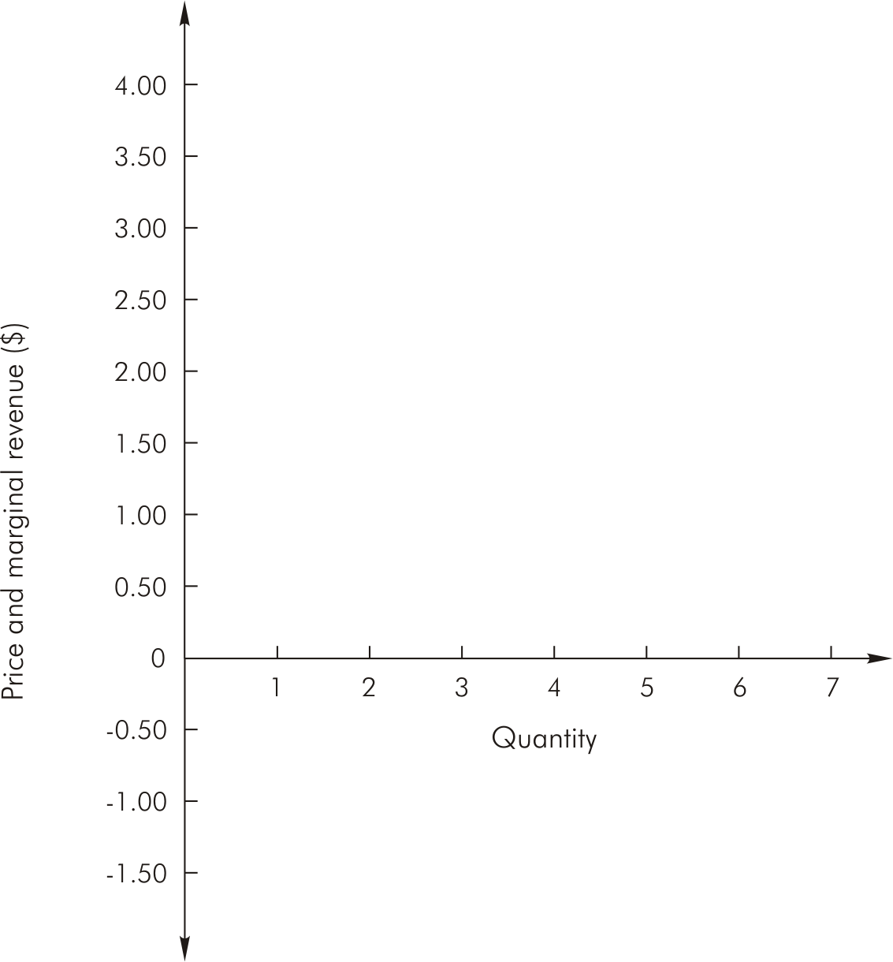
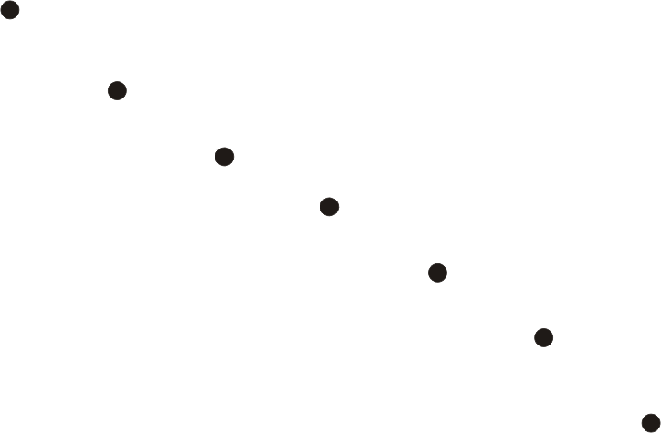
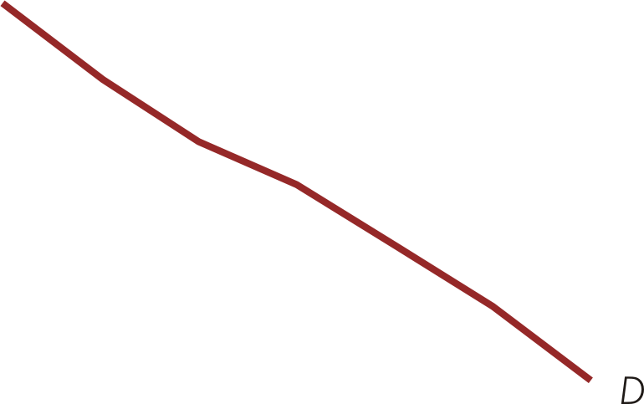
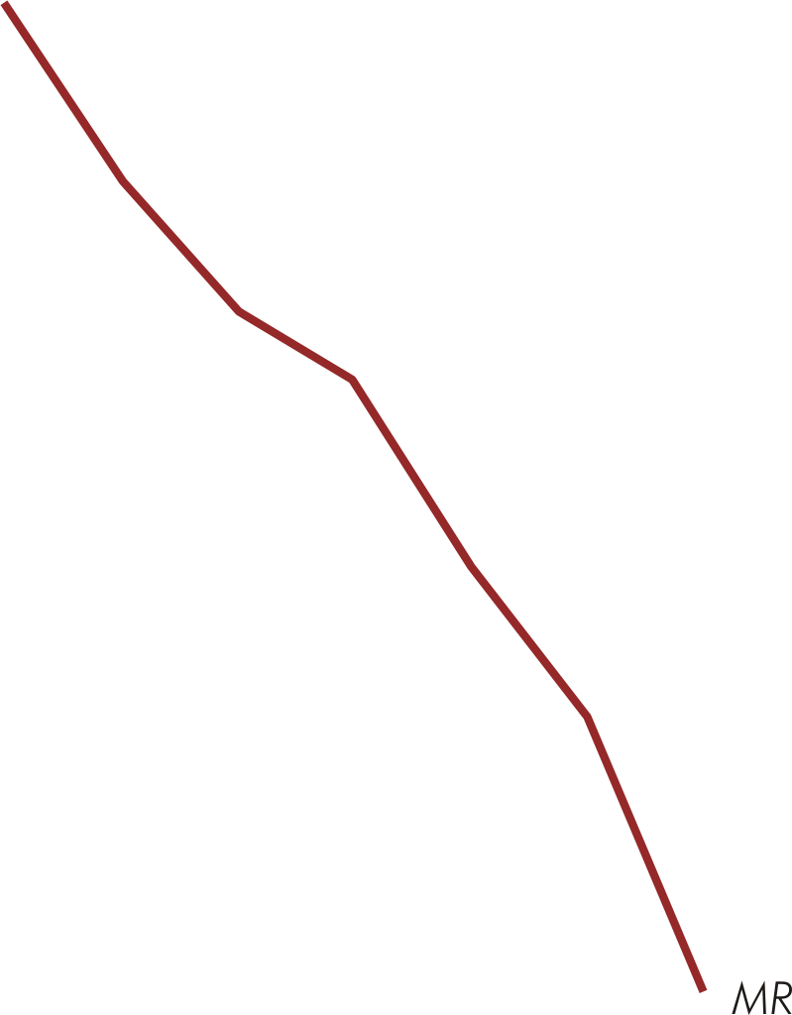
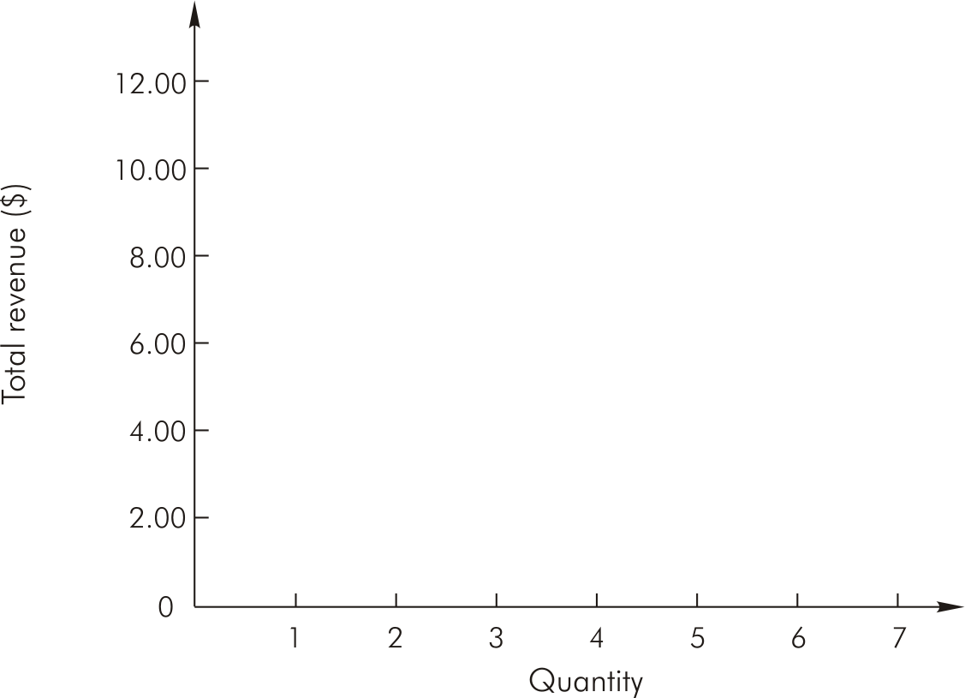
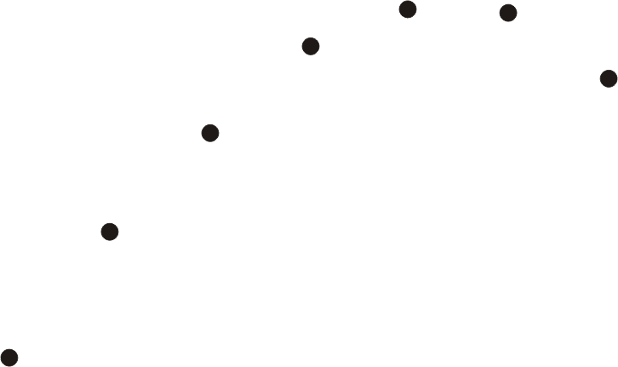
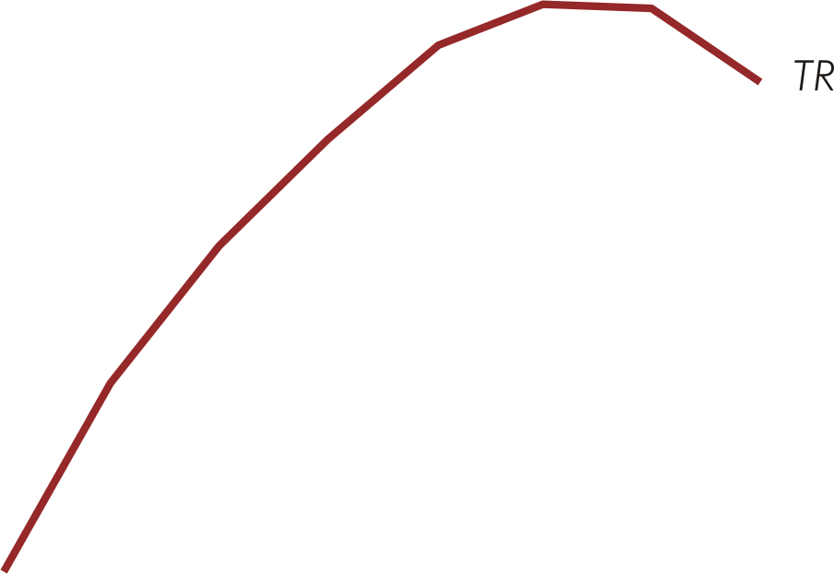
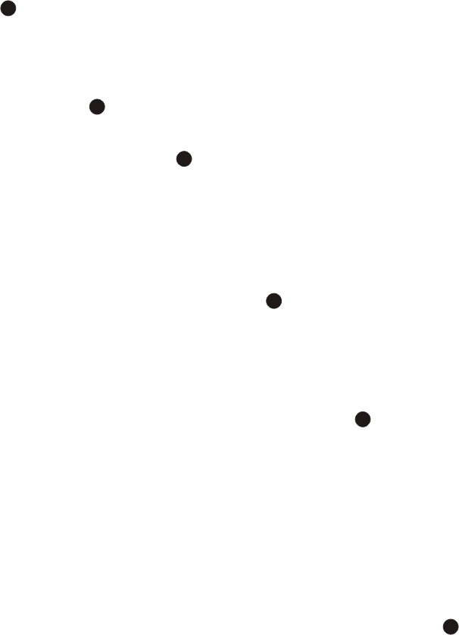
Demand, MR, & TR (Figure 6.4)
Panel A
Panel B

Slide 22
Demand & Marginal Revenue
When inverse demand is linear,
P = A + BQ (A > 0, B < 0)
  Marginal revenue is also linear, intersects the vertical (price) axis at the same point as demand, & is twice as steep as demand
  MR = A + 2BQ

Slide 23
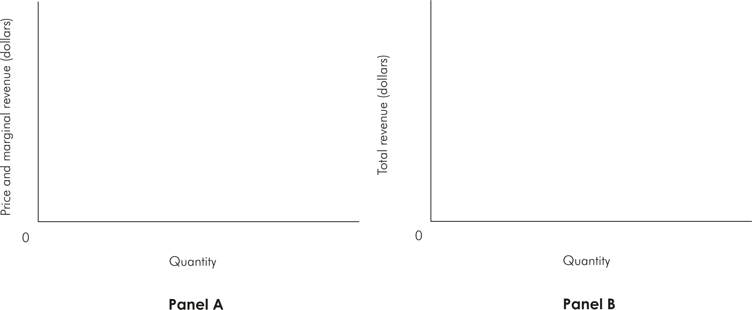




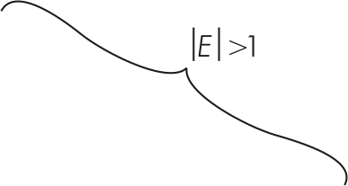
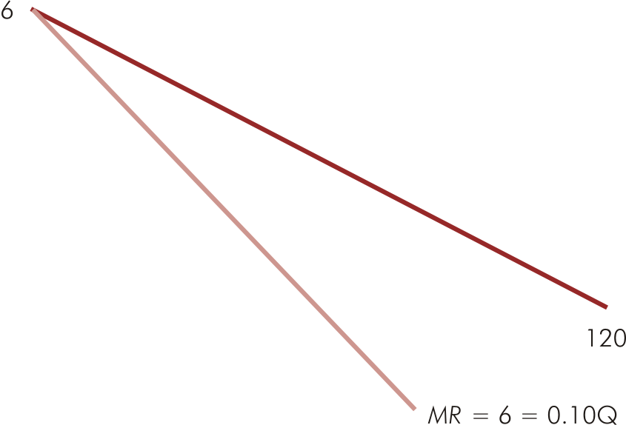
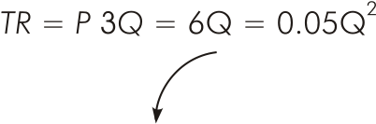

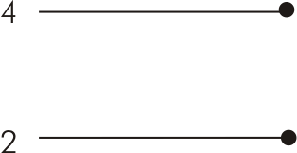
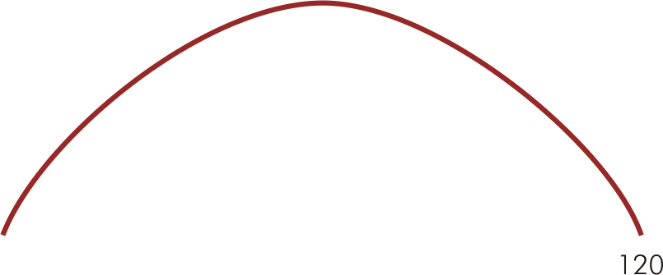

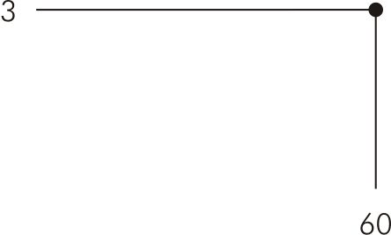
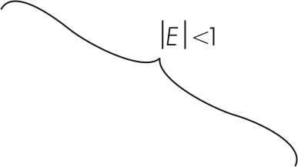
Linear Demand, MR, & Elasticity (Figure 6.5)

Slide 24
Marginal Revenue & Price Elasticity
For all demand & marginal revenue curves, the relation between marginal revenue, price, & elasticity can be expressed as

Slide 25
Notice the Marginal Revenue (MR) function dips below the horizontal axis at Q = 800.
R
e
v
e
n
u
e
$
1
6
0
,
0
0
0
1
2
0
,
0
0
0
T
o
t
a
l
r
e
v
e
n
u
e
R
=
4
2
0
0
Q
-
.
2
5
Q
0
4
0
0
8
0
0
1
,
2
0
0
Q
u
a
n
t
i
t
y
D
e
m
a
n
d
e
d
(
b
)
Notes:
5

Slide 26
Price Elasticity & Total Revenue
Table 6.2
 | Elastic Quantity-effect dominates | Unitary elastic No dominant effect | Inelastic Price-effect dominates
Price rises
Price falls
⏐%∆Q⏐> ⏐%∆P⏐
⏐%∆Q⏐= ⏐%∆P⏐
⏐%∆Q⏐< ⏐%∆P⏐
TR falls
No change in TR
TR rises
TR rises
No change in TR
TR falls

Slide 27
Check Station
The management of a professional sports team has a 36,000-seat stadium it wishes to fill. It recognizes, however, that the number of seats sold (Q) is very sensitive to ticket prices (P). It estimates demand to be Q = 60,000 - 3,000P. Assuming the team’s costs are known and do not vary with attendance, what is the management’s optimal pricing policy?

Slide 28
Notice the inverse demand function is given by:
Since variable cost (and hence marginal cost) is zero, maximizing profits means maximizing revenue.
The revenue function is given by:

