Slide 1
Fiscal Policy, Deficits, and Debt
13
McGraw-Hill/Irwin
Copyright © 2012 by The McGraw-Hill Companies, Inc. All rights reserved.
Notes:
This chapter explores the tools of government stabilization policy in terms of the aggregate demand-aggregate supply (AD-AS) model. Next, this chapter examines fiscal policy measures that automatically adjust government expenditures and tax revenues when the economy moves through the business cycle phases. The recent use and resurgence of fiscal policy as a tool is discussed, as are problems, criticisms, and complications of fiscal policy.
The material on the public debt discusses two false concerns associated with a large public debt: (1) the debt will force the U.S. into bankruptcy; and (2) the debt imposes a burden on future generations. The debt discussion, however, also entails a look at substantive economic issues. Potential problems of a large public debt include greater income inequality, reduced economic incentives, and crowding out of private investment.
The last word examines social security and Medicare shortfalls.

Slide 2

Fiscal Policy
The use of the taxing and spending powers of government to regulate aggregate expenditure, and thereby to stabilize the economy
The economy needs to be stabilized. The economy can be stabilized. The economy should be stabilized. This is the Keynesian view

Slide 3

Employment Act of 1946
This legislation established a responsibility for the federal government to promote “maximum employment, production, and purchasing power.”

Slide 4
Fiscal Policy
Deliberate changes in:
  Government spending
  Taxes
Designed to:
  Achieve full-employment
  Control inflation
  Encourage economic growth
LO1
13-4
Notes:
Discretionary fiscal policy refers to the deliberate manipulation of taxes and government spending by Congress to alter real domestic output and employment, control inflation, and stimulate economic growth. “Discretionary” means the changes are at the option of the Federal government. Discretionary fiscal policy changes are often initiated by the President, on the advice of the Council of Economic Advisers (CEA). You can find information on the CEA at http://whitehouse.gov; they are found under “The Administration” tab, in the “Executive Office of the President” section.

Slide 5
Expansionary Fiscal Policy
Use during a recession
  Increase government spending
  Decrease taxes
  Combination of both
  Create a deficit
LO1
13-5
Notes:
Expansionary fiscal policy is used to combat a recession. The problem during a recession is that aggregate demand is too low, so increasing government spending and/or a reduction in taxes will increase aggregate demand. Expansionary fiscal policy will create a deficit.

Slide 6
Policy Options: G or T?
To expand the size of government
  If recession, then increase government spending
  If inflation, then increase taxes
To reduce the size of government
  If recession, then decrease taxes
  If inflation, then decrease government spending
LO1
13-6
Notes:
Economists tend to favor higher G during recessions and higher taxes during inflationary times if they are concerned about unmet social needs or infrastructure. Both actions either expand or preserve the size of government.
Others tend to favor lower T for recessions and lower G during inflationary periods when they think government is too large and inefficient. Both of these actions either restrain the growth of government or reduce taxes.

Slide 7

Expansionary Fiscal Policy
$5 billion
increase in
spending
Recessions
Decrease AD
AS
Full $20 billion
increase in
aggregate demand
Price level
P₁
AD₁
AD₂
$490
$510
Real GDP (billions)
LO1
13-7
Notes:
This figure shows the expansionary fiscal policy. Expansionary fiscal policy uses increases in government spending or tax cuts to push the economy out of recession. In an economy with a MPC of .75, a $5 billion increase in government spending, or a $6.67 billion decrease in personal taxes (producing a $5 billion initial increase in consumption), expands aggregate demand from AD₂ to the downsloping dashed curve. The multiplier then magnifies this initial increase in spending to AD₁. So real GDP rises along the horizontal axis by $20 billion.

Slide 8
Contractionary Fiscal Policy
Use during demand-pull inflation
  Decrease government spending
  Increase taxes
  Combination of both
  Create a surplus
LO1
13-8
Notes:
When demand-pull inflation occurs, contractionary policy is the remedy. The problem with inflation is that aggregate demand is too high so the government will decrease government spending and/or increase taxes to cause aggregate demand to fall. When the government uses contractionary fiscal policy, it will create a surplus.

Slide 9
Contractionary Fiscal Policy
$3 billion initial
decrease in
spending
AS
Price level
P₂
d
c
b
Full $12 billion
decrease in
aggregate demand
P₁
a
AD₄
AD₅
AD₃
$502
$510
$522
Real GDP (billions)
LO1
13-9
Notes:
This figure shows the effects of contractionary fiscal policy.
Contractionary fiscal policy uses decreases in government spending, increases in taxes, or both, to reduce demand-pull inflation. Here, an increase in aggregate demand from AD₃ to AD₄ has driven the economy to point b and ratcheted the price level up to P₂, where it becomes inflexible downward. If the economy’s MPC is .75 and the multiplier therefore is 4, the government can either reduce its spending by $3 billion or increase its taxes by $4 billion (which will decrease consumption by $3 billion) to eliminate the inflationary GDP gap of $12 billion (= $522 billion - $510 billion). Aggregate demand will shift leftward, first from AD₄ to the dashed downsloping curve to its left, and then to AD₅. With the price level remaining at P₂, the economy will move from point b to point c and the inflationary GDP gap will disappear.

Slide 10
Discretionary versus
non-discretionary spending
Discretionary fiscal policy is the deliberate manipulation of government purchases, taxation, and transfer payments to pursue macroeconomic goals such as full employment and price stability.
The Bush tax stimulus package of 2008 and the Obama stimulus package of 2009 are examples of discretionary fiscal policy

Slide 12
Automatic stabilizers
Non-discretionary or “built-in” features of government spending and taxation that reduce fluctuations in disposable income, and thus consumption, over the business cycle.
Tax rates for various types of income are set by elected officials. Tax collections depend on the employment levels/incomes, profits, capital gains, retails sales, . . .
Elected officials establish eligibility requirements and support levels for needs-tested transfer payments—e.g., TANF, food stamps, and unemployment compensation. Actual government outlays for needs-tested transfer payments depend on (1) the number of persons eligible; and (2) the number of those eligible that actually file claims.

Slide 13

As the economy enters a recession, federal revenues tend to decline while at the same time transfer payments rise. Thus recession brings about an automatic decline of net taxes (NT)
Remember that: DI = Y - NT

Slide 14
Built-In Stability
Automatic stabilizers
  Taxes vary directly with GDP
  Transfers vary inversely with GDP
Reduces severity of business fluctuations
Tax progressivity
  Progressive tax system
  Proportional tax system
  Regressive tax system
LO2
13-14
Notes:
Built-in stability arises because net taxes change with GDP (recall that taxes reduce incomes and therefore, spending). It is desirable for spending to rise when the economy is slumping and vice versa when the economy is becoming inflationary. Automatic stability reduces instability, but does not eliminate economic instability.
Tax revenues vary directly with GDP; income, sales, excise, and payroll taxes all increase when the economy is expanding and all decrease when the economy is contracting.
Transfer payments like unemployment compensation and welfare payments vary indirectly with the economic business cycles. Unemployment compensation and welfare payments decrease during economic expansion. Unemployment compensation and welfare payments increase during economic contractions.
The size of automatic stability depends on the responsiveness of changes in taxes to changes in GDP: The more progressive the tax system, the greater the economy’s built-in stability.
A progressive tax system means the average tax rate rises with GDP.
A proportional tax system means the average tax rate remains constant as GDP rises.
A regressive tax system means the average tax rate falls as GDP rises.
However, tax revenues will rise with GDP under both the progressive and the proportional tax systems, and they may rise, fall, or stay the same under a regressive tax system.

Slide 15
Built-In Stability
T
Surplus
Government expenditures, G,
and tax revenues, T
G
Deficit
GDP₁
GDP₂
GDP₃
Real domestic output, GDP
LO2
13-15
Notes:
This figure shows built-in stability. Tax revenues, T, vary directly with GDP, and government spending, G, is assumed to be independent of GDP. As GDP falls in a recession, deficits occur automatically and help alleviate the recession. As GDP rises during expansion, surpluses occur automatically and help offset possible inflation.

Slide 16
Evaluating Fiscal Policy
Is the fiscal policy…
  Expansionary?
  Neutral?
  Contractionary?
Use the cyclically adjusted budget to evaluate
LO3
13-16
Notes:
Another name for the cyclically adjusted budget is the full-employment budget. The cyclically adjusted budget measures what the Federal budget deficit or surplus would be with existing taxes and government spending if the economy is at full-employment. Fiscal policy is neutral when the tax revenues equal government expenditures after adjusting for the reduction in revenues from a recession. The cyclically adjusted budget deficit is zero in year 1 and year 2.
Fiscal policy is expansionary when the cyclically adjusted budget deficit is zero one year and there is a deficit the next.
Fiscal policy is contractionary when the cyclically adjusted budget deficit is zero one year and is followed by a cyclically adjusted budget surplus the next year.
See the next two slides for graphs.

Slide 17
Cyclically Adjusted Budgets
T
b
a
Government expenditures, G, and
tax revenues, T (billions)
G
$500
450
c
GDP₂
GDP₁
(year 2)
(year 1)
Real domestic output, GDP
LO3
13-17
Notes:
This figure shows the cyclically adjusted deficits in this graph. The cyclically adjusted deficit is zero at the full-employment output GDP₁. But it is also zero at the recessionary output GDP₂ because the $500 billion of government expenditures at GDP₂ equals the $500 billion of tax revenues that would be forthcoming at the full-employment GDP₁. There has been no change in fiscal policy.

Slide 18
Cyclically Adjusted Budgets
T₁
T₂
e
d
Government expenditures, G, and
tax revenues, T (billions)
G
$500
475
h
450
f
425
g
GDP₄
GDP₃
(year 4)
(year 3)
Real domestic output, GDP
LO3
13-18
Notes:
This figure shows cyclically adjusted deficits in this graph. Discretionary fiscal policy, as reflected in the downward shift of the tax line from T₁ to T₂, has increased the cyclically adjusted budget deficit from zero in year 3 (before the tax cut) to $25 billion in year 4 (after the tax cut). This is found by comparing the $500 billion of government spending in year 4 with the $475 billion of taxes that would accrue at the full-employment GDP₃. Such a rise in the cyclically adjusted deficit (as a percentage of potential GDP) identifies an expansionary fiscal policy.

Slide 19
Recent U.S. Fiscal Policy
Federal Deficits (-) and Surpluses (+) as Percentages of GDP, 2000-2009
(1) Year | (2) Actual Deficit – or Surplus + | (3) Cyclically Adjusted Deficit – or Surplus +*
2000 | +2.4 | +1.1
2001 | +1.3 | +0.5
2002 | -1.5 | -1.3
2003 | -3.4 | -2.7
2004 | -3.5 | -3.2
2005 | -2.6 | -2.5
2006 | -1.9 | -2.0
2007 | -1.2 | -1.2
2008 | -3.2 | -2.8
2009 | -9.9 | -7.3
As a percentage of potential GDP
Source: Congressional Budget Office, http://www.cbo.gov.
LO3
13-19
Notes:
This table shows Federal deficits (-) and surpluses (+) as percentages of GDP, 2000–2009. Observe that the cyclically adjusted deficits are generally smaller than the actual deficits. This is because the actual deficits include cyclical deficits, whereas the cyclically adjusted deficits eliminate them. The expansionary fiscal policy of the early 1990s became contractionary from 1999 to 2001. In 2002 President Bush passed tax cuts and increased unemployment benefits, thereby increasing the cyclically adjusted deficit. The 2003 Bush tax cut increased the standardized budget deficit as a percentage of potential GDP. Federal budget deficits are expected to persist for many years to come.

Slide 20
Principles of Taxation
Horizontal equity: Tax code should be written so that those in the same economic circumstances pay the same amount in taxes.
Vertical equity: Tax code should be written so that those in different economic circumstances should pay an unequal amount in taxes.
Benefits received principle: Those who derive more benefits from government programs should pay more taxes.

Slide 21
Definitions
Taxable income: Gross income - income exempt from taxes. Example: For single filers who use the 1040EZ:
Average tax rate (ATR): Tax payments as a percent of taxable income.
Marginal tax rate (MTR): The tax rate applied to the last dollar of taxable income.

Slide 22
Definitions, continued
Progressive tax: The proportion of taxable income taken in taxes increases as taxable income increases.
Regressive tax: The proportion of taxable income taken in taxes decreases as taxable income increases.
Proportional tax: The proportion of taxable income taken in taxes remains constant as taxable income increases.

Slide 23
Needy
Affluent
The tax code is a tool
for income redistribution
By making the tax structure “progressive,” governments can make the after-tax distribution of income more equitable (or even).

Slide 24
Federal personal Income Tax rates Under the
1993 Tax Reform Act
(Married couple filing jointly)

Slide 25
Average and Marginal Tax Rates under the Tax Reform Act of 1993 (for a couple with 2 children)

Slide 26
Tax Brackets for 2003 under the 2001 Tax Reform Act
2003 Taxable Income | Marginal Tax Rate
$0-$12,000 | 10.0%
$12,000-$47,500 | 15.0
$47,500-$114,650 | 27.0
$114,650-$174,700 | 30.0
$174,700-$311,950 | 35.0
Over $311,950 | 38.6
Source : Wall Street Journal

Slide 27
Quick Facts about President Bush’s Tax Bill
The 39.6% tax rate reduced to 33%
The 36% tax rate reduced to 33%
The 31% rate reduced to 25%
The 28% rate reduced to 25%
The current 15% bracket is retained over most of its range
A new 10% bracket applies to the lowest ¼ of 15% range.
Maximum rate on capital gains reduced from 28 to 15 percent.
President Bush comments (wav)

Slide 28
Laffer Curve
Supply-Sider View:
High marginal tax rates create a disincentive to work and investment
If marginal tax rate is above t*, reducing it can actually lead to an increase in government tax revenues.
“Effort-releasing” effect of lower marginal rates.
Marginal Tax Rate
t*
0
R*
Tax Revenue (Billions)

Slide 29
Fiscal Policy: The Great Recession
Financial market problems began in 2007
Credit market freeze
Pessimism spreads to the overall economy
Recession officially began December 2007 and lasted 18 months
LO4
13-29
Notes:
In 2008 Congress passed an economic stimulus package of $152 billion consisting of checks to taxpayers, veterans, and social security recipients and some tax breaks for businesses. This package didn’t work to stimulate the economy as hoped. So in 2009, the American Recovery and Reinvestment Act was enacted and consisted of $787 billion of tax rebates and large amounts of government expenditures. This came after the government spent $700 billion for financial institutions in the TARP.

Slide 30
Budget Deficits and Projections
Actual
Projected
(as of March 2010)
$200
0
-200
-400
-600
-800
-1000
-1200
-1400
-1600
Budget Deficit (-) or Surplus, Billions
1994
1996
1998
2000
2002
2004
2006
2008
2010
2012
2014
Source: Congressional Budget Office, http://www.cbo.gov.
LO4
13-30
Notes:
This figure shows Federal budget deficits and surpluses, actual and projected, for fiscal years 1994-2014 (in billions of nominal dollars).

Slide 32
Global Perspective
LO4
13-32
Notes:
The Global Perspective shows cyclically adjusted budget deficits or surpluses as a percentage of potential GDP for selected nations. Because of the global recession, in 2009 all but a few of the world’s major nations had cyclically adjusted budget deficits. These deficits varied as percentages of potential GDP, but they each reflected some degree of expansionary fiscal policy.

Slide 33
Problems, Criticisms, & Complications
Problems of Timing
  Recognition lag
  Administrative lag
  Operational lag
Political business cycles
Future policy reversals
Off-setting state and local finance
Crowding-out effect
LO4
13-33
Notes:
Recognition lag is the elapsed time between the beginning of a recession or inflation and awareness of this occurrence. Administrative lag is the difficulty in changing policy once the problem has been recognized. Operational lag is the time elapsed between the change in policy and its impact on the economy.
A political business cycle may destabilize the economy: Election years have been characterized by more expansionary policies regardless of economic conditions.
Households may believe that the tax reduction is temporary and save a large portion of their tax cut, reducing the magnitude of the effect desired by policy makers.
State and local finance policies may offset federal stabilization policies. They are often procyclical because balanced-budget requirements cause states and local governments to raise taxes in a recession or cut spending making the recession possibly worse. In an inflationary period, they may increase spending or cut taxes as their budgets head for a surplus.
“Crowding‑out” may occur with government deficit spending. It may increase the interest rate and reduce private spending which weakens or cancels the stimulus of fiscal policy.

Slide 34
Current Thinking on Fiscal Policy
Let the Federal Reserve handle short-term fluctuations
Fiscal policy should be evaluated in terms of long-term effects
Use tax cuts to enhance work effort, investment, and innovation
Use government spending on public capital projects
LO4
13-34
Notes:
Some economists oppose the use of fiscal policy, believing that monetary policy is more effective, or that the economy is sufficiently self-correcting.
Most economists support the use of fiscal policy to help “push the economy” in a desired direction, and the use of monetary policy more for “fine tuning.”
Economists agree that the potential impacts (positive and negative) of fiscal policy on long-term productivity growth should be evaluated and considered in the decision-making process, along with the short-run cyclical effects.

Slide 35
The U.S. Public Debt
$11.9 trillion in 2009
  The accumulation of years of federal deficits and surpluses
Owed to the holders of U.S. securities
  Treasury bills
  Treasury notes
  Treasury bonds
  U.S. savings bonds
LO4
13-35
Notes:
The national or public debt is the total accumulation of the Federal government’s total deficits and surpluses that have occurred through time. Deficits (and by extension the debt) are the result of war financing, recessions, and lack of political will to reduce or avoid them.
Treasury bills are short-term securities.
Treasury notes are medium-term securities.
Treasury bonds are long-term securities.
U.S. savings bonds are long-term, non-marketable securities.

Slide 36
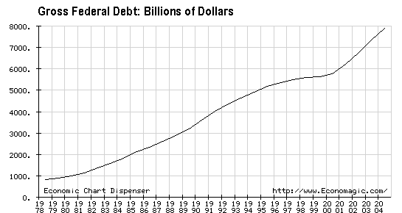
For updated information, check the National Debt Clock

Slide 37
Is a large national debt a bad thing?
Arguments against a large national debt include:
The “burden on future generations” argument.
A large national debt means that a significant share of federal spending must be allocated for interest payments—leaving less for other priorities.
A large national debt makes the U.S. too dependent on foreign financial inflows.
Federal borrowing “crowds out” private sector borrowing units—i.e., firms and households.

Slide 38
“[W]e (the U.S.) owe $5.7 trillion in debt and if we don’t pay it off, our children and our grandchildren are going to have to.”
Congressman Marion Berry, in a speech to the Jonesboro Lions Club on April 16, 2001.

Slide 39
Interest payments as a Percent of Federal Expenditures (Annual)
www.economagic.com

Slide 40
Hall & Liberman Rule-of-Thumb
As long as the debt grows by the same percentage as nominal GDP, the ratios of debt to GDP will remain constant. In this case, the government can continue to pay interest on its rising debt without increasing the average tax rate in the economy.

Slide 41
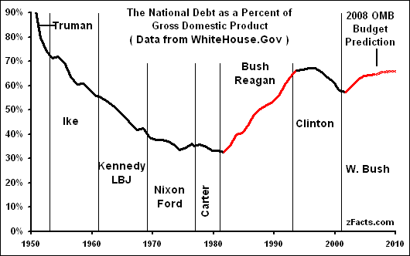
Click image below to enlarge.
National Debt Graph (2007 Budget data)

Slide 42
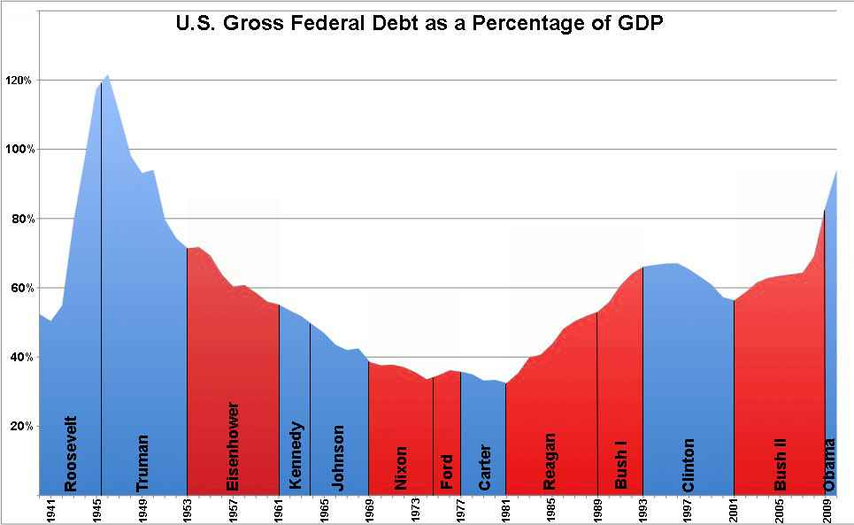

Slide 43
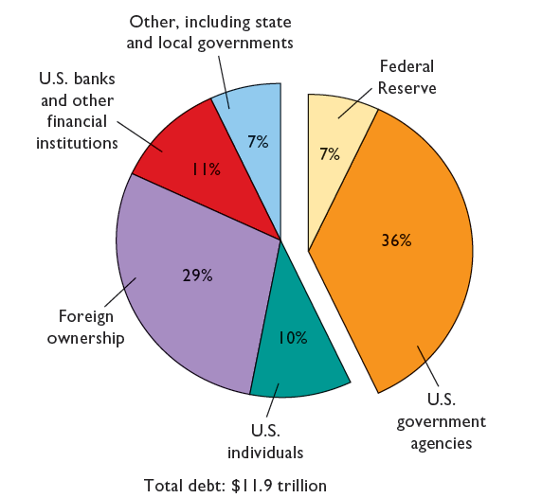
The U.S. Public Debt
Debt held outside
the Federal
government and the
Federal Reserve:
57%
Debt held by
the Federal
government and the
Federal Reserve:
43%
LO4
13-43
Notes:
This figure shows the ownership of the total public debt, 2009.

Slide 44
The U.S. Public Debt
Interest charges on debt
  Largest burden of the debt
  1.3% of GDP in 2009
False Concerns
  Bankruptcy
    Refinancing
    Taxation
  Burdening future generations
LO4
13-44
Notes:
Interest charges are the main burden imposed by the debt because government always has to at least pay the interest on their debt in order to remain in good credit standing.
Can the federal government go bankrupt? There are reasons why it cannot.
The government can raise taxes to pay back the debt, and it can borrow more (i.e. sell new bonds) to refinance bonds when they mature. Corporations use similar methods—they almost always have outstanding debt. Of course, refinancing could become an issue with a high enough debt-to-GDP ratio. Some countries, such as Greece, have run into this problem. High and rising ratios in the United States might raise fears that the U.S. government might be unable to pay back loans as they come due. But, with the present U.S. debt-to-GDP ratio and the prospects of long-term economic growth, this is a false concern for the United States.
The government has the power to tax, which businesses and individuals do not have when they are in debt.
Does the debt impose a burden on future generations? In 2009 the per capita federal debt in U.S. was $37,437. But the public debt is a public credit—your grandmother may own the bonds on which taxpayers are paying interest. Some day you may inherit those bonds that are assets to those who have them. The true burden is borne by those who pay taxes or loan government money today to finance government spending. If the spending is for productive purposes, it will enhance future earning power and the size of the debt relative to future GDP and population could actually decline. Borrowing allows growth to occur when it is invested in productive capital.

Slide 45
Substantive Issues
Income distribution
Incentives
Foreign-owned public debt
Crowding-out effect revisited
  Future generations
  Public investment
LO4
13-45
Notes:
Repayment of the debt affects income distribution. If working taxpayers will be paying interest to the mainly wealthier groups who hold the bonds, this probably increases income inequality.
Since interest must be paid out of government revenues, a large debt and high interest can increase the tax burden and may decrease incentives to work, save, and invest for taxpayers.
A higher proportion of the debt is owed to foreigners (about 29 percent) than in the past, and this can increase the burden since payments leave the country. But Americans also own foreign bonds and this offsets the concern.
Some economists believe that public borrowing crowds out private investment, but the extent of this effect is not clear. See the next slide for the graph.
There are some positive aspects of borrowing even with crowding-out. If borrowing is for public investment that causes the economy to grow more in the future, the burden on future generations will be less than if the government had not borrowed for this purpose. Public investment makes private investment more attractive. For example, new federal buildings generate private business; good highways help private shipping, etc.

Slide 46
Crowding-Out Effect
16
14
Increase in
investment
demand
12
b
c
10
Real interest rate (percent)
8
a
6
Crowding-out
effect
4
2
ID₂
ID₁
0
5
10
15
20
25
30
35
40
Investment (billions of dollars)
LO4
13-46
Notes:
This figure shows the investment demand curve and the crowding-out effect. If the investment demand curve (ID₁) is fixed, the increase in the interest rate from 6 percent to 10 percent caused by financing a large public debt will move the economy from a to b, crowding out $10 billion of private investment, and decreasing the size of the capital stock inherited by future generations. However, if the public goods enabled by the debt improve the investment prospects of businesses, the private investment demand curve will shift rightward, as from ID₁ to ID₂. That shift may offset the crowding-out effect wholly or in part. In this case, it moves the economy from a to c.

Slide 47
Social Security, Medicare Shortfalls
More Americans will be receiving benefits as they age
Social security shortfalls
  Income during retirement
  Funds will be depleted by 2037
Medicare shortfalls
  Medical care during retirement
  Funds will be depleted by 2017
13-47
Notes:
Social Security is the major public retirement program in the United States. Half of the tax (6.2%) is paid by individuals and half is paid by employers (another 6.2%).
The Medicare program is the U.S. health care program for people age 65 and older in the United States. Half of the tax (1.45 %) is paid by individuals and half is paid by employers (another 1.45%).
There is an impending long-run shortfall in Social Security funding. It is a “pay-as-you-go” system, meaning that current revenues are used to pay current retirees (instead of paying from funds accumulated over time). Despite efforts to build a trust fund, eventually Social Security revenues will fall below payouts to retirees. Baby boomers are entering retirement age and living longer, meaning that there will be more recipients receiving payouts for longer periods of time.
The ratio of the number of workers contributing to the system for each recipient has declined.

Slide 48
Social Security, Medicare Shortfalls
Possible options “to fix” include:
  Increasing the retirement age
  Increasing the portion of earnings subject to the social security tax
  Disqualifying wealthy individuals
  Redirecting low-skilled immigrants to higher-skilled, higher paying work
  Defined contribution plans owned by individuals
13-48
Notes:
Numerous solutions have been suggested and each has an economic trade-off: reduce benefits by reducing direct payments, taxing benefits, and/or increasing the age at which workers are eligible to receive benefits (already part of the system), increase revenues by raising payroll taxes, increase the trust fund by setting aside more of current system revenues, or by investing trust fund monies in corporate stocks and bonds. Additionally, one solution is to allow workers to invest half of their payroll taxes in approved stock and bond funds – sometimes referred to as “privatizing” Social Security. There are many possible solutions, and the political process may well result in a combination of the many policies proposed.

