Slide 1
Potential GDP and the Natural Unemployment Rate
The Three Main Schools of Thought
Potential GDP
The production Function
The Demand and Supply of Labor
The Natural Unemployment Rate

Slide 2

The Classical view
Market industrialized economies are inherently stable and tend automatically to full employment.
Government policies that aim to improve the performance of the economy do more harm than good.
“Laissez-faire.”
Contemporary Advocates: Finn Kidland, Edward Prescott, Robert Lucas, Neil Wallace, Thomas Sargent

Slide 3
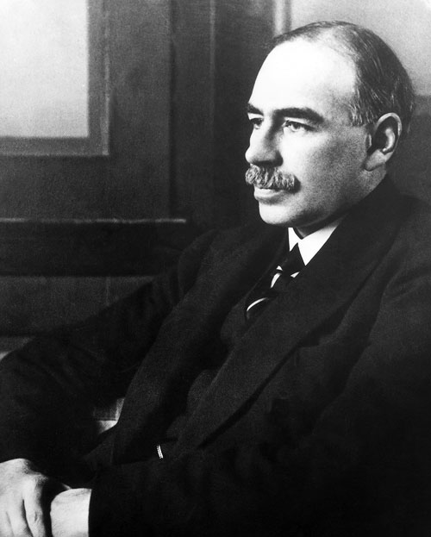
The Keynesian View
Market, industrialized economies are inherently unstable and do not automatically tend to full employment.
Private spending (and most importantly, investment spending) is volatile—causing business cycle fluctuations.
“The economy needs to be stabilized, the economy can be stabilized, the economy should be stabilized” (Franco Modigliani).
Keynesian economics is an attack on the Classical theory.
J.M. Keynes
John Maynard Keynes (1936). The General Theory of Employment, Interest, and Money

Slide 4

Monetarism
An updated version of the Classical theory.
Attributes business cycle expansions and contractions to erratic growth of the money supply.
Favor controls on money supply growth.
Free market or “laissez faire” preference.
Milton Friedman

Slide 5
Potential GDP
The value of real GDP when the economy’s resources—land, labor, capital, and entrepreneurship—are fully employed.

Slide 6
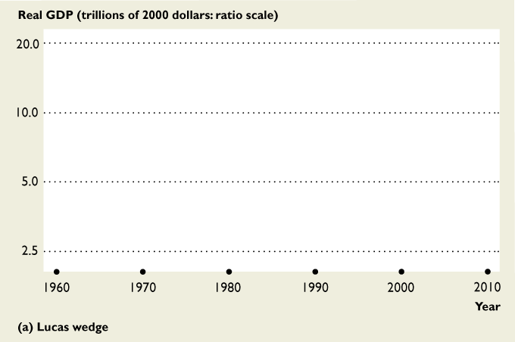
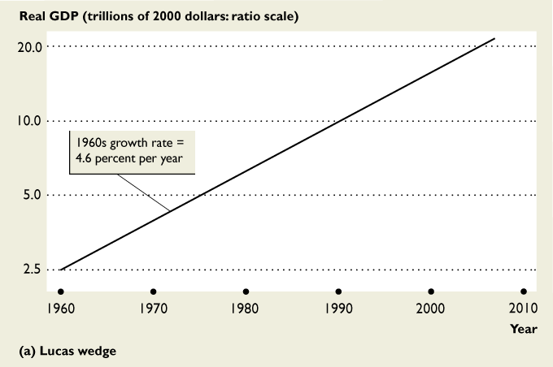
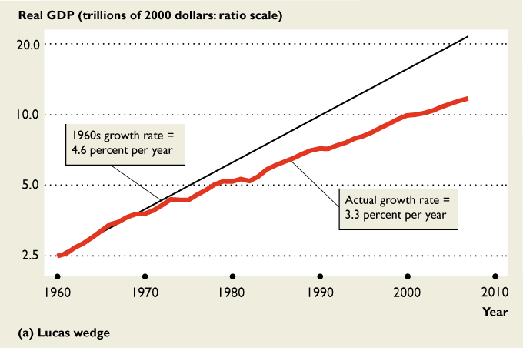
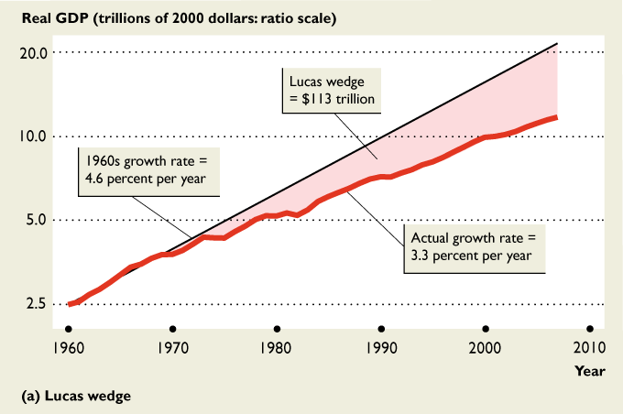
Lucas Wedge: Lost Output Due to Slow Growth

Slide 7
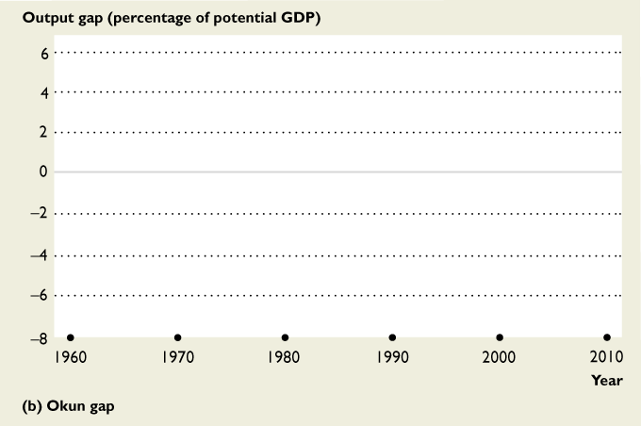
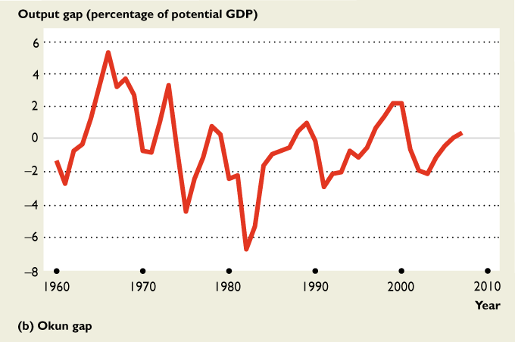
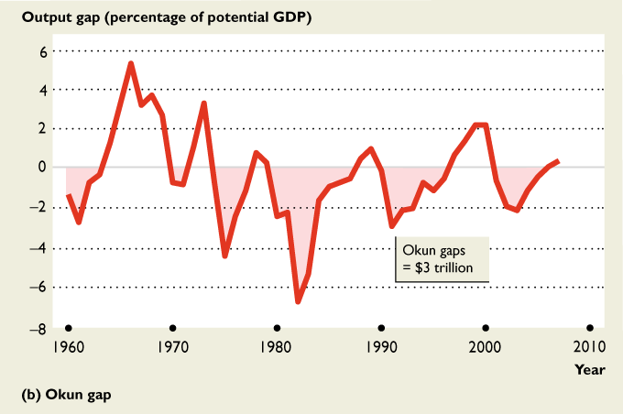
Measuring the GDP Gap

Slide 8
Recession is shaded
Source: Brown’s calculation from BLS and BEA data

Slide 9
The Natural Rate of Unemployment
The “full employment” unemployment rate—all unemployment is structural, seasonal, or frictional
Key Points:
The natural rate is not a constant—it varies over time and between countries.
The natural rate can change due to demographics, the availability of unemployment benefits, or structural change.

Slide 10
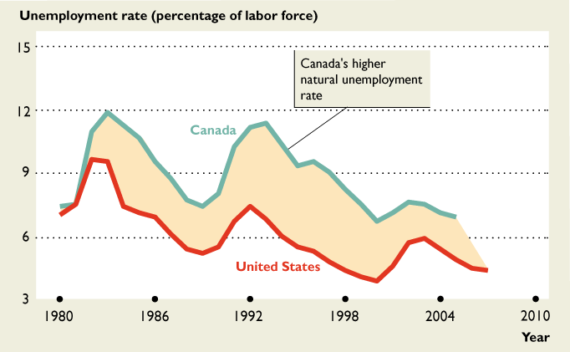
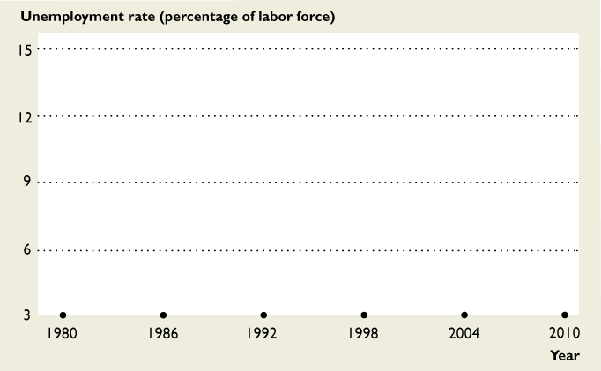
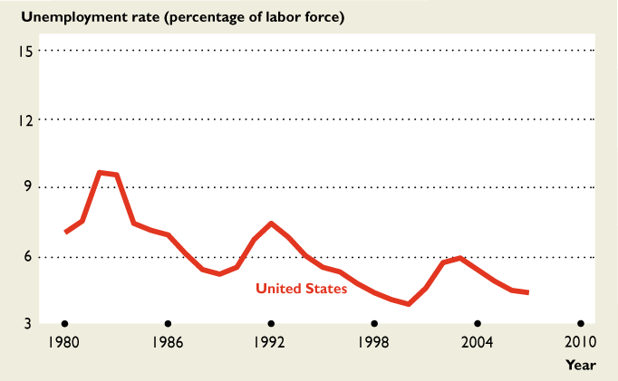
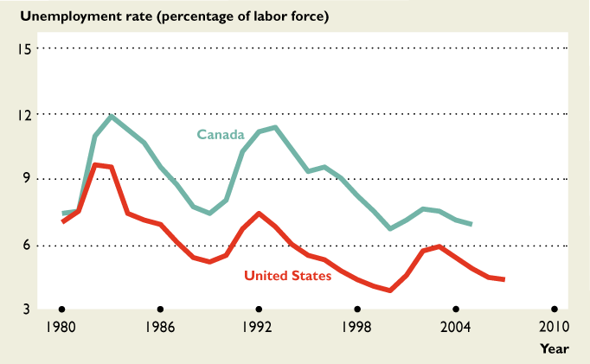
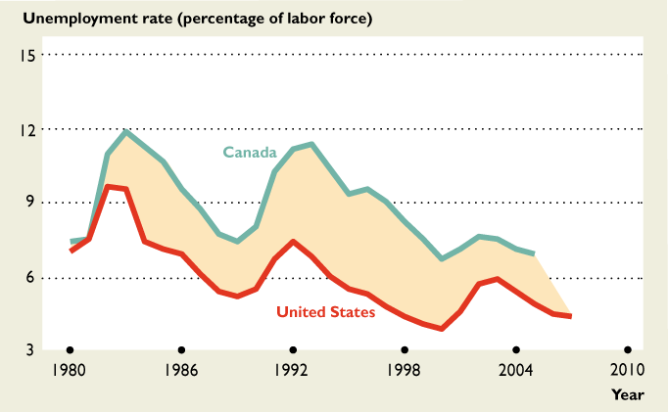
Canada Increased Unemployment Benefits in 1980.

Slide 11
The Production Function
Shows the relationship between real GDP and the quantity of employment, holding all other resources constant.

Slide 12
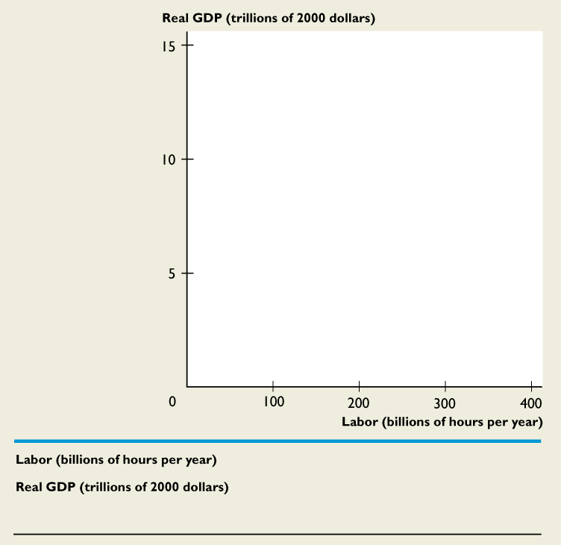
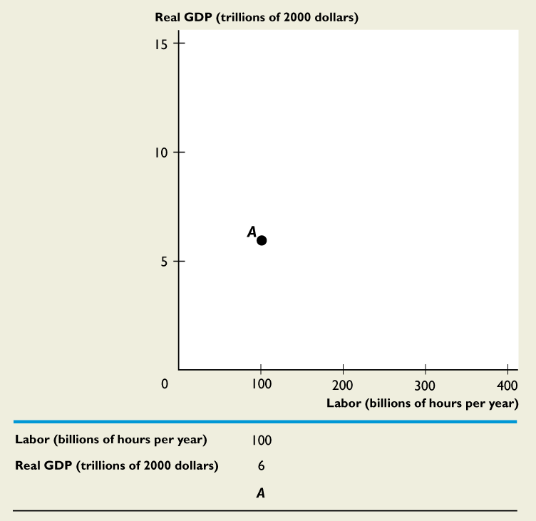
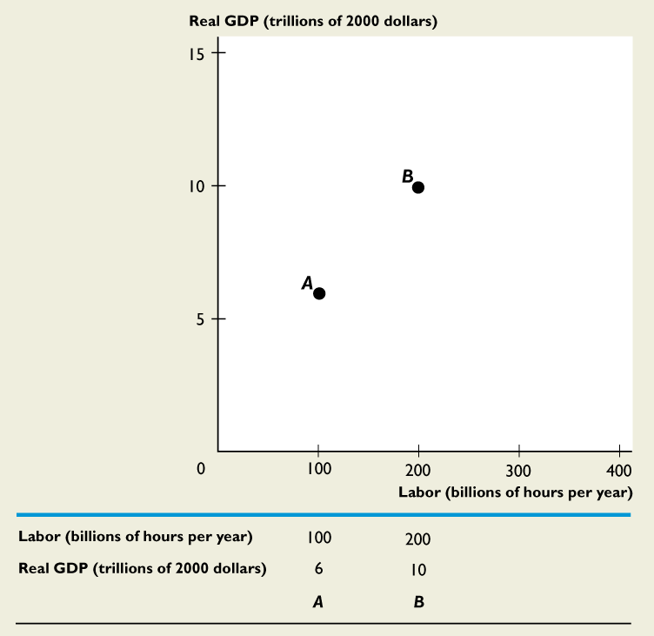
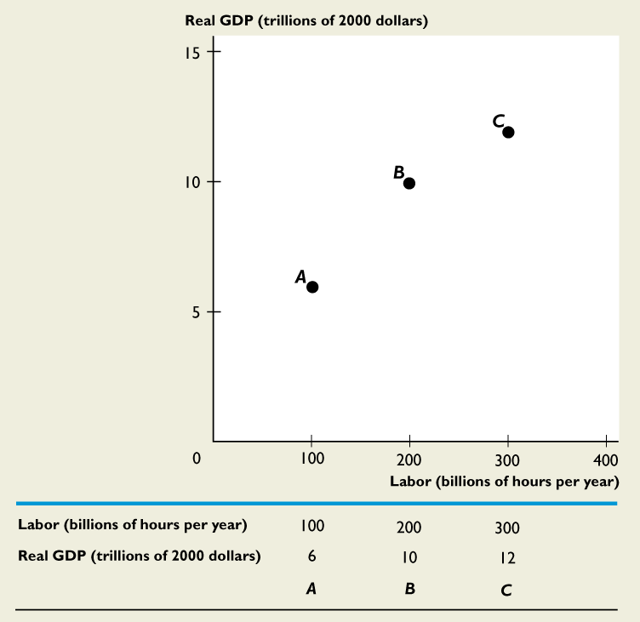
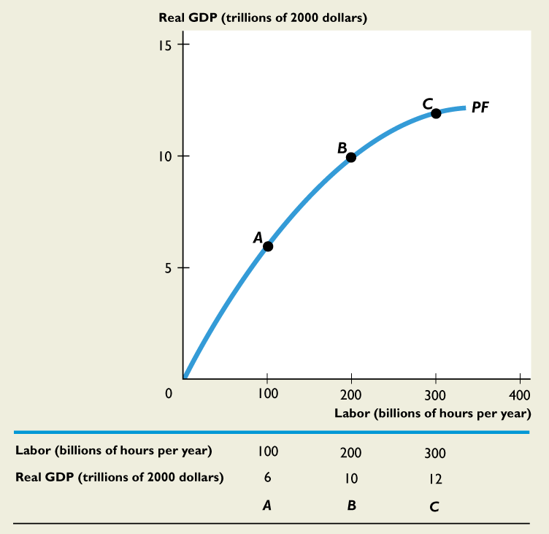
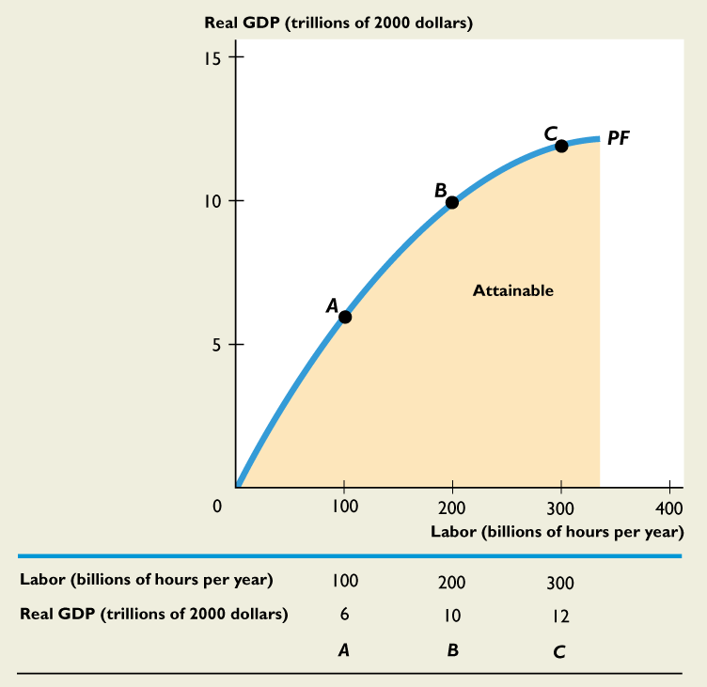
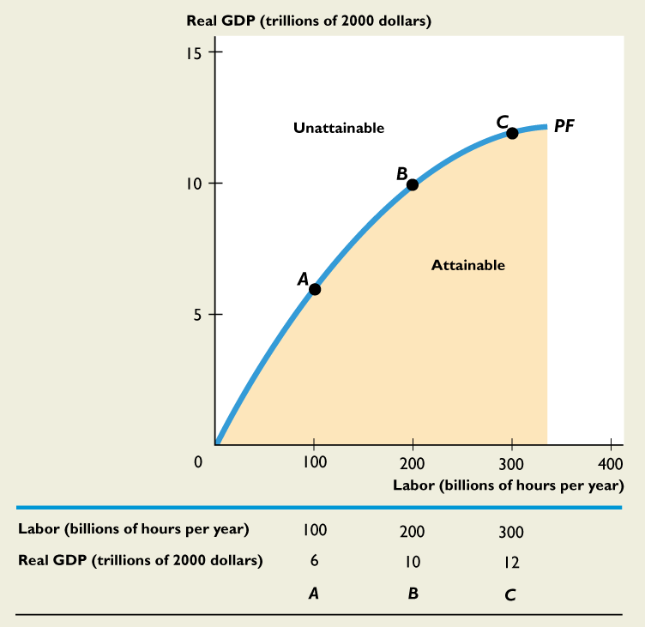

Slide 13

Application of Fertilizer is subject to Diminishing Returns
Fertilizer | Wheat | Extra Wheat
(Tons) | (BUs) | (Bus)
0 | 1000
1 | 1200 | 200
2 | 1300 | 100
3 | 1340 | 40
4 | 1350 | 10
5 | 1350 | 0
Question: How much would a grower being willing to pay for the 5th ton of fertilizer?

Slide 14

Diminishing Returns
Because we are adding labor to a fixed quantity of other resources, each additional hour worked adds a diminishing increment to real GDP.

Slide 15
The Labor Market
Application of demand and
supply to the problem of total employment.

Slide 16
Definitions
Quantity of labor demanded: The total hours that all firms in the economy plan to hire in a given time period at a given real wage rate.
Demand for labor: The relationship between the quantity of labor demanded and the real wage rate, when all other influences on hiring plans remain constant.
Quantity of labor supplied : The total hours that all households in the economy plan to work in a given time period at a given real wage rate.
Supply of labor: The relationship between the quantity of labor supplied and the real wage rate, when all other influences on work plans remain constant.

Slide 17
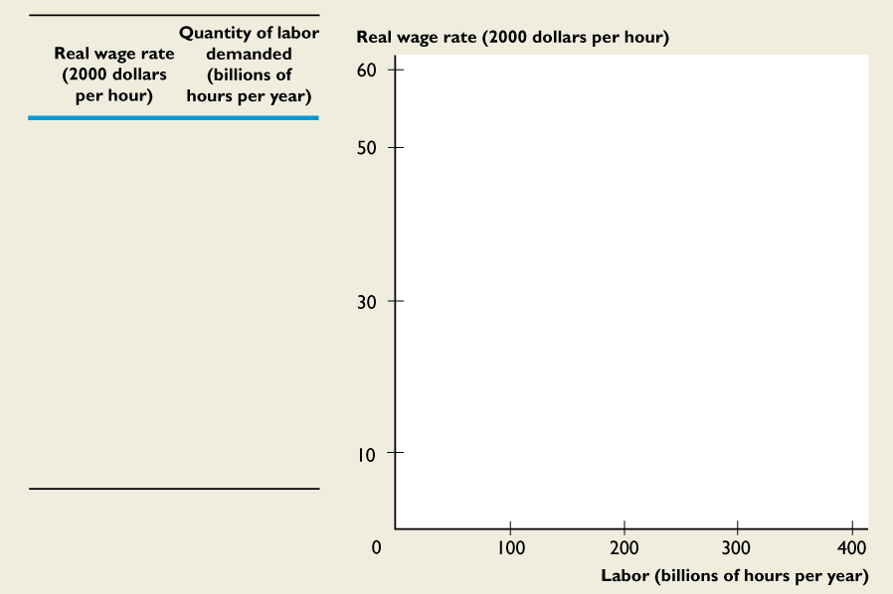
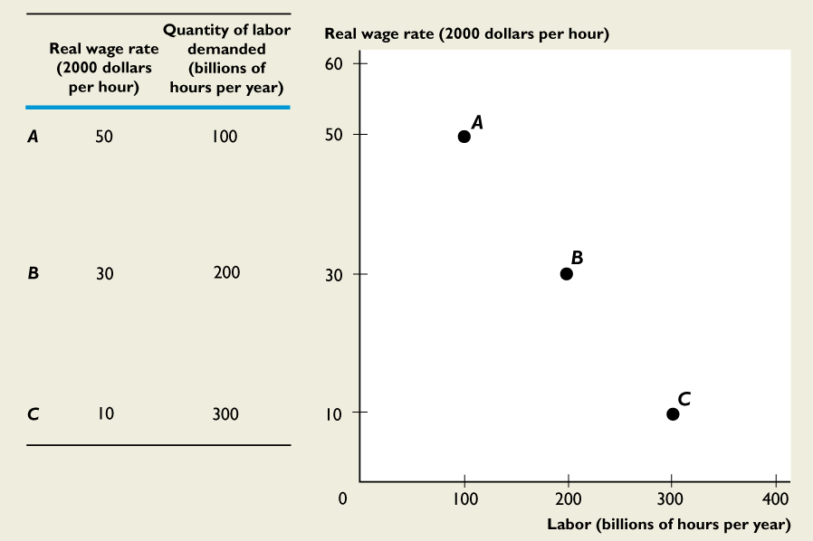
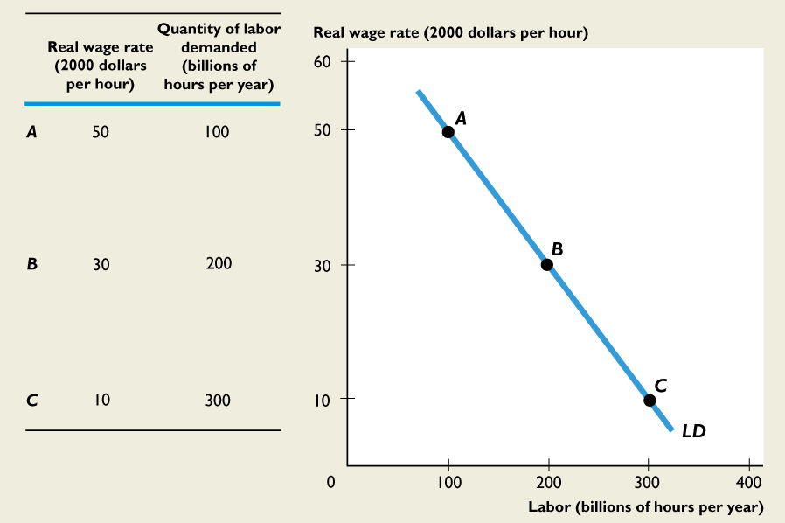
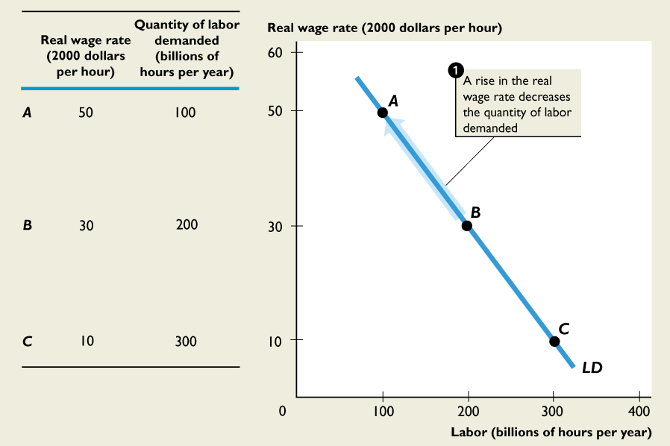
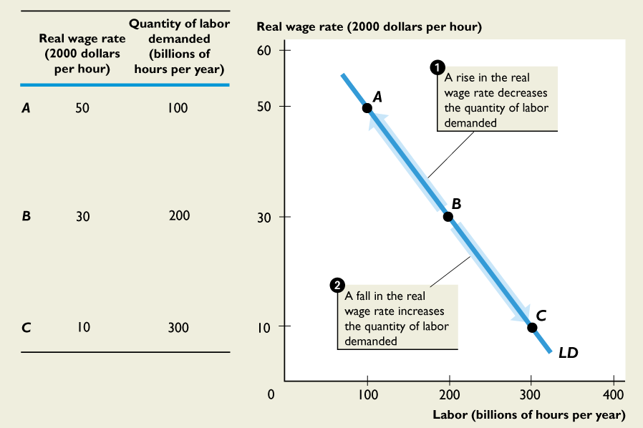

Slide 18

Because the use of labor is subject to diminishing returns, employers will hire additional labor ONLY if the real wage has decreased.

Slide 19
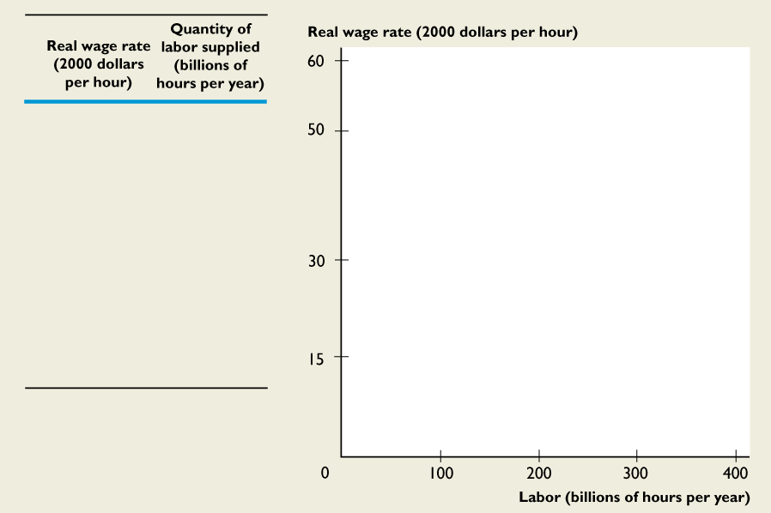
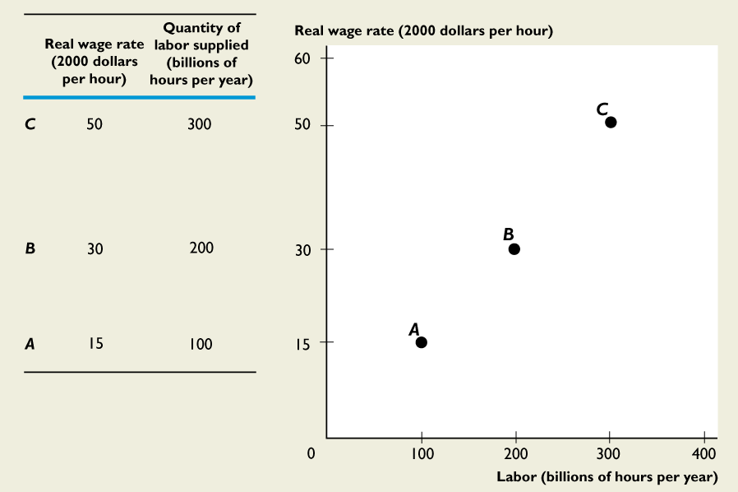
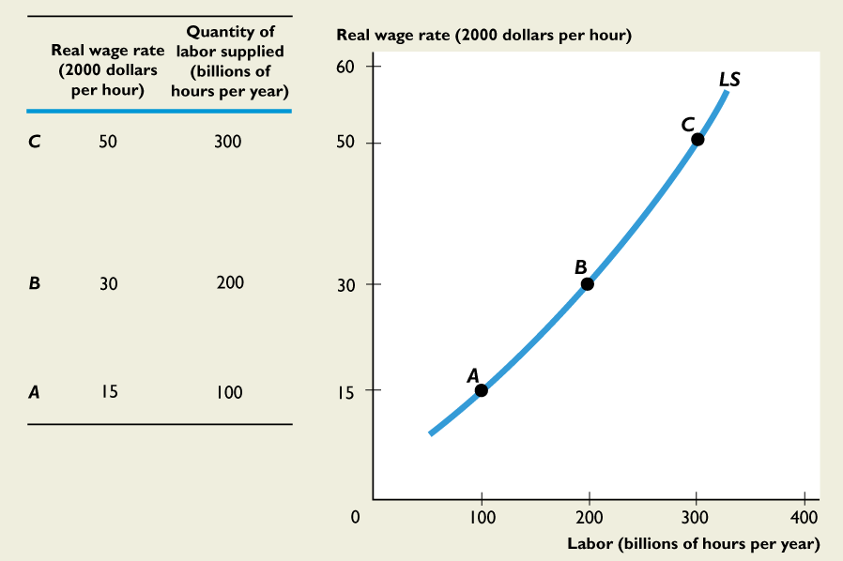
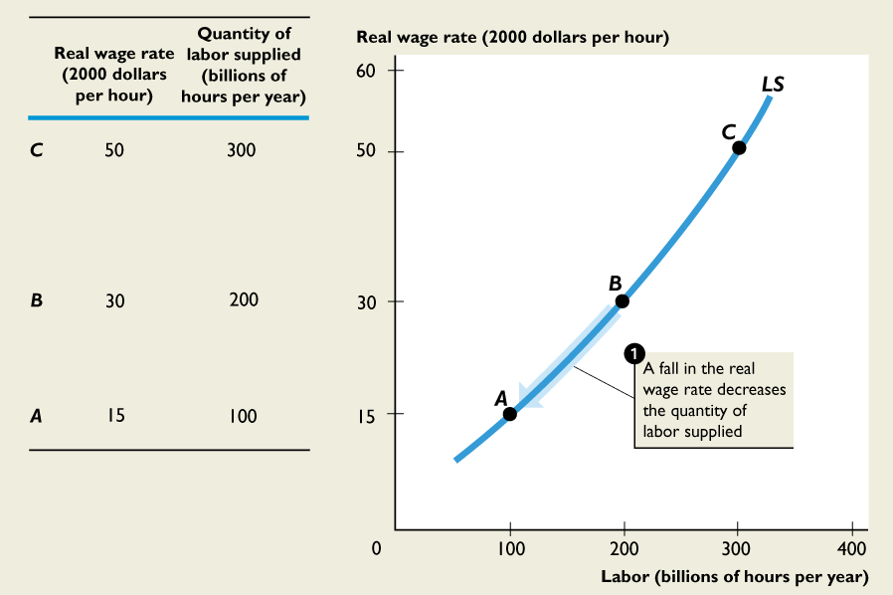
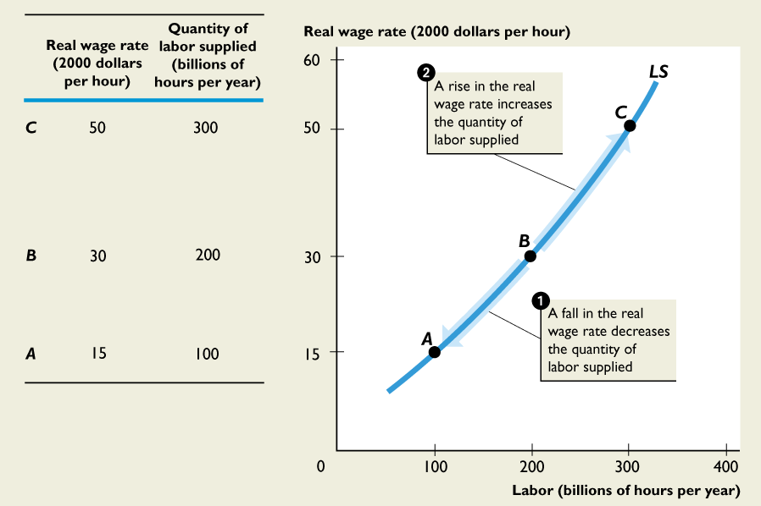

Slide 20
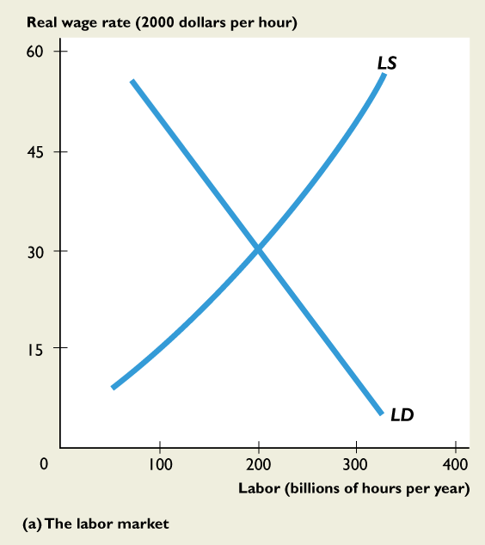
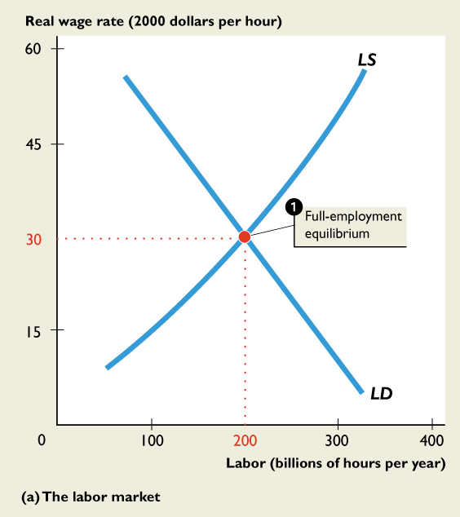
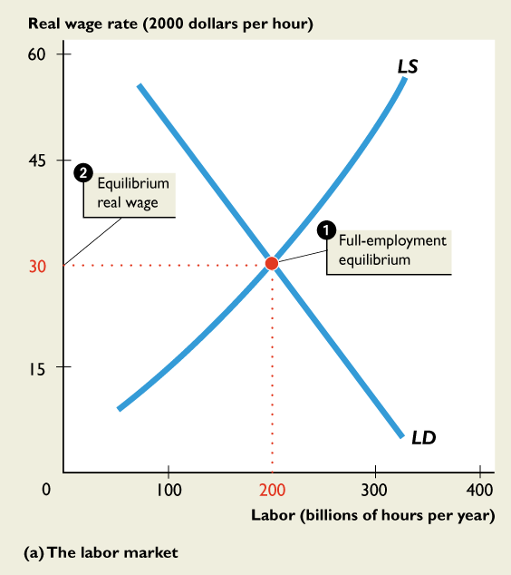
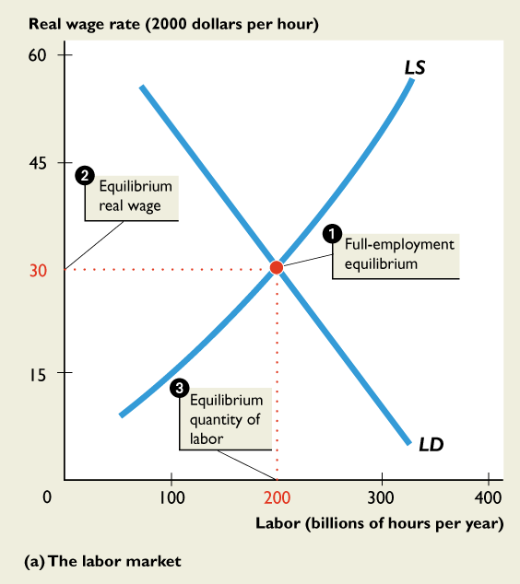

Slide 21
Labor Market Equilibrium and Potential GDP
2 Key points:
Potential GDP is the level of real output produced when total employment is equal to the equilibrium number of hours worked.
Deviations of the economy from potential GDP must result from labor market disequilibrium.

Slide 22
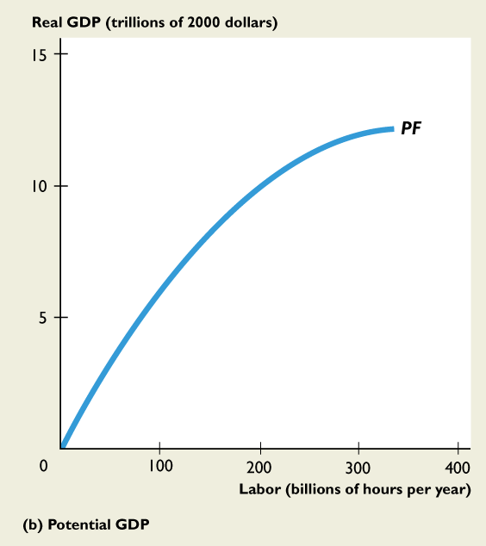
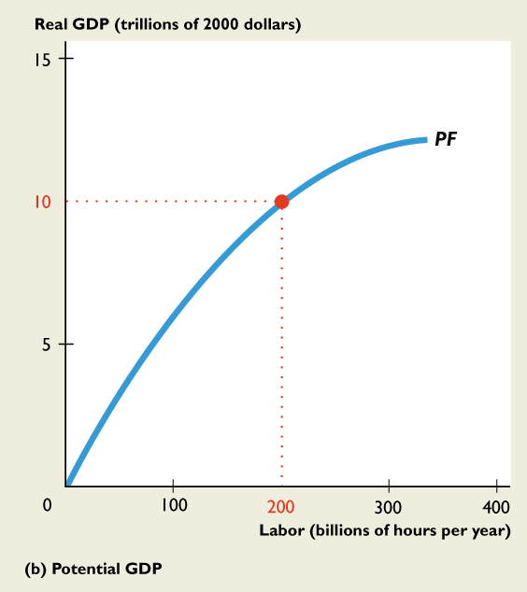
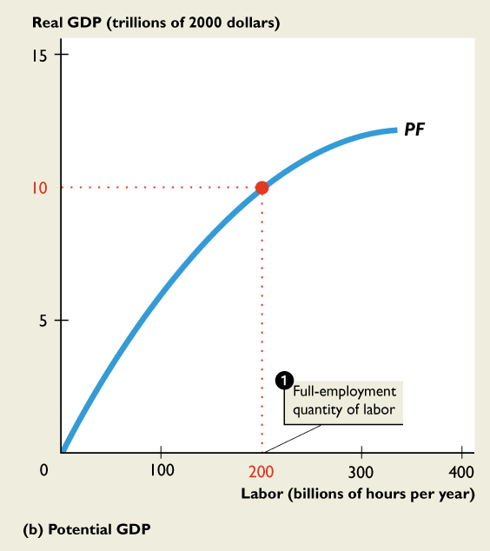
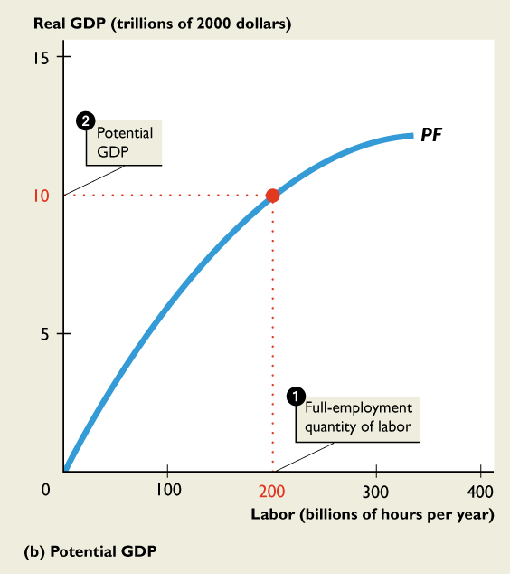

Slide 23
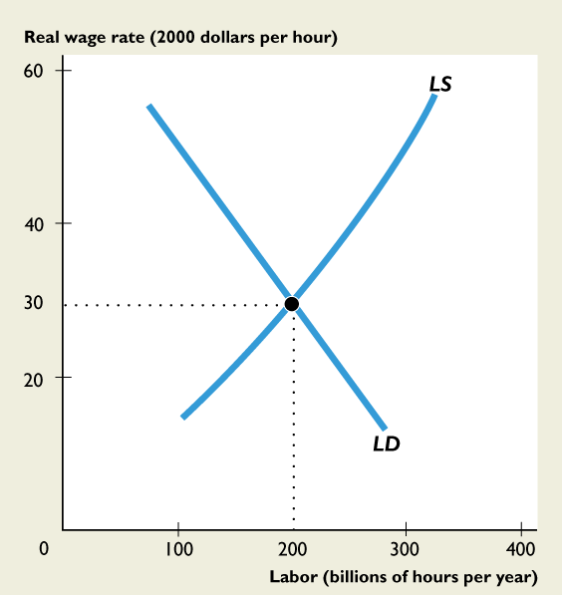
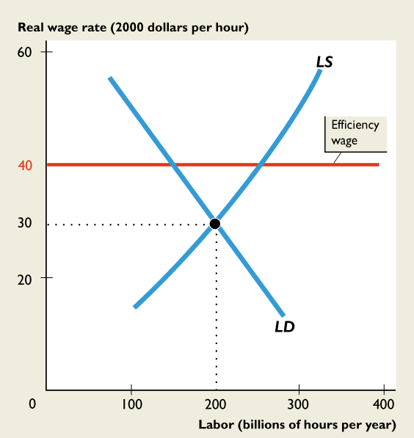
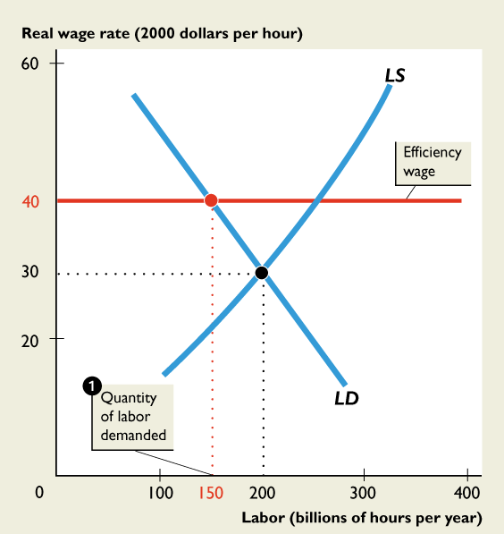
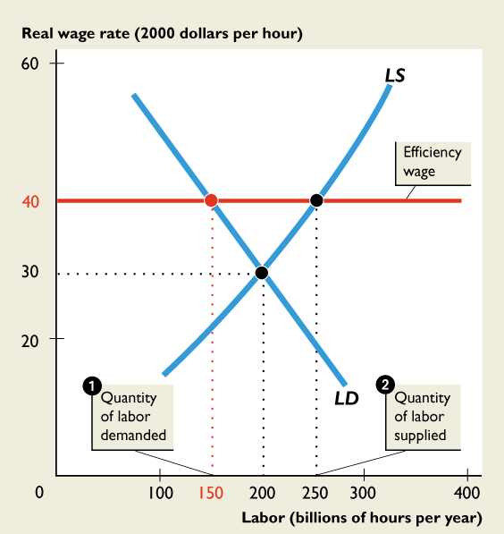
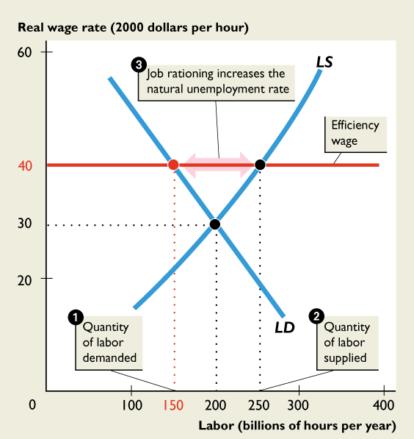

Slide 24

Wage Stickiness
Why should wages get stuck above their equilibrium level?
Some Employers Pay an efficiency wage (above-market wage) to incentivize effort , minimize turnover, and attract good people.
The minimum wage law.
Union wages: Wages that result from collective bargaining agreements.

Slide 25
Output/Wages
W*
Real Wage = w/p

Slide 26
Job Rationing
A situation in which the real wage is above its equilibrium value—in which case jobs are not rationed among job seekers by the real wage rate. There is a scarcity of jobs at prevailing wages.

Slide 27
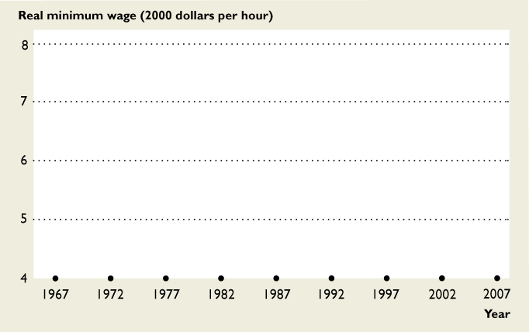
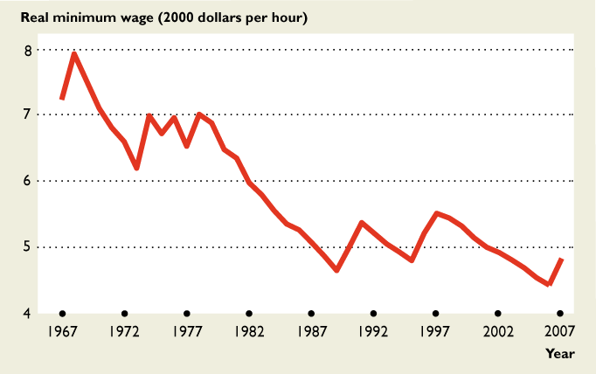
But the Minimum Wage Has Fallen in Real Terms

Slide 28
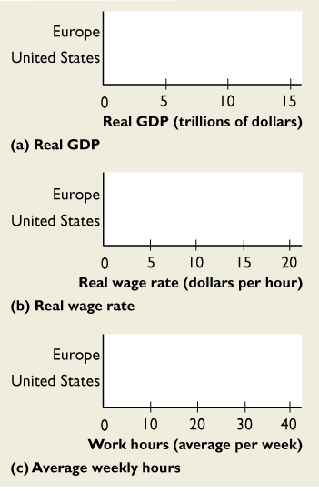
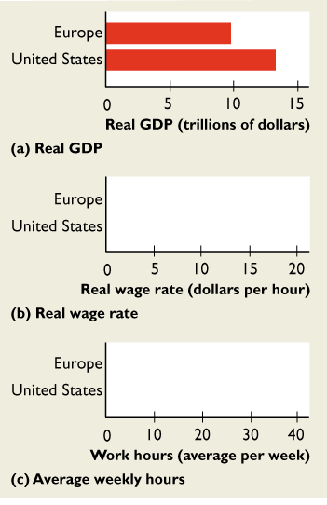
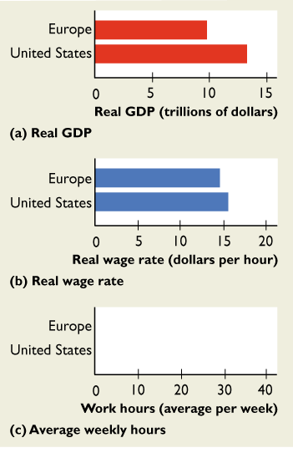
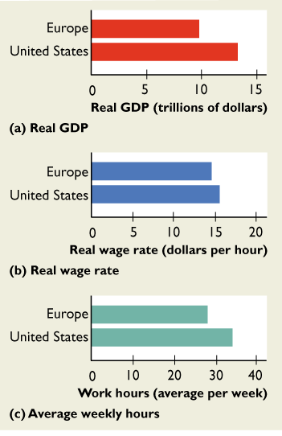

Slide 29
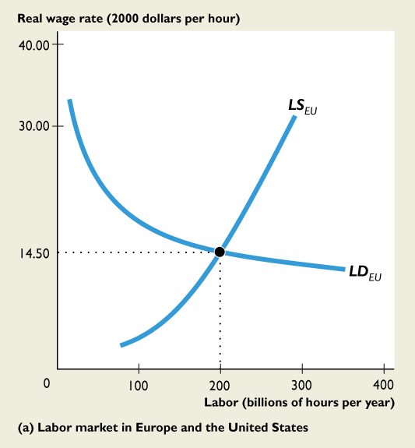









Slide 30








