Slide 1

The CPI and the Cost of Living
Outline
The Consumer Price Index (CPI)
What is inflation?
The CPI and the Inflation Rate
Adjusting the money (nominal) wage for inflation using the CPI
The Costs of Inflation
Is the CPI accurate?
Consequences of overstating inflation

Slide 2
The Consumer Price Index (CPI)
We use the CPI to measure changes in the cost of living experienced by households.
The CPI is the “narrow” price index in that the market basket used to construct it includes items purchased by households.
Bureau of Labor Statistics economic assistants check the prices of 80,000 items in 30 metropolitan areas each month.
The inflation rate is simply the percentage change in the CPI from one period to the next.
1982-84 is the reference base period

Slide 3
THE CONSUMER PRICE INDEX
Calculating the CPI
  The CPI calculation has three steps:
    Find the cost of the CPI basket at base period prices.
    Find the cost of the CPI basket at current period prices.
    Calculate the CPI for the base period and the current period.

Slide 4
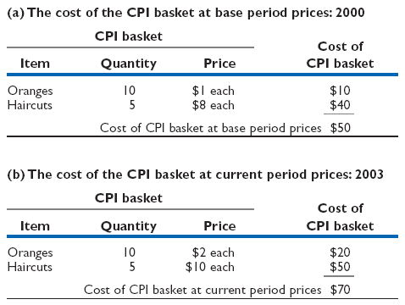
THE CONSUMER PRICE INDEX
Table 7.1 shows the consumer price index: a simplified CPI calculation.

Slide 5
7.1 THE CONSUMER PRICE INDEX
Cost of CPI basket at current period prices
CPI =
x 100
Cost of CPI basket at base period prices
$50
For 2000, the CPI is:
x 100
= 100
$50
$70
For 2003, the CPI is:
x 100
= 140
$50

Slide 6

Inflation
prices
Inflation is a sustained increase
in the prices of goods and services
(or the cost of living). To measure
inflation, we look at changes in the
price of a market basket of goods
or services households typically
purchase with their income
Time

Slide 7
THE CONSUMER PRICE INDEX
Measuring Inflation
  Inflation rate
  The percentage change in the price level from one year to the next.
CPI in current year − CPI in previous year
Inflation rate =
x 100
CPI in previous year
140 − 120
Inflation rate =
x 100
= 16.7 percent
120
Notes:
Emphasize the distinction between the price level and the inflation rate.
Do some calculations and have the students do some too.

Slide 8
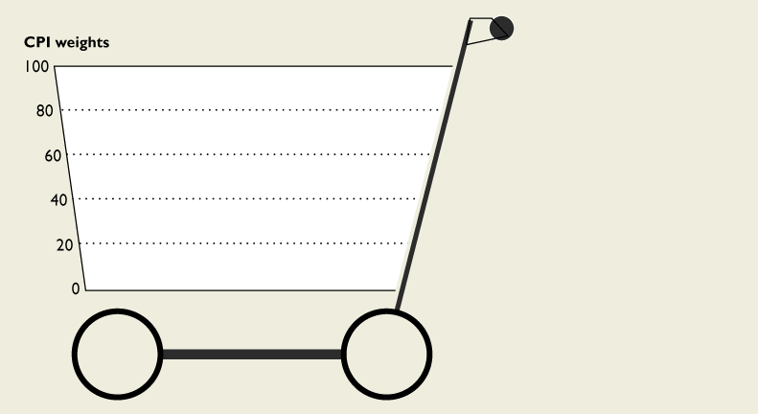
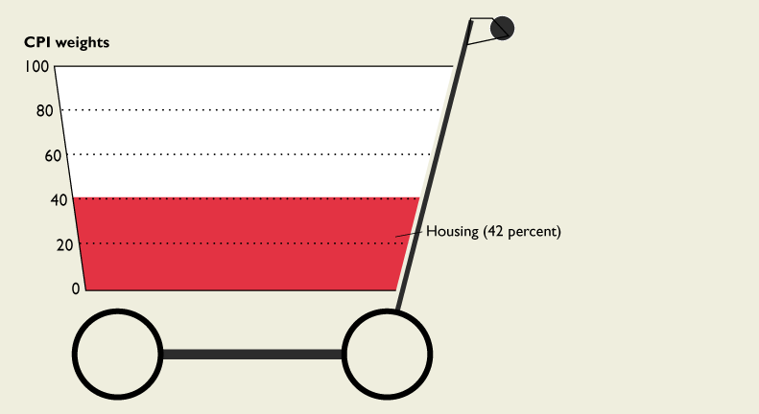
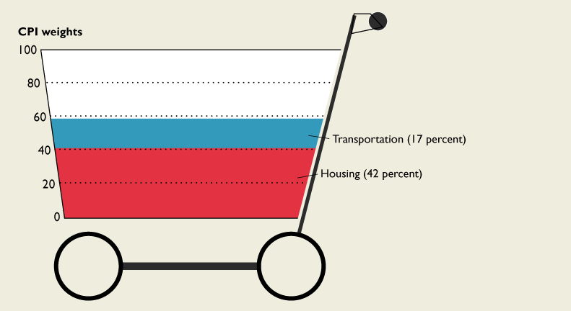
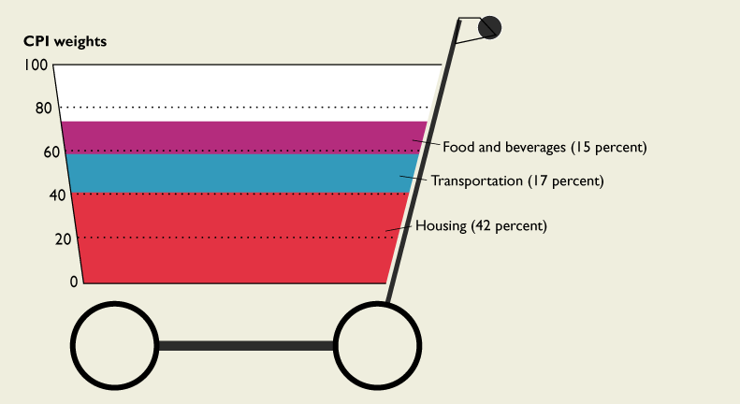
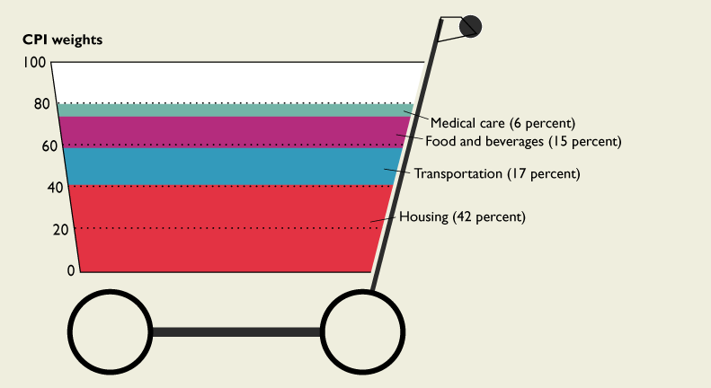
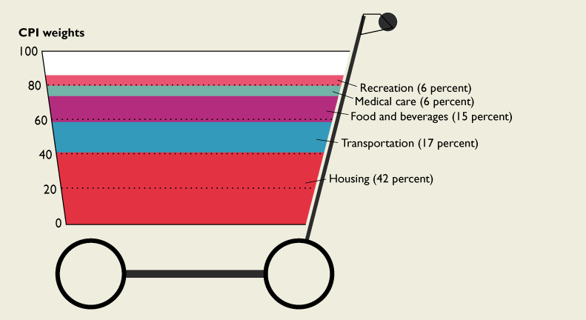
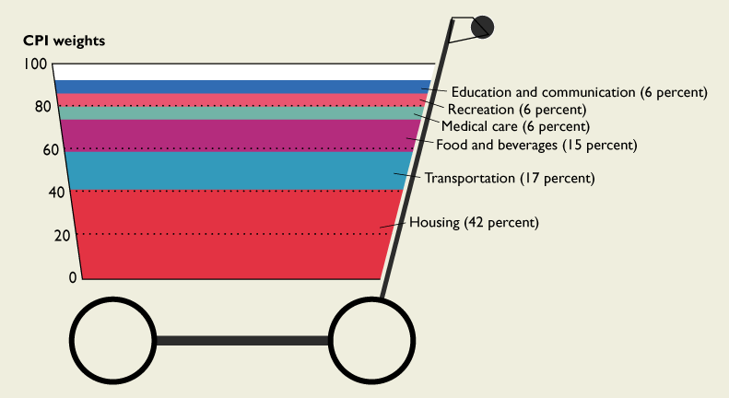
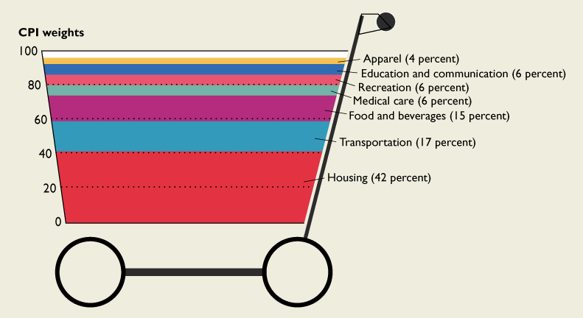
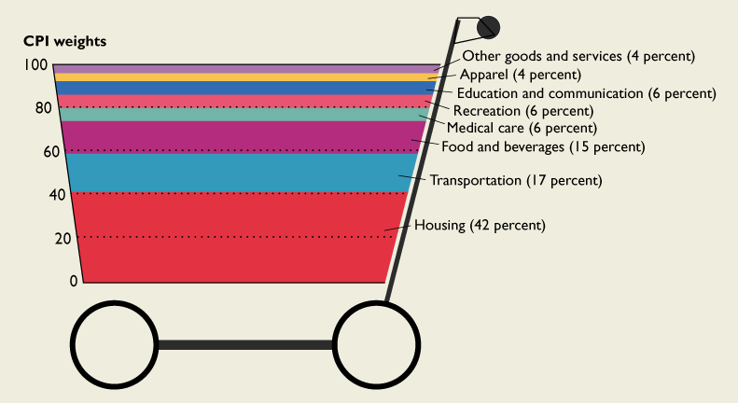
The CPI Market Basket
The BLS now revises the CPI market basket every 2 years

Slide 9
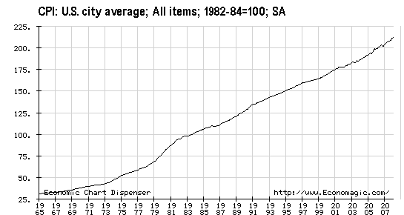

Slide 10
The Consumer Price Index
Source: Bureau of Labor Statistics

Slide 11

Computing the Inflation Rate for 2007
The CPI was equal to 203.30 in December 2006. In December 2007 it was 211.680.

Slide 12
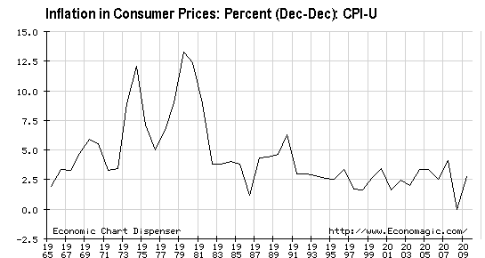
The Inflation record

Slide 13
Source: The Economist

Slide 14

The inflation myth
Inflation cannot by itself decrease average real income. Inflation can shift purchasing power from some groups to others

Slide 15
Inflation in not an equal opportunity villain. That is, inflation arbitrarily, and unfairly, redistributes real purchasing power from some groups to others.

Slide 16
The race to stay ahead of inflation
Inflation erodes the purchasing power of income and sets off a race to stay ahead of the cost of living.
Teachers, fireman, truck drivers, nurses, accountants, plumbers, social security recipients, and others strive to increase their incomes so as not to suffer a decrease in their standard of living.
Some groups do better than others.

Slide 17
Machinists
Job description: Set up and operate a variety of machine tools to produce precision parts and instruments.
 | Mean | CPI
Year | Annual Wage | (1982-84 = 100)
1995 | $31,270 | 152.4
2005 | $34,790 | 196.4
Source: Bureau of Labor Statistics

Slide 18

Are machinists better off in 2005?

Slide 19
Why are we smiling? Because our social security benefits are indexed to the CPI
Why doesn’t Congress index the minimum wage to the CPI?

Slide 20
Value of the Federal Minimum Wage
 | Nominal | Real Value
Year | Value | (1982-84)
1938 | $0.25 | $1.77
1949 | 0.40 | 1.68
1955 | 0.75 | 2.80
1961 | 1.15 | 3.85
1966 | 1.25 | 3.86
1974 | 2.00 | 4.06
1978 | 2.65 | 4.06
1989 | 3.35 | 2.70
1996 | 4.75 | 3.03
2006 | 5.15 | 2.53
2007 | 5.85 | 2.76
2010 | 7.25 | 3.32
Source: U.S. Department of Labor

Slide 21
Unexpected inflation redistributes real income from lenders to borrowers
Repayments schedules for most debt contracts are fixed in nominal or money terms—that is, debts are not indexed to inflation.
Inflation erodes the real value of repayments.
Savings & Loan institutions lost money on long term mortgages in the70s and 80s.

Slide 22

We bought this house in 1957 for $19,000. We financed the house on a 30 year mortgage note at 3.5 percent interest. Can you guess what our monthly payment was?
Answer: $85.32

Slide 23
Inflation undermines confidence
in political leaders and institutions

Slide 24

Sources of Bias in the CPI
Some economists have complained that the CPI does not accurately measure changes in the cost-of-living. They cite the following problems
New goods bias
Quality change bias
Commodity substitution bias
Outlet substitution bias

Slide 25

New Goods Bias
Think of all the stuff you buy today that was not around just 20 years ago
Personal computers and software
Satellite TV
Cell phone service
High-speed internet service
Laser eye surgery
Digital music players
Serotonin reuptake inhibitors

Slide 26

Quality Change Bias
Many items have undergone qualitative improvements over time. Cars, cameras, and software are three examples

Slide 27
Consequences of Overstating Inflation
Changes in real income over time are not measured properly.
Private contracts are distorted.
Increase in government outlays

