Slide 1

ECON 2313: Fall Semester, 2010
Welcome!

Slide 2

What is economics?
Economics is the study
of how individuals and
societies allocate
scarce resources among
(competing) alternative
uses.

Slide 3
Scarcity
Available resources are insufficient to satisfy wants.
We cannot produce enough goods and services to satisfy everyone—we don’t have the resources!

Slide 4

What to produce?
Because resources are scarce, growing more corn means growing less wheat, building more SUV’s means building fewer military vehicles, and building more prisons means we have to sacrifice something else—like new schools.

Slide 5
Congress made supplemental appropriations for the Iraq effort of $110 billion June 2003 and March 2004. We should ask the question: what could we have for $110 billion?

Slide 6
What can you buy for $110 billion?
628 Boeing 7E7 Aircraft
Construct three (3) 700 mile bullet trains (includes the cost of inner-city land acquisition).
4,075 “high quality” educational facilities to accommodate 1,000 students.
Write a $379 check to every U.S. citizen.
Fund 1,000 universities the size of Arkansas State for one year.

Slide 7
The geneology of economics
Economics
Webster’s Ninth New Collegiate Dictionary.
eco• nom • ic 1. archaic: of or relating to a household or its management.
eco = oikos, meaning “house” or “household”
nom = nemein, meaning “to manage”
ic = ic, mean “of” or “relating to”

Slide 8

Parkin and Bade definition
Economics is the social science that studies the choices we make as we cope with scarcity and the incentives that influence and reconcile our choices.

Slide 9

Incentive
A reward or penalty—a “carrot” or a “stick”—that encourages or discourages an action.
Airline fare structures give you an incentive to stay over Saturday night.
The risk of a getting a ticket for speeding gives you an incentive to obey they speed limit—or at least slow down.

Slide 10
Economics: The
Big Questions
How do choices end up determining what, how, and for whom goods and services are produced?
When do choices made in the pursuit of self-interest also promote the social interest?

Slide 11
What, How, For Whom?
Because resources are scarce, growing more corn means growing less wheat, building more SUV’s means building fewer military vehicles, and building more prisons means we have to sacrifice something else—like new schools.

Slide 12
How to produce?
In France, basket-carrying workers pick the grape crop by hand. Grape picking in California is often mechanized.
GM uses workers to weld body parts together in some plants and uses robots in others.

Slide 13
For whom are goods produced?
Source: Bureau of Labor Statistics 2005 Occupational Survey

Slide 14
The personal distribution of income describes the distribution of income among households or individuals

Slide 15
Source: Bureau of the Census

Slide 16
Source: Bureau of the Census

Slide 17
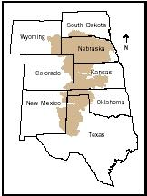
When is the Pursuit of Self-Interest in the Social Interest?
Subprime mortgage brokers and underwriters behaved in their own interests—but contributed to the housing prices bust.
BP scrimped on deep water drilling safety measures—with catastrophic results.
Farmers on the high plains draw from the Ogallala Aquifer—but the water is rapidly running out.

Slide 18
Microeconomics
The study of the choices that individuals and businesses make and the way these choices respond to incentives, interact, and are influenced by government
Examples of microeconomic questions?
What determines the price of gasoline?
Why is housing so much more expensive in San Francisco compared to Dallas?
Will more students enroll in nursing schools in response to rising incomes of nurses?
Will the “free” availability of Linux affect sales of Windows?

Slide 19
Macroeconomics
The study of the aggregate (or total) effects on the national economy and the global economy of the choices that individuals, businesses, and governments make.

Slide 20
Macroeconomic Questions
The standard of living
The cost of living
Economic fluctuations—recessions and expansions

Slide 21
The Standard of Living
The standard of living is (imperfectly) measured by the average quantity of goods and services per person (or per capita).
Issues:
How to explain changes over time in the standard of living?
How to explain cross-national differences in the standard of living?

Slide 22
The Cost of Living
The cost of living refers to the prices of goods and services that are typically purchased by households.
Issues:
How to explain changes over time in the cost of living?
How to explain cross-national differences in the cost of living?

Slide 23
The Business Cycle
Real GDP
Time
The term business cycle is used to describe observed fluctuations in key macroeconomic measures such as real GDP, personal income, profits, or employment.
A full cycle consists of an expansion and a contraction (or recession).
Business cycles are recurring phenomena; however, they are irregularly recurring.

Slide 24
Business Cycle Phases and Turning Points
Total Production
Peak
Expansion
Peak
Expansion
Recession
Recession
Trough
2
4
8
Year

Slide 25
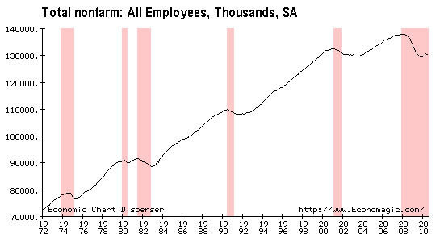
USA Employment is down 7.7 million since December 2007
Recessions shaded pink

Slide 26
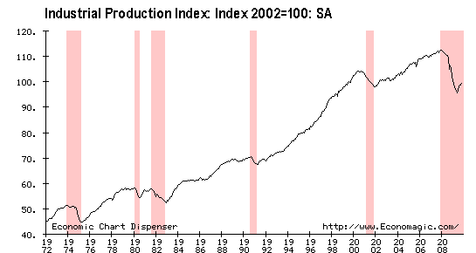

Slide 27

The Art and Science
of Economics
Economists assume that economic decision-makers are rational and engage in “maximizing” behavior

Slide 28
Positive and normative
economics
Economics deals with questions of “what is” and “what ought to be.” The former set of questions belong to positive economics; the latter to normative economics

Slide 29
Positive economics attempts
set forth scientific statements
--that is, statements subject to verification or
falsification
For instance:
“ If they raise tuition again at ASU, enrollment will decline.”
The recent rise in interest rates is likely to depress housing construction.
Total employment in the U.S. fell in the year 2002.

Slide 30

It’s unfair to ask a person to live on $7.25 an hour.

Slide 31

I shouldn’t have the government telling me how much I should pay for fast food cooks or any other type of labor service.

Slide 32
Who is right?
It is a normative issue.

Slide 33

What is an Economic Model?
An economic model is
a simplified substitute
for economic reality.

Slide 34
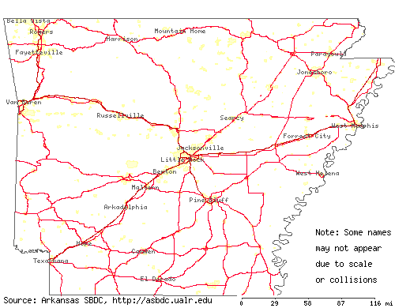
This map of Arkansas is a good example of a “model”

Slide 35
Ceteris Paribus
“All other things being equal” or “All other factors held constant.”
Simplification in model building is achieved by the ceteris paribus assumption. It allows us to reason about the relationship between two variables without the intrusion of other variables.

Slide 36
Economic reasoning:
Some pitfalls
Association-is-causation fallacy
Fallacy of composition
Ignoring secondary effects

Slide 37
Correlation versus Causation
Correlation is the tendency for the values of two variable to move in a predictable and related way. For example, beer consumption tends to rise when unemployment rises—that is, these variables are correlated. Does it follow that beer consumption causes unemployment?

Slide 38
Association-is-causation
fallacy: More examples
Researchers at the Aabo Akademi found that Finns who speak the language of their Nordic neighbors were up to 25 percent less likely to fall ill than those who do not.
My rooster died—the sun won’t come up tomorrow.
Crimes rates tend to be higher in cities with more police per capita.

Slide 39
Fallacy of
composition
To commit the fallacy of composition is to suppose that what is true in the individual case also holds true for the group.
Example: “The best way to leave a burning theater is to run for the exit.”

Slide 40

Secondary effects
The imposition of a luxury tax in 1990 (for items priced $100,000 or more was blamed for destroying jobs in the yacht-building industry.

