Slide 1
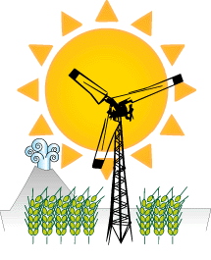
Renewable Energy

Slide 2
Types of Renewable Energy
Solar Energy
Wind Energy
Hydroelectric
Biomass Energy
Geothermal Energy

Slide 3
Solar Energy
With the exception of geothermal energy, some sources lump
all other forms of alternative energy into solar. For the purposes
of this class, we will only use the following:
Photovoltaic energy - sunlight is directly converted to electricity
Solar thermal electrical - sunlight is used to boil a fluid that
turns a turbine
Solar thermal - sunlight is used for heating

Slide 4
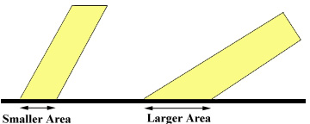
Insolation
Insolation - amount of incident solar radiation power per area;
is a measure of how much solar energy is striking the ground
Depends upon 1) latitude, 2) time of year, and 3) average climate
(cloudiness vs. clear skies)
Latitude and time of year determine how steeply sunlight is
striking the Earth; the greater the angle, the more the light
is spread over a larger area

Slide 5
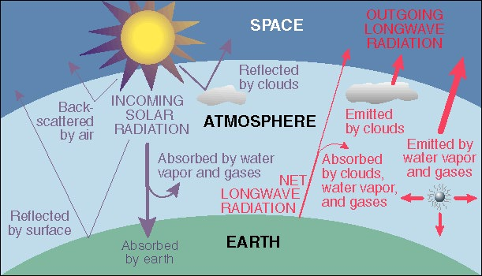
Clouds
If there are no clouds, then about 50% of the sunlight that strikes
the upper atmosphere gets through to the ground (the other 50%
is absorbed or reflected).
If it is cloudy, only about 30% of the radiation reaches the surface,
and it is scattered (coming from all directions).

Slide 6
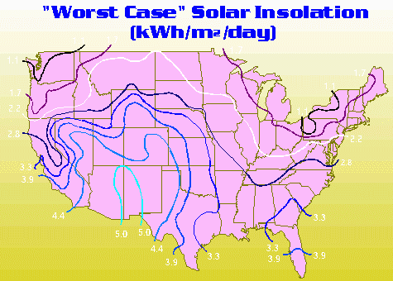
Insolation For the U.S.
These factors can cause huge regional differences.

Slide 7
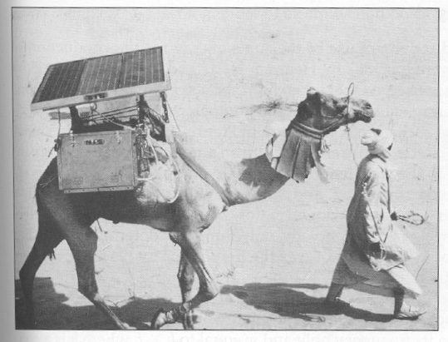
Photovoltaics
Fairly clean source of electricity; some pollution in creating
cells
Efficiency and cost limits use and marketability
Use limited mostly to special uses

Slide 8
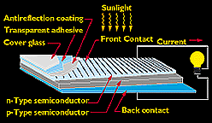
Cell
The basic photovoltaic cell looks like this

Slide 9
Why?
Light can behave like a wave, or as a particle
Photon - parcel of energy that can be delivered by light;
energy = h x f, where h is a constant and f = frequency
Electron in the atom needs a certain amount of energy to get out
If photon has less energy than this, electron does not absorb it or
it re-radiates it
If photon has just the right energy, electron absorbs and gets out
If photon has more than enough, electron absorbs, but waste the
difference

Slide 10
Efficiency and Cost
Photoelectric effect limits the amount of energy that can be
delivered to the electrons
Cells can be made more efficient (20-25%), but at a cost
Current price is still 2-3 times what it needs to be in order to
compete
http://www1.eere.energy.gov/solar/photovoltaics.html

Slide 11
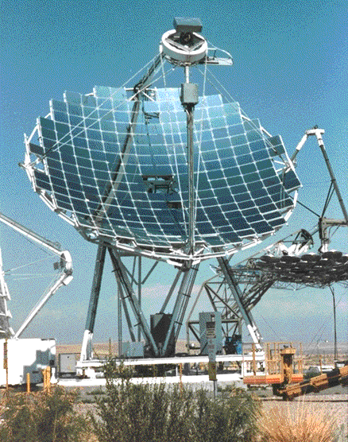
Solar Thermal Electrical
Use sunlight as the heat source
for conventional generator
Requires some form of sunlight
concentrator; normal insolation
values are too low
Could conceivably reach efficiencies of normal power plants

Slide 12
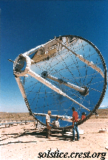
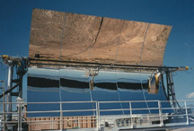
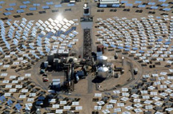
Systems
1) Parabolic dish
2) Parabolic trough
3) Point focus heliostats

Slide 13
Economics
Projected data from Sandia National Labs (SUNLAB)
Current costs are about 6.7 cents/kwhr for power towers.

Slide 14
Solar Thermal Heating
Homes need heat for two purposes: heating and hot water
Sunlight can be used either actively or passively
The proposed usage determines the type of system
Many historical uses; ancient Rome had ordinances about
blocking light; Chaco Canyon, New Mexico (1000 A.D.)

Slide 15
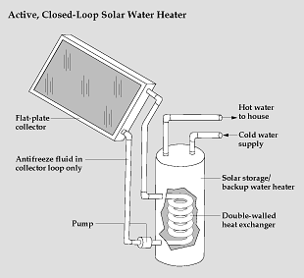
Active System
4 main components:
1) collector
2) heat transport fluid
3) storage facility
4) pump or fan
Most often used for baseboard
heat and hot water
If used in a frigid climate, need to ensure that liquids will not
freeze in collector during the night

Slide 16
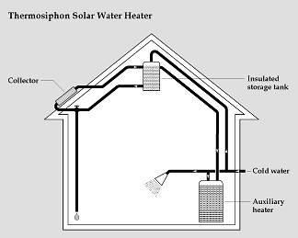
Passive System
Different from an active system
since no energy input to move
heated fluid; relies on natural
convection
Can be as simple as just having
south-facing windows with
shades open
For heating at night, need some sort of storage during the day
Ex. stone floors, stone sculptures, aquarium

Slide 17
Economics
Can provide 40%-80% of a typical household's hot water demand
Can substantially reduce heating load for air; each square foot of
south-facing window provides about 30-40 Btu/hr of heat
Need to build systems into the house; retrofitting can make these
system too expensive

Slide 18
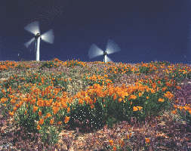
Wind Energy
Contributed more than 3.5 billion kWh
of electricity last year.
No CO₂ emissions or water used
For most turbines, noise is less than 50 dB at a distance of 250 yards.
Occupy only about 5% of the land; the rest is available for other uses.
Power output: P = 0.5 x air density x A x Cp x V³ x Ng x Nb
where A is the area of the turbines, V is the velocity of the wind, and
the rest are coefficients that depend on efficiencies of energy transfer

Slide 19
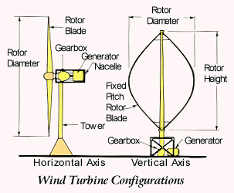
Systems
Two types of systems:
1) Horizontal shaft
2) Vertical shaft
Horizontal has to be aligned with
prevailing wind directions;
vertical will catch any wind
Easier maintenance of generator on vertical shaft
Greater efficiency on horizontal since it can get above air near
ground

Slide 20
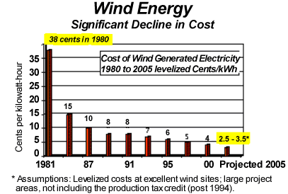
Economics
Costs have gone from
$0.30/kWh in 1981 to
$0.04/kWh in 2000
Source: AWEA
Winds exceeding 5 m/s (11 mph) are required for cost-effective
application of small grid-connected wind machines; windfarms
require wind speeds of 6 m/s (13 mph). This does not occur everywhere in the U.S.

Slide 21
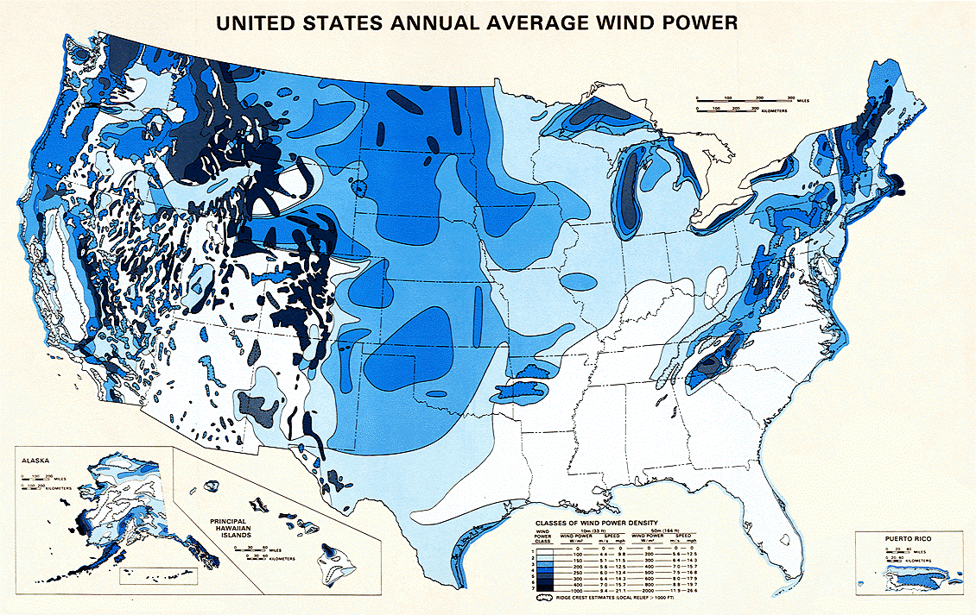
Locations

Slide 22
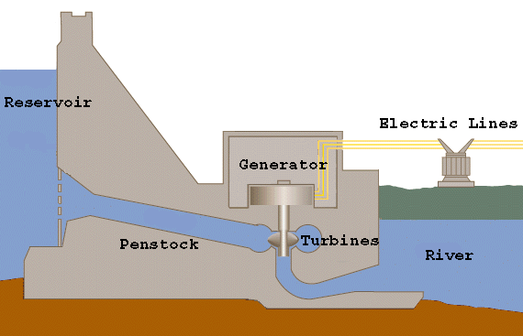
Hydroelectric
Hydropower has been used for over 2000 years
Using it to generate electricity started in 1880’s
Potential energy of water converted to kinetic energy of turbine blade converted to electricity
At one time, accounted for over 40% of the U.S.’s electrical needs; today, it is only about 7%

Slide 23
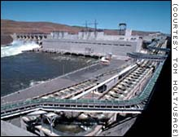
Environmental Damage
Converts river environment to lake; different organisms live in each
Stops flow of farm-enriching silt downstream; poorer soils require more fertilizer
Forest/farmland swamped with water
Plant material covered with water decays in oxygen-depleted environment -> methane release to atmosphere
Environmental damage + cost + lack of good rivers left to dam have resulted in a leveling of this type of energy

Slide 24
Biomass
Biomass energy - creation of energy by burning organic matter
Can be waste matter (manure, paper, garbage, etc.) or matter
grown for the purpose (trees, corn)
Can be burned as is in power plants or converted to fluid form

Slide 25
Conversion
1) Direct combustion - burn in a power plant
2) Thermal decomposition - use heat to convert the solid waste to
fluid fuel; ex. wood distillation
3) Biochemical conversion - bacterial decomposition in oxygen
deprived atmosphere; ex. grain fermentation

Slide 26
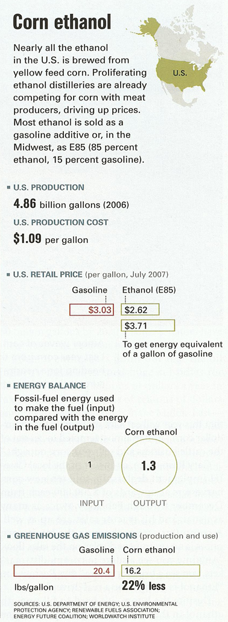
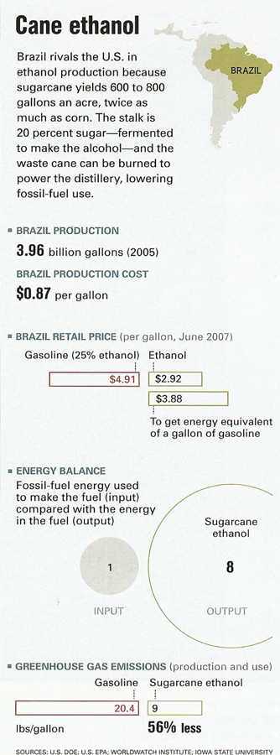
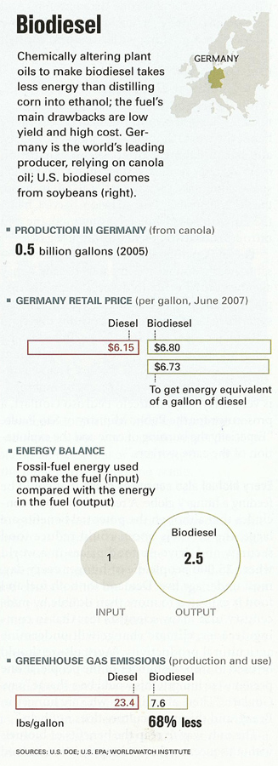
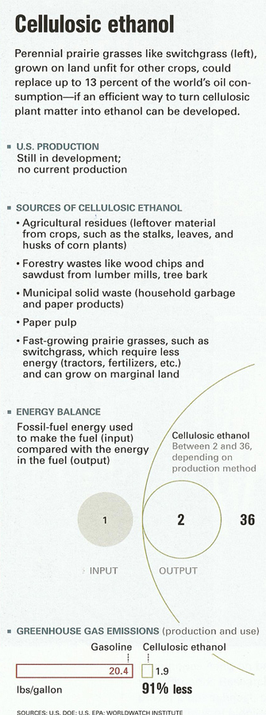
Economics

Slide 27
Geothermal Energy
Energy from within the Earth; deepest wells only go down a mile
or so
Temperature in the Earth increase about 30 C for every
kilometer into the Earth
For the creation of electricity, need hotter material (magma) to
have breached cracks and become near surface

Slide 28
Issues
Hydrothermal resources - reservoirs of steam or hot water -
are available only in the western states, Alaska, and Hawaii
Normal heat profile of Earth makes for extremely low
efficiencies outside of these regions
Use in heat pumps is the only economical use outside of these
regions

Slide 29
Geothermal Heat Pump
Near surface earth can be used as a hot or cold reservoir
for heat pumps
Improves efficiency since the temperature difference between
inside and ground is not as great as inside and atmosphere
Initial higher price of burying the coils is offset by the savings
over the lifetime of the system

Slide 30
Renewables
Electricity Net Generation From Renewable Energy by Energy Use Sector and Energy Source, 2003-2007
(Thousand Kilowatthours)
Sector/Source | 2002 | 2004 | 2005 | 2006 | 2007
Total | 355,293,119 | 351,020,900 | 357,533,995 | 385,669,799 | 351,300,592
Biomass | 53,341,092 | 53,073,722 | 54,160,152 | 54,758,512 | 55,400,235
Geothermal | 14,424,231 | 14,810,975 | 14,691,745 | 14,568,029 | 14,838,636
Hydroelectric Conventional | 275,806,329 | 268,417,308 | 270,321,255 | 289,246,416 | 248,312,395
Solar/PV | 534,001 | 575,155 | 550,294 | 507,706 | 606,082
Wind | 11,187,466 | 14,143,741 | 17,810,549 | 26,589,137 | 32,143,244

Slide 31
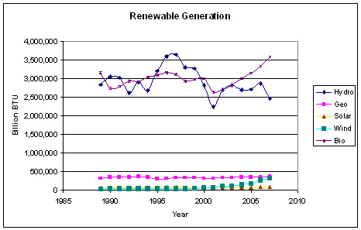
Renewables
U.S. Annual Consumption of energy = 102 x 10⁶ billion Btu

Slide 32
Conclusions
Wind offers the greatest promise currently
Solar thermal offers some possibilities in certain locals in the
near future
Photovoltaics need either a reduction in price or increase in
efficiency to become widespread
Biodiesel of food crops has problems; biodiesel of non-food crops is showing promise
Home use can be done today for heating and cooling if
systems are built into the house

